Slide 1
Travel Rules and Forms
Olivia Guo ---AP Travel
March 2024

Slide 2
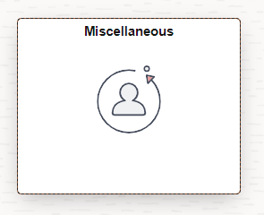
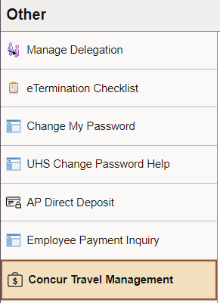
How to set up a new Concur account
Employee Account: Go to P.A.S.S., select Miscellaneous, and click on Concur Travel Management. If the employee is not already set up as a Concur user, the self registration page will appear. Complete the required information and save.
Self Registration is an overnight process; the new Concur profile will become available the next day.
If any updates are needed later (e.g., default cost center change, change of delegate to approve, adding newly created Vendor ID), complete “Concur Supplemental Form for Employee Access Updates” and submit it to concur@central.uh.edu. The form can be obtained from the Finance Form website http://www.uh.edu/finance/pages/forms.htm

Slide 3
Concur Self-Service

Slide 4
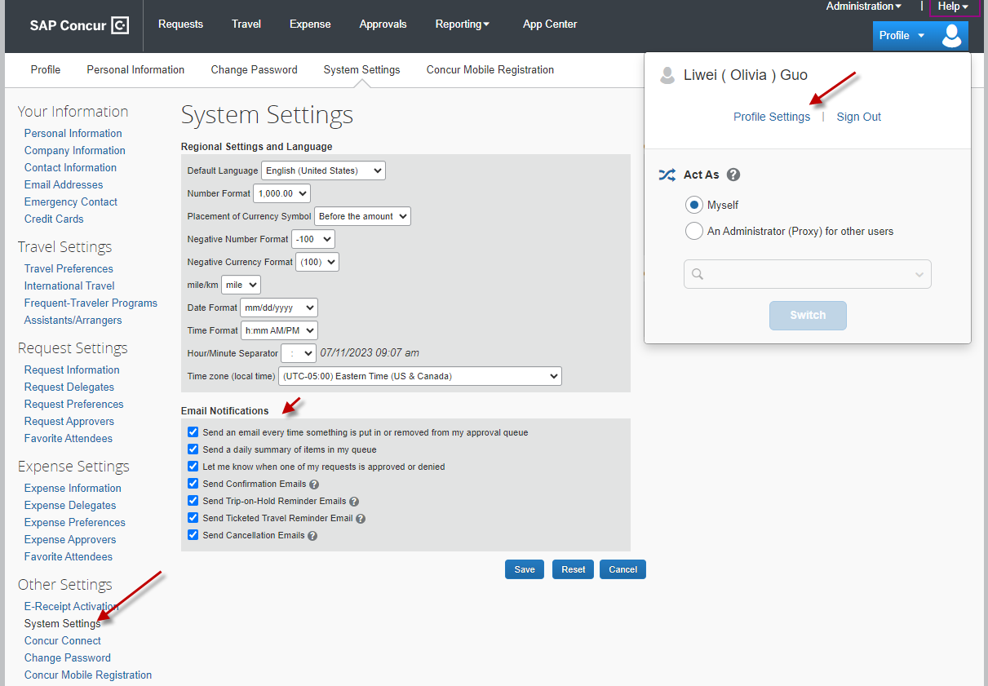
Concur Self-Service
After profile is set up, go to Profile Settings – Other Settings – System Settings and enable “Email Notifications” function

Slide 5
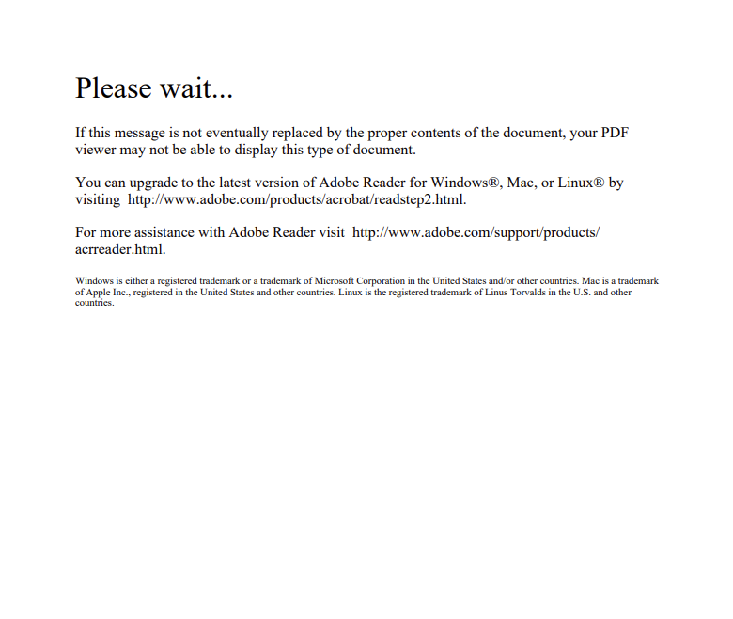
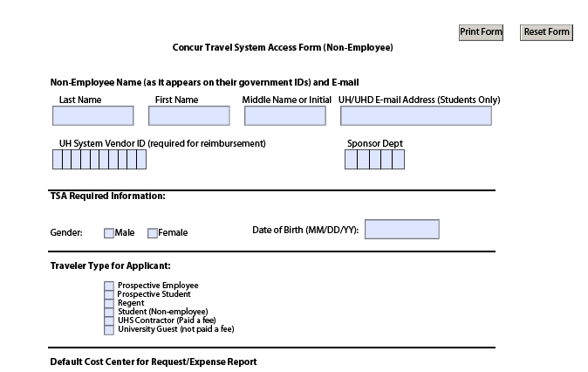
Non-Employee Concur Accounts
Send a “Concur Non-Employee Access Form” to concur@central.uh.edu. The form can be obtained from the Finance Form page: http://www.uh.edu/finance/pages/forms.htm
The document may look like this. Just download it and it should look like this:

Slide 6
Travel Request
All UH travel for employees, prospective employees, students, prospective students, university guests, contractors, and regents
Submitted and Approved before travel begins
Estimate of expenses
Authorization to travel
Reimbursement
Travel Request must be created in the profile of the person who will be traveling

Slide 7
Travel Request
Created in Concur by traveler or delegate
Workflow approval
Employee travelers must submit their own TR into workflow to acknowledge their review
Approvers are automatically notified when a Travel Request is pending their approval
An approved Travel Request is required for all university travel, whether paid by UH or not
Travel should NOT be booked until the TR is fully approved

Slide 8
Travel Reimbursement Expense Report
Required for reimbursement for travel expenses
Only economy/coach class airfare allowed
Meals are always reimbursed based on actuals (not Per Diem)
Itemized receipts must be provided if over GSA Rate
Receipts not required for incidentals less than or equal to $75
Expense Report must be created in the profile of the person who traveled; for reimbursements
Please do not manually create PCC1 voucher in PeopleSoft to get reimbursement

Slide 9
Travel Expenses
Airfare
Must be purchased at the lowest price available (i.e., economy/coach class).
Add-ons to economy airfare such as extra leg rooms, additional luggage, early-bird check-in, and seat selection is allowed, seat upgrade with fees is not allowed, first class or business class is not allowed.
Additional baggage fees incurred due to unauthorized travelers are Not Allowed.
Rental Car
Luxury vehicles and additional cost upgrades are Not Allowed.
SUVs, Vans and larger sized vehicles may be permissible if three or more travelers will be traveling in one vehicle. The Concur Expense Report must indicate the number of travelers in the expense comments field.
Hotel
Must adhere to the daily Meal & Lodging Limits, the receipt must be itemized and attached with proof of payment.
Additional fees for unauthorized travelers or upgrade fee are Not Allowed (i.e., rollaway bed).

Slide 10
Travel Expenses --- Continued
Conference/Workshop/Convention/Training Hotels
If the conference hotel is used, and the daily meals/lodging combined amount does not exceed the university daily limit, the amount will be reimbursed without additional documentation;
If the conference hotel is used, and the daily meals/lodging exceeds the university daily limit, the published hotel expenses and actual meals up to the federal travel regulation meal rate (M&IE) for the travel destination may be reimbursed if the traveler provides one of the following
The publicized document showing the conference hotel rate (must be the lowest rate) in the expense report;
or
The appropriate Division Vice Presidents’ approval ( VP approval can be provided in the form of an email or by adding them to Concur Expense Report approval flow)

Slide 11
Deadline for Submittal of Reimbursement Expense Reports
Traveler has up to 60 days after completion of travel to turn in receipts to the dept.
If turned in after 60 days, must get routed to the Tax Department (with Taxable Payments or Reimbursements to Employees form-Exhibit B, SAM 03.D.06) before submitting to AP, this form need to be processed through DocuSign
Department has a maximum of 15 days after received from traveler to submit to AP
If submitted after 15 days, justification is needed
Notes:
If last travel day fall on a Friday, days are counted beginning Saturday.

Slide 12
Deadline for Submittal of Travel Card Expense Reports
Cardholders and custodians are responsible for submitting Expense Reports in Concur through the certifying signatory to Accounts Payable no later than the 25th of the month following the month in which those transactions occurred, otherwise violation will be recorded
For example:
Charges with a transaction date in September (September 1 – September 30) must be submitted to Accounts Payable on an Expense Report by October 25 in Concur. If the 25th falls on a weekend or holiday, the due date will be the following business day unless otherwise announced by AP.

Slide 13
Travel Card Overview
Primary Custodian
Employee who has custody of the travel card
Responsible for submitting expense reports in Concur
Expense Report must be created in the profile of the primary custodian (cardholder); to close out travel card charges
Delegates in Concur
Employees authorized to create/review Travel Request and/or Expense Reports for specific employees and/or non-employees.
Submit Travel Requests and/or Expense Reports in Concur on behalf of specific non-employees (employees must submit their own Requests/Reports).
Approve Travel Requests and/or Expense Reports in Concur on behalf of specific employee approvers.

Slide 14
Travel Card Applications (Now accepted through DocuSign only)
All forms must go to DocuSign starting September 1st, 2023
Addendum A --- Cardholder Application Form ( Local Dept and Multiple User Travel )
Addendum B --- Cardholder Application Form ( Local Individual Travel)
Addendum E --- Acknowledgement of Responsibilities for Multiple User Travel

Slide 15
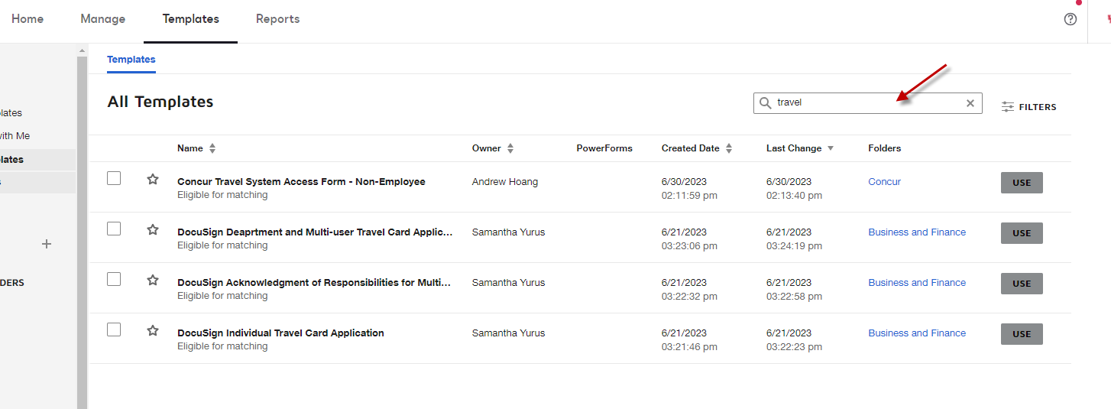
Travel Card Applications --- continued

Slide 16
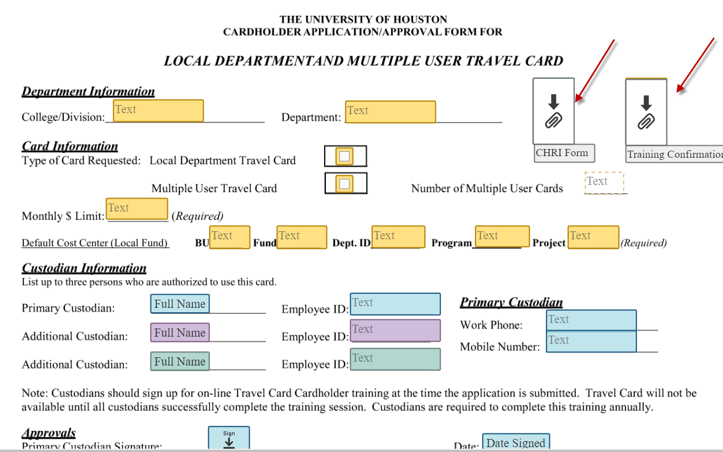
Travel Card Requirements --- continued
Complete the travel card application through DocuSign

Slide 17
Travel Card Requirements --- continued
Complete HR form and attach with application: Authorization for Criminal History Investigation (CHRI Request Form valid for up to 6 months) *Procurement/Travel Card Clearance
https://uh.edu/human-resources/talent-acquisition/chri/
Complete the T Card Cardholder training (SF2404) through T.A.P. (Valid for up to 1 year) and attach with application
Login to P.A.S.S. → Training → Request Training → Search by Course Number → SF2404 → View Available Sessions → Select Session (0001) → Continue
http://www.uh.edu/adminservices/PASS/trainingenrollment.htm

Slide 18
Cardholder/Custodian Responsibilities
Complete annual Online Training
Safeguard the travel card
Ensure that travel card expenses benefit the University
Ensure that travel card expenses are in compliance with University policy
Obtain itemized receipts for all travel card purchases
Report unauthorized transactions promptly
Report lost/stolen cards to AP Travel promptly
Notify College/Division Administrator of Cancellations
Complete Addendum E (Acknowledgement of Responsibilities for Multiple User Travel Card) – when applicable
Submit expense reports in Concur for the travel card transactions by the due date
If new custodian transferred from other department, pleae

Slide 19
Allowable Travel Card Purchases
Local Department Travel Card
Airfare
Hotel (no State Hotel Occupancy Tax)
Rental Car
Registration Fees Related with Travel
Other travel related charges made from the office
Local Multiple-User Travel Card
Airfare
Hotel (no State Hotel Occupancy Tax)
Rental Car
Registration Fees Related with Travel
Travel Meals for authorized travelers only, for overnight trips
Travel Incidentals
Business Meals during business trip

Slide 20
Allowable Travel Card Purchases
Local Individual Travel Card
*Not to be used to make purchases for individuals other than the cardholder.
Airfare
Hotel (no State Hotel Occupancy Tax)
Rental Car
Registration Fees Related with Travel
Travel Meals, for overnight trips
Travel Incidentals
Business Meals during business trip (no sales tax for Texas vendors)
When purchasing business meals from Texas vendors, the cardholder must claim exemption from State of Texas sales tax using the university’s Tax Exemption Certificate. Same applies for employees lodging in Texas.
Note: Meals for a group of employee travelers are not considered business meals, each traveler should pay their own bill.

Slide 21
Unauthorized Travel Card Charges
When authorized Travel Card users allow someone else to use their Travel Card
State fund travel/Moving expense
Non-travel charges, except for business meals and needed materials during travel status
Gratuity exceeding 20% and error amount over $10 whole expense report on Travel Cards charged to local funds
Anything in excess of the 20% and $10 allowance will need to be coded as, “Unallowable Charge on UH Credit Card” in Concur
Personal purchases by error
Airfare that includes any non-business destination(s)
First class and business airfare
Meal and lodging exceeding the published amount on the UH Travel website
Texas state occupancy tax
Texas sales tax when purchasing business meal
Other inappropriate use

Slide 22
Reason Why Travel Card is declined
No efficient credit available
MCC Code
Multiple incorrect PIN attempts– multi-user card and individual card
Card not activated yet

Slide 23
Reason Why Travel Card is declined (continued)
In order to override credit limit or MCC code, please send AP Travel the following information
CDA’s approval email
Vendor Name
Cardholder Name
Last 4 digits of travel card
Amount
Purpose
Benefit
Override starts date
Override ends date

Slide 24
Transfer Custodianship
In order to transfer the primary custodianship, please send AP Travel the following information --- Concur allows only one primary custodian
CDA’s approval email
Last 4 digits and/or name of the travel card
New custodian’s CHRI for P/T card clearance (valid for up to 6 months)
Verify that the new custodian has completed the Travel Card Custodian Training in T.A.P.(SF2404) --- This is mandatory training and valid for up to 12 months
If the new custodian hasn’t completed the training, they can do so by requesting this training through P.A.S.S., the training will then appear in T.A.P the following day
Verify that the new custodian has an active Concur profile

Slide 25
Deadline for Submittal of Travel Card Expense Reports
Cardholders and custodians are responsible for submitting Expense Reports in Concur through the certifying signatory to Accounts Payable no later than the 25th of the month following the month in which those transactions occurred, otherwise violation will be recorded
For example:
Charges with a transaction date in September (September 1 – September 30) must be submitted to Accounts Payable on an Expense Report by October 25 in Concur. If the 25th falls on a weekend or holiday, the due date will be the following business day unless otherwise announced by AP.

Slide 26
Foreign Travel
Travel Request
VP Approval (Concur automatically routes TR through VP)
International Travel Export Control Form --- all travelers to destination outside the United States and the U.S territories and possessions, this form should be processed through DocuSign
Agenda
Fly America Act Waiver Checklist (if applicable)
Foreign air carrier
Fund: State fund, 5013, 5014, 5015, 5033, 5034 and 5035.
Documents available in Concur (Travel tab)
Link: http://www.uh.edu/research/sponsored-projects/proc-pol-guide/travel/
Notes:
Left off here

Slide 27
Post Trip Report
Must be uploaded to the Expense Report
A brief explanation of the activities that occurred each day on the trip is all that is required.
A statement explaining the purpose for the travel and how it benefits the university.
Traveler’s signature
Date

Slide 28
Travel to Canada/Mexico
Treated as domestic travel
Does not require VP approval
Post-Trip report not required
Charge to domestic account codes.
See Employee-Out-of-State: Alaska, Hawaii, Canada, Mexico, Puerto Rico, and US Possessions/Territories
Treated as foreign travel
Daily Meal and Lodging Cap of $460.
International Travel Export Control Form is required.
Fly America Act (if applicable)

Slide 29
Travel Advances
Used to receive money before travel
Criteria:
1. Local Cost Centers Only
2. Employee Foreign Travel or Group Travel
Requirements
1. Employee Foreign Travel: VP approval, Export Controls, Agenda, and Breakdown of expenses
2. Group Travel: Roster, Agenda, Breakdown of expenses
Travel Advance requests must be submitted to Accounts Payable no later than 10 working days prior to the travel

Slide 30
Travel Advances --- continued
A Concur Expense Report must be created and submitted to properly process the Travel Advance.
The appropriate Travel Request must be linked to the Expense Report.
If the expenses were less than the amount issued, the Traveler will need to pay back the University of Houston for the excess amount.
In Concur, the returned amount must be coded as, “Cash Advance Return.”
If the expenses were greater than the amount issued, the travel expenses must be entered in the Concur Expense Report. Concur will automatically subtract the travel advance amount from the travel expense amounts entered in the expense report. Concur will then generate a voucher to issue a reimbursement for the excess amount.

Slide 31
State Contracted Vendors for Car Rental (12/21/2022-05/21/2025)
Travelers are strongly encouraged to book rental car from state contracted vendors because the rate is fixed and LDW ( liability and loss/damage waiver) insurance is included in the base rate. Instructions on how to book a State contracted rental car ban be found at:
https://www.uh.edu/office-of-finance/ap-travel/uh-travel/transportation/rental-rates/
Enterprise Rent-A-Car/National Car Rental
Hertz
Please contact AP Travel for contract verification code

Slide 32
State Contracted Airline Contract (09/01/2023-08/31/2024)
American Airlines
Delta Airlines
Southwest Airlines
www.swabiz.com
Reach out AP Travel for Company ID
Two baggage's free, no change or cancel fees as long as you cancel the flight 10 minutes prior scheduled departure time
Points/Credits never expire
Verification Codes:

Slide 33
Moving & House Hunting Expenses
Not allowed on a travel card
Not allowed with 1XXX fund (state cost centers)
Only one house hunting trip allowed up to one week
Required documents:
Travel Request
Note: Create a Travel Request for House hunting expenses and another one for the actual Relocation expenses.
Addendum A
Offer Letter
Exhibit B
Itemized receipts for all expenses(including meals while moving)
Link: http://www.uh.edu/administration-finance/tax-information/moving-and-relocation/

Slide 34
Texas Hotel Occupancy Tax Exemption Certificate
State portion of tax exempt in Texas for employees (6 percent tax), but not prospective employees
Traveler needs to present Certificate when check-in
https://uh.edu/office-of-finance/tax-information/official-tax-documents/
Employee can be reimbursed with explanation if failed to provide the Certificate when check in. But if travel card is used, it is traveler/custodian’s responsibility to get refund
Note: Federal grants or contracts may not permit reimbursement of the state hotel occupancy tax

Slide 35
Meals & Lodging in Continental US
Local: Actual expense, receipt required if exceeds GSA rate
State: Actual expense, not to exceed GSA rate, no exception
GSA rates can be found at the GSA website
Choose current year
Use city or county (NACO to look up county for a particular location)
Local & State: “Standard Rate” if city or county not found
https://www.gsa.gov/travel/plan-book/per-diem-rates?gsaredirect=perdiem
Itemized receipt always required for lodging
Daily cap amount on Local funds
Local (Texas): combined meals and lodging not to exceed $255
Local (Other) : combined meals and lodging not to exceed $395
San Francisco, CA; Santa Monica, CA; Boston/Cambridge, MA; New York City, NY; and Santa Barbara: combined meals and lodging not to exceed $415
Reimbursement Rates: https://uh.edu/office-of-finance/ap-travel_test/general/recent-changes/combined-meals-and-lodging-travel-limits.pdf
Note: Non-overnight meals are not reimbursable for employees

Slide 36
Meals & Lodging Outside Continental US
Local: Actual expense, receipt required if exceeds GSA Rate
State: Actual expense not to exceed GSA Rate
Foreign: Department of State website
Alaska, Hawaii, PR, & any US possessions & territories: Department of Defense website
Cap amount: combined meals and lodging cannot exceed the greater of $460 or amount in GSA website (GSA)
Non-overnight meals not reimbursable for employees
GSA rates
Choose country
“Other Foreign Countries” if location not found
Choose correct month
Itemized receipts always required for lodging
https://aoprals.state.gov/web920/per_diem.asp

Slide 37
Meal and Lodging Limit --- Cap
UH travel will continue using the combined travel meals and lodging limits --- cap, this information is updated every October 1st.
Meals and lodging expenses exceeding the daily cap will no longer require a MAPP exception, but the appropriate Division Vice President’s approval will be required, VP approval can be added to the Concur approval flow.
Instruction for how to add the appropriate Vice President can be found on the Travel Website at: https://www.uh.edu/office-of-finance/ap-travel/concur-tcard/tm-printable/creating-a-travel-request.pdf
An exception has been added to Concur to alert the Expense Report initiator and Travel Office if the GSA rate has been exceeded. This would indicate receipts are required.

Slide 38
Reimbursement Requirements for Meal and Logging

Slide 39
Meals and Lodging Expense Narrative
Meals/Lodging combined amount
The UH cap will tell you the maximum amount you can get reimbursed for your daily meals/lodging. See an exception below**.
Requirement for Meal Receipts
The GSA Federal meal rate is used to determine if itemized receipts are required for your meals.
If your actual daily meal amount is more than the GSA Federal meal rate, you must provide itemized receipts
If it is equal to or less than the GSA Federal meal rate, you don not have to provide meal receipts
If you use multi-user or individual travel card to pay meal expense, itemized receipts are always required;
Note that the GSA rate varies depending on your travel destination. Your daily meal expense cannot exceed 200% of the GSA Federal meal rate

Slide 40
Meals and Lodging Expense Narrative (continued)
Requirement for Lodging Receipts
An itemized receipt is always required for your lodging expenses, regardless of the GSA Federal rate
Conference Hotel **
If you used a conference hotel published by your conference and your daily meals/lodging amount exceeded the UH cap, the university may pay or reimburse the full conference hotel expenses (lowest published rate) and actual daily meal expenses up to the GSA Federal meal rate. To be qualified for this exception, you will need to upload the document published by the conference showing the lowest conference hotel rate or obtain your VP’s approval

Slide 41
Lavish/Extravagant
The IRS requires all travel expenses to be reasonable and ordinary, specifically precluding lavish and extravagant expenses from reimbursement. Expenses considered lavish/extravagant is not allowed.
The following expenses may be defined as “lavish/extravagant”:
Hotel: Resort hotel (except for conference) and/or suites, room upgrade without appropriate explanation
Meal: 200% of GSA rate
Car Rental: SUVs or vans for less than three business travelers, sports car, limousines
Any upgrade other than additional charges for airfare and rental car for three or more travelers as mentioned in the MAPP

Slide 42
Alcohol & Business Meals
Alcohol cannot be purchased during normal business hours by employees.
Must be itemized and charged to account 53113, whether part of a business meal or travel meal.
Cannot be charged to tuition, sponsored project, federal indirect cost, or Athletic cost centers (2064, 2160, 2164, 2072, 1000s, 5000s, or Athletics).
Entertainment expenses cannot be charged to tuition funds (2064, 2160, 2164)

Slide 43
Business/Personal Travel
Travel Outside the United States
All approved university employee business travel outside the US that includes some personal travel days is “Considered to be entirely for business” because the employee is considered to have “no substantial control” over making the trip. The only exception is the President’s travel outside the US.
The appropriate vice-president/president has the ultimate responsibility for determining the extent of reimbursement for the transportation costs and other travel expenses.
Travel Primarily for Personal Reasons in the US
The cost of traveling to/from the destination (airfare, mileage to/from airport, airport parking, etc.) may not be directly charged to the university or reimbursed. Only expenses that are directly related to conducting university business may be charged to or reimbursed by the university, such as lodging and meals on “days spent on business activities,” and local transportation costs to/from business meetings.

Slide 44
Travel Days
The university of Houston allow travelers to travel to their business destination one contiguous day before and one contiguous day after business days without providing additional documentation or explanation. (Note that these days will be counted as business versus personal days.)
Travel days more than one day before a business purpose or more than one day after a business day will require additional explanation and documentation such as an airfare price quotation plus other expenses showing better value, and may be counted as personal days if the delay is for personal purpose.

Slide 45
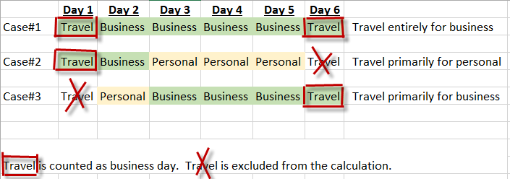
What days count as business days for domestic travel
https://uh.edu/office-of-finance/ap-travel_test/domtravel/faqs/

Slide 46
State Fund Travel
Only travel for employees and prospective employees
Travel Request must be approved before travel starts, no exception
Must stay within GSA rate for meal and lodging, no exception
Travel card can not be used
Gratuity/alcoholic beverages are not allowed
State occupancy tax not allowed when travelling inside Texas
Business meal not allowed
No food or beverage of any kind except for travel meals
Moving/House hunting travel not allowed
When non-contracted travel vendors are used, please complete Travel Exemption Form and attach to Expense Report

Slide 47
Documentation Requirements for Reimbursement
Airfare
The employee’s name
The transaction service provider’s name
The ticket number
The class of transportation
Travel dates
The amount charged for the transaction
The origin and destination
Proof of payment

Slide 48
Documentation Requirements for Reimbursement (continued)
Lodging
Must be issued by commercial lodging establishment or travel agent or broker who purchased the lodging
The name and address of the commercial lodging establishment
The name of the employee
The single room rate
A daily itemization of the lodging charges
Proof of payment

Slide 49
Documentation Requirements for Reimbursement (continued)
Rental car
The rental company name
The renter’s name
Start and end date of rental
An itemization of expenses incurred
Proof of payment
Rental car class (midsize, full, suv, ect)
Note: Rental car gas charges can only be approved if the rental car information is provided.

Slide 50
Frequently Made Mistakes
Incorrect travel/traveler type on expense report, or not same as Travel Request
Not linking Expense Report to Travel Request unless it is department travel card expense report
Not providing Travel Request (department travel card expense report)
Incorrect expense report ID format, should be: Last Name, first name initial, Destination, first day of travel(MMDDYY)
Conference agenda or daily itinerary is not attached
Itemized meal receipt is not provided when daily meal expense exceeds GSA rate
When claim personal mileage, “Point to Point” address is not used
Reallocation using both state fund and local fund in same expense report

Slide 51
Frequently Made Mistakes (continued)
Airbnb cleaning fee and service fee are not listed as room rate
Missing post-trip report after foreign travel
Missing hotel folio as supporting document when claiming meal expense
Missing car rental invoice as supporting document when claiming gasoline for rental car
Missing proof of payment for airfare/lodging/car rental/registration
Gasoline for UH vehicle is code as gasoline for rental car --- should be coded as other incidental
Uber/Lyft expense is coded as “other public transportation” --- need to code as taxi

Slide 52
Frequently Made Mistakes (continued)
Require reimbursement for future travel
Expense Report Name does not reflect actual travel start date, even different with Travel Request

Slide 53
Booking from Third Party
For local funds, third party vendors can be used, but we advise against using them especially when bundle expenses. Third party vendors usually do not provide an itemization of the expenses, which can lead to issues when processing an expense report due to lack of documentation, or determining the appropriate amounts for each expense entry. If overbooked, merchants tend to cancel the hotels/airfares that were booked by a third party first, which may lead to additional cost. For rental car, the state contracted rate is the most cost effective as the rate stays low, and it includes LDW.
Hotel engine is another option for lodging expenses, and is a private hotel booking platform that connects State of Texas travelers to rates unavailable to the public. Please contact AP Travel for invitation.

Slide 54
Trouble Shooting
Can not find supervisor or certifying signatory’s name – Contact concur@central.uh.edu to update approval workflow
Have not receive reimbursement payment 3 business days after expense report is approved --- Make sure vendor status is approved/active and not on hold
Error message when creating expense report: “An error occurred attempting to look up the account code(s) for the entry” --- Make sure the travel type on expense report header is correct, for example if the travel type is house hunting, expense type can only be “Househunting All Expenses”
Can not open “Concur Non-Employee Access Form” --- Use Firefox as browser instead of Google Chrome

Slide 55
Travel and Non-Travel
Expenditure | Non Travel | Travel | Travel
 | Inside Houston Metro Area Trip | Outside Metro | Outside Metro Overnight Travel
 | Outside Metro Same Day Trip without Transportation | Same Day Trip with Transportation
Transportation: Airfare | N/A | Paid or Reimbursed (Not Taxed) | Paid or Reimbursed (Not Taxed)
Transportation: Rental Car | N/A | Paid or Reimbursed (Not Taxed) | Paid or Reimbursed (Not Taxed)
Transportation: Other Transportation (e.g., Train, Bus) | N/A | Paid or Reimbursed (Not Taxed) | Paid or Reimbursed (Not Taxed)
Local Transportation within Metro Area (Metro, Taxi, Uber, etc.) | Paid or Reimbursed (Not Taxed) | Paid or Reimbursed (Not Taxed) | Paid or Reimbursed (Not Taxed)
Mileage | Reimbursed (Not Taxed) | Reimbursed (Not Taxed) | Reimbursed (Not Taxed)
Meal | Not Paid or Not Reimbursed | Not Paid or Not Reimbursed for employee | Paid or Reimbursed (Not Taxed)
Lodging | Not Paid or Not Reimbursed | Not Paid or Not Reimbursed | Paid or Reimbursed (Not Taxed)
Incidental | Not Paid or Not Reimbursed | Not Paid or Not Reimbursed | Paid or Reimbursed (Not Taxed)

Slide 56
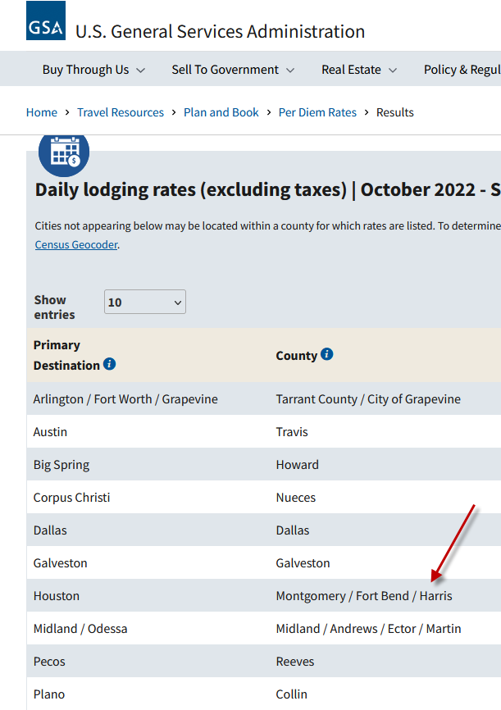
Travel and Non-Travel (continued)
How to definite “Houston Metro Area”
Per GSA, the following three counties are considered as “Houston Metro Area”

Slide 57
Travel and Non-Travel (continued)

Slide 58
Same Day Trip
How to process non-overnight travel expenses?
Concur or;
PCC9 Regular Purchase Voucher
When to use Concur?
If a UH travel card is used for airfare, rental car, taxi or registration expenses
If traveler paid for airfare, rental car, registration, public transportation or taxi outside of Houston metropolitan area
Travel Request is required
When to use PCC9 Regular Purchase Voucher?
Account code 54807 should be used if ALL of the following conditions are met:
Payment for an employee (not a student, regent, prospective employee, contractor, or university guest
On mileage, parking and tolls charged on non-overnight travel
On public transportation and taxi in the Houston metropolitan area
The payment is made with local (not state appropriated) funds
Travel request is not required
Reimbursement to organization in stead of individual traveler
Department is not supposed to create PCC1 voucher

Slide 59
Additional Information
Concur and Tcard Training Material
Visit: https://uh.edu/office-of-finance/ap-travel_test/concur-tcard/tm-printable/
University of Houston Travel Policies
Visit: https://uh.edu/office-of-finance/ap-travel_test/general/travel-policies/
Insurance
Visit: https://uh.edu/office-of-finance/ap-travel_test/general/insurance/
Travel Forms
Visit: https://uh.edu/office-of-finance/ap-travel_test/forms/

Slide 60
AP Travel Contacts
Olivia Guo– AP Manager
713-743-6920
lguo9@central.uh.edu
Victor Rodriguez-- AP Analyst II
713-743-3260
vjrodri4@cougarnetl.uh.edu
Tripti Das -- AP Analyst II
713-743-2542
tdas2s@central.uh.edu
Monica Li -- AP Analyst II
713-743-8496
smli3@central.uh.edu
Ace Anzaldua – AP Analyst II
713-743-0365
crguyanz@central.uh.edu
Tax Dept.
Tax Office
tax@uh.edu
Concur System
Concur Support
Frank Pham – Coordinator, Application Security, Financial Computing Systems
713-743-5112
concur@central.uh.edu

