Slide 2
What is C.L.I.C.K.?
Creating
Literacy
In
Computer
Knowledge
➢www.uh.edu/plantops/programs/click

Slide 3


class sessions and information on how to sign up please visit the C.L.I.C.K. web page
➢www.uh.edu/plantops/programs/click
•To see the dates and times for

Slide 4
Welcome to C.L.I.C.K Training 102
PowerPoint ByYvonneHernandez

Slide 5
CLASS OUTLINE
•Log into CougarNet
•Log into Access UH
•What is Access UH?
•Important services in Access UH
•Navigate through PeopleSoft
•Personal Information
•Change Password
•Time Reporting
•Computer ethics

Slide 6
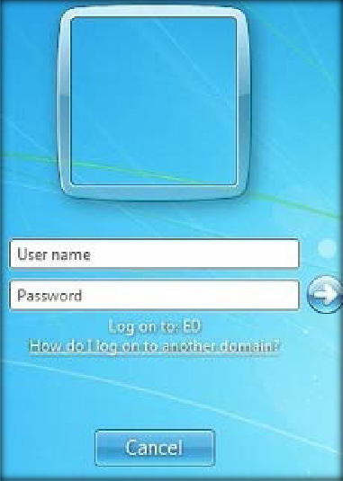
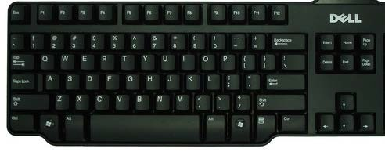
Log into CougarNet
Ctrl
Delete
Alt

Slide 7

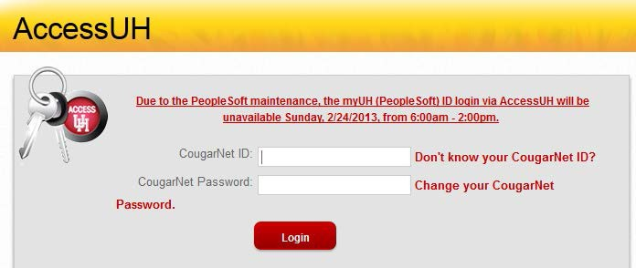

 AccessUH lets you use your CougarNet ID to access many online services without logging into each one separately.
What is AccessUH?

Slide 8





Important services in AccessUH
P.A.S.S. (HR)-Allows employees to check benefits and payroll info, update directory listing and much more.
Email (Exchange)-Provides email, calendar, and contact and task lists. It is accessed via Outlook or the web.
T.A.P. (Employee Online Training)- Allows employees to complete yearly mandatory training online.
FAMIS (Facility work order system)-Allows active students, faculty, and staff the capability to enter service requests.

Slide 9
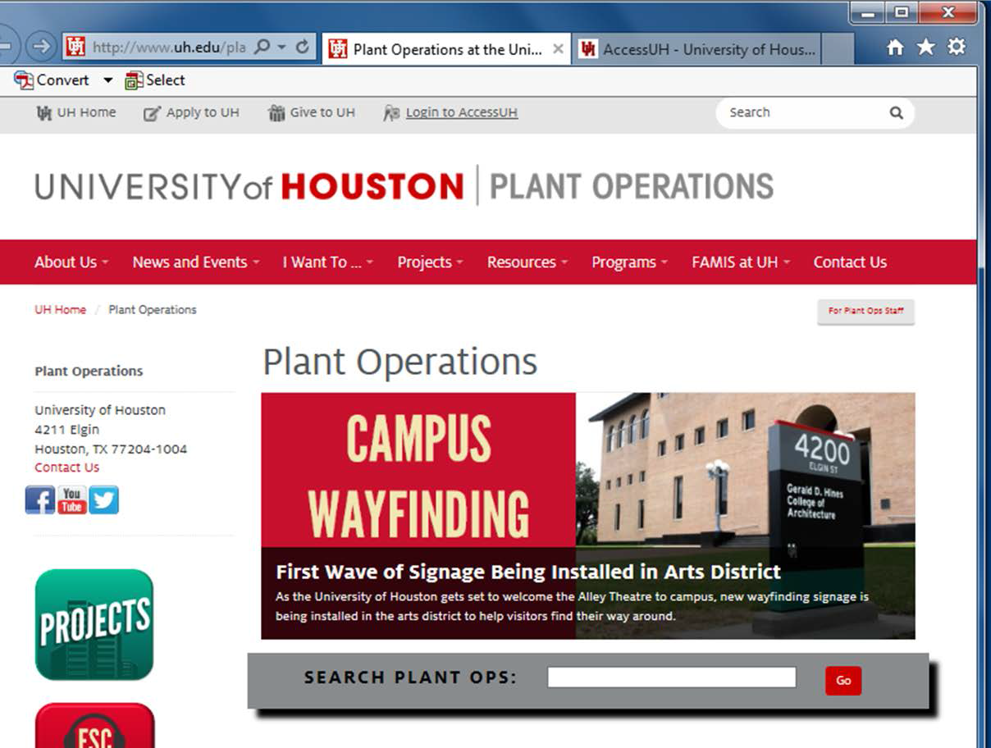
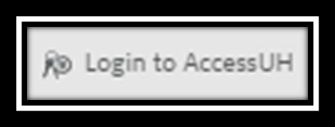

https://accessuh.uh.edu/login.php
AccessUH

Slide 10
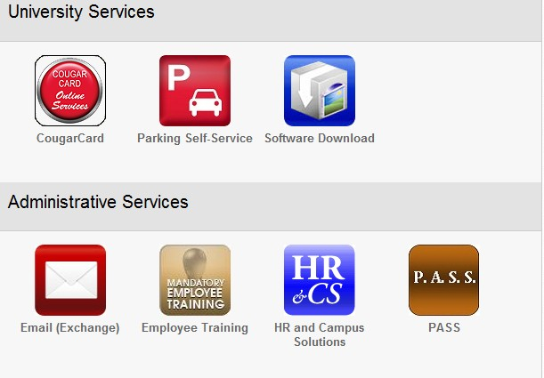

Click on the P.A.S.S. icon

Slide 11
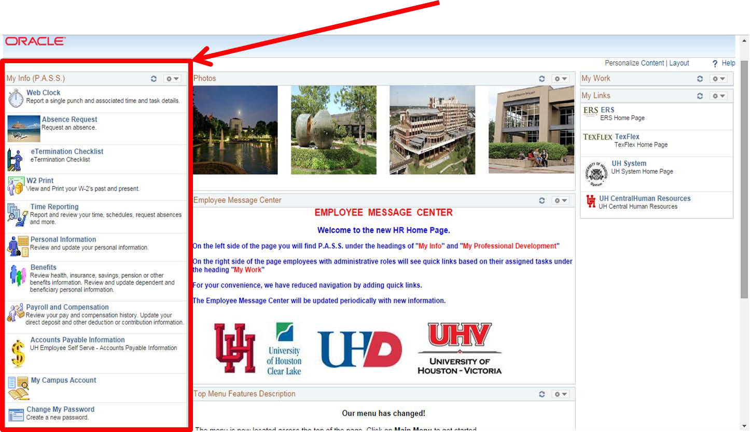
P.A.S.S. Main Menu

Slide 12

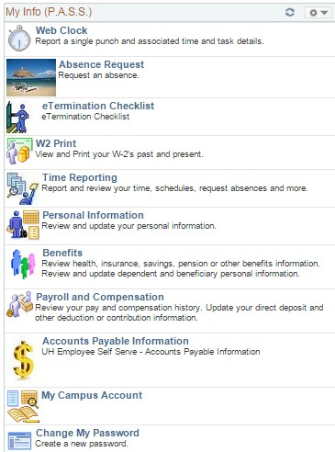
Navigating through P.A.S.S.
Personal Information
Change My Password
Time Reporting

Slide 13

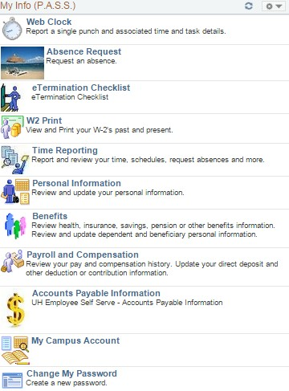
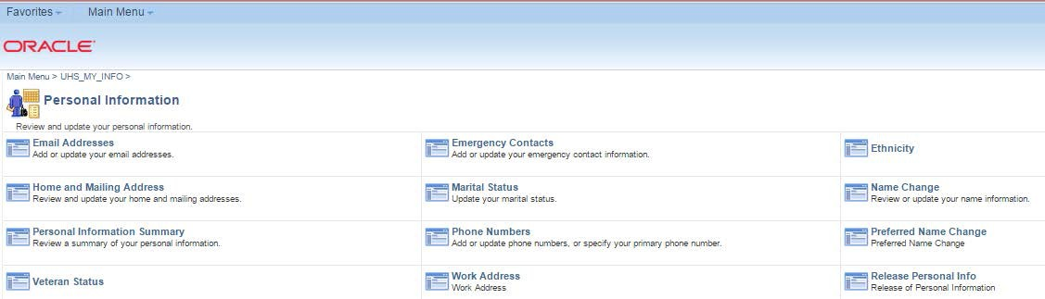
Personal Information
You can also access your personal information by clicking on the shortcut in the main menu

Slide 14

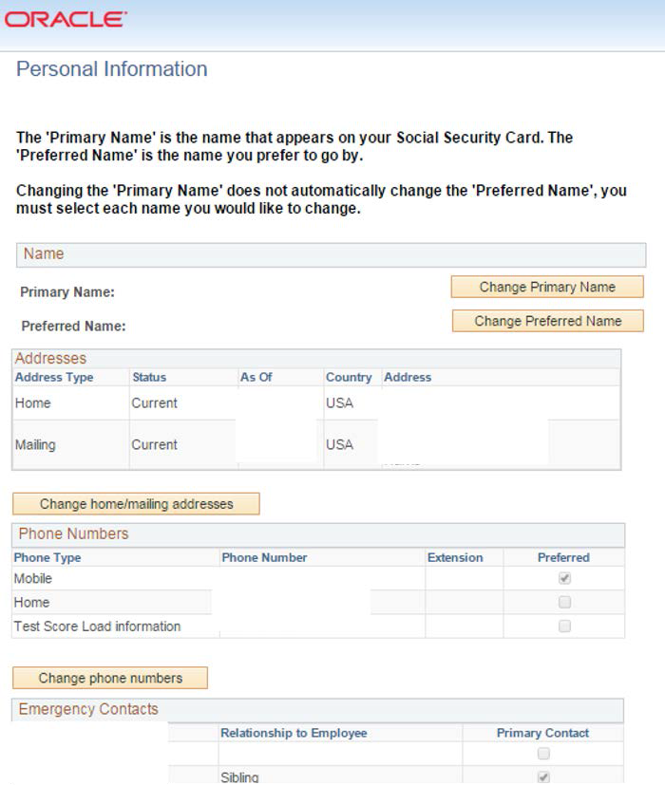
Personal Information Summary
 Review your personal information summary for any changes such as:
Home address
Phone numbers
Emergency contact
Email Address
Note: It is important to provide your email address because when you reset your CougarNet password it will send it to the email you have provided.

Slide 15

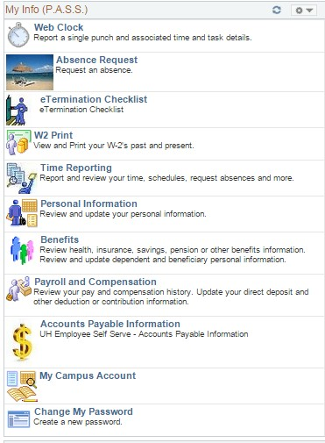
Change Password

Slide 16

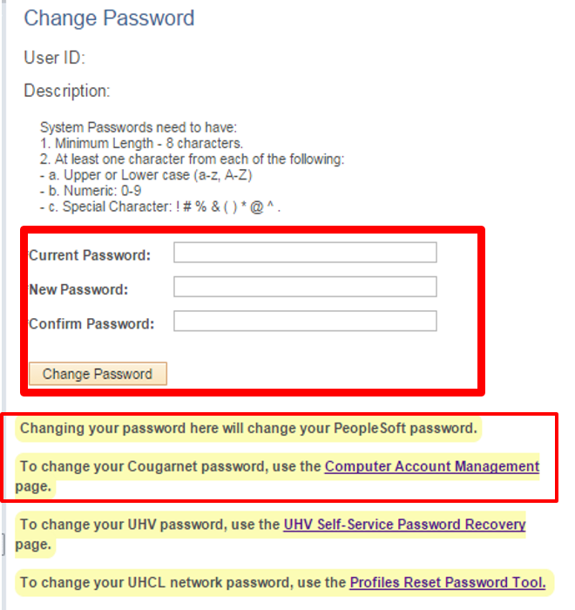
Change Password
This will change only your PeopleSoft password.
If your password is about to expire you can change your current password.
Under computer account management you can change your CougarNet Password.

Slide 17

Time Reporting
• Report Time
➢Timesheet
➢Absence Request
• View Time
➢Pay Time
➢Absence Request History
➢Absence Balances

Slide 18

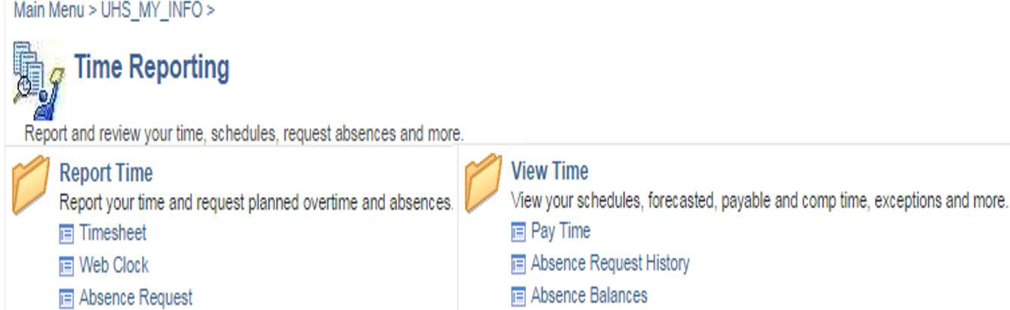
Time Reporting Menu: Report Time
Time Reporting Menu lets you report and view your time.

Slide 19
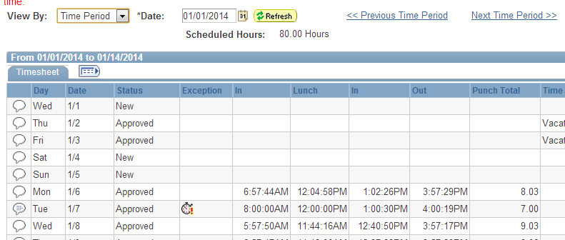
Time Sheet
#1
#2
View your timesheet by three categories:
  Time Period, Day , Week
Select the Time Frame you wish to view and click Refresh
Day and Date
  The day and the date of the punch is listed (Punch Times )
#4
#3
4. The Punch Times will reflect the actual time of the punch.
Punch times include:
In (When you arrive to work)
Meal (When you leave for a meal)
In (When you return from a meal)
Out (When you leave for the day)

Slide 20
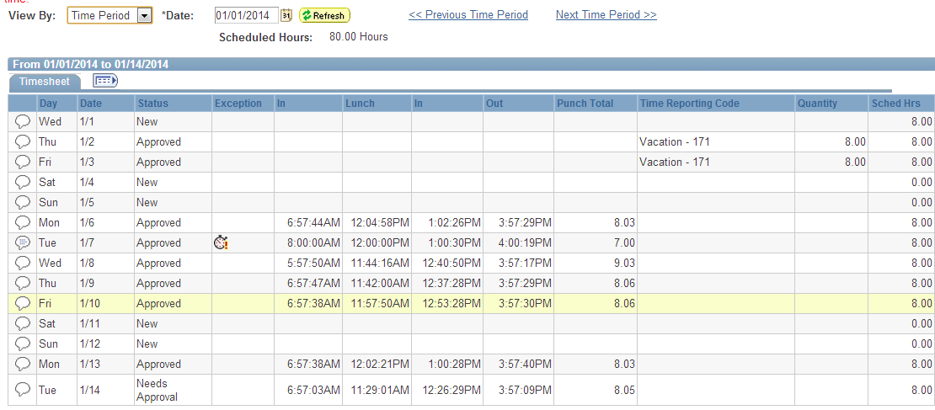
Time Sheet
#5 Scheduled Hours
Your scheduled hours for the day, according to the schedule in the system
#6
#5
#6 Status
The status indicates if the hours have been approved by the manager
#7 Comments
Any time a change is made to a timesheet, the manager will enter a comment . Click on the icon to view the comment.
#7

Slide 21

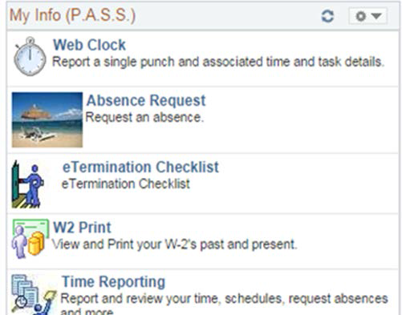

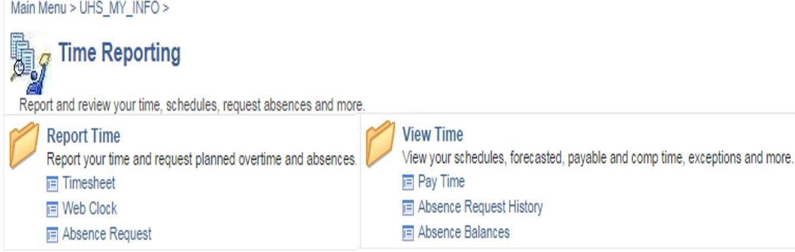
Absence Request
There are two locations for an Absence Request.
Absence request is located under Time Reporting.
Absence Request is also located on the main menu.

Slide 22
Absence Request: Process
➢Email notification: Request is approved, denied, or pushed back or Verification via P.A.S.S.
➢It is important to enter your request as soon as possible.
➢120 days in the future to enter your leave request.
➢If there is a mistake with your leave request, talk to your supervisor.
Note: Once an absence request is approved, denied, or pushed back, the employee will be notified via email. The employee can also go to Pass and look under the absence request history to review the status of a request.

Slide 23

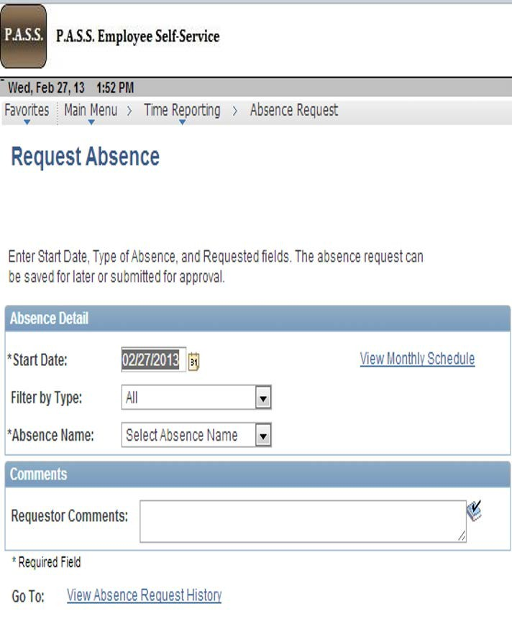
Absence Request
Once you click into Absence Request
Select the date you will start your absence.
Type in the date in month, day, year format or click on the calendar icon. This will bring up a calendar where you will be able to select the specific date.
In the absence request form, you can also view your absence request history.

Slide 24
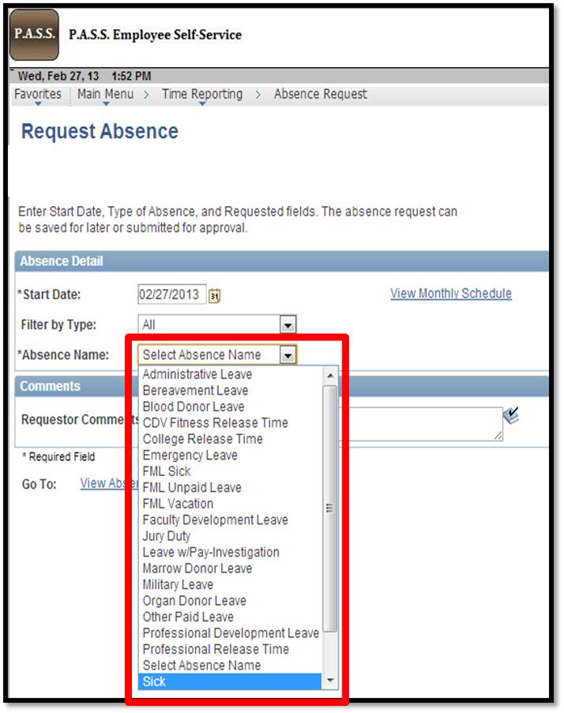
Absence Request
You can simply select the type of leave you wish to request by selecting from the "Absence Name" drop down menu.
This menu will include all absence types.

Slide 25

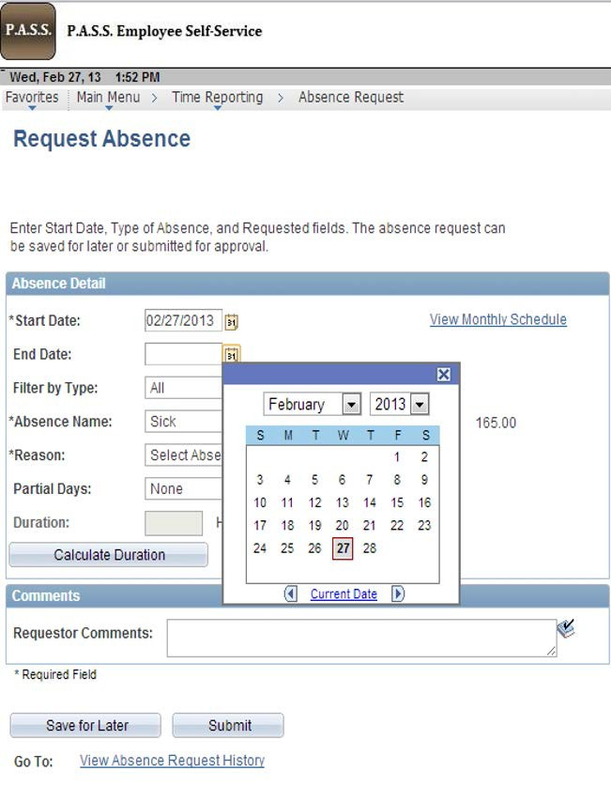
Absence Request
When you select the type of absence, multiple fields will open up on the form.
Complete the required fields that include the end date of your absence as well as if partial days will be taken.
To complete the end date, you can enter the last day of your leave in the field with the month day year format or you may click on the calendar icon and select the date.

Slide 26

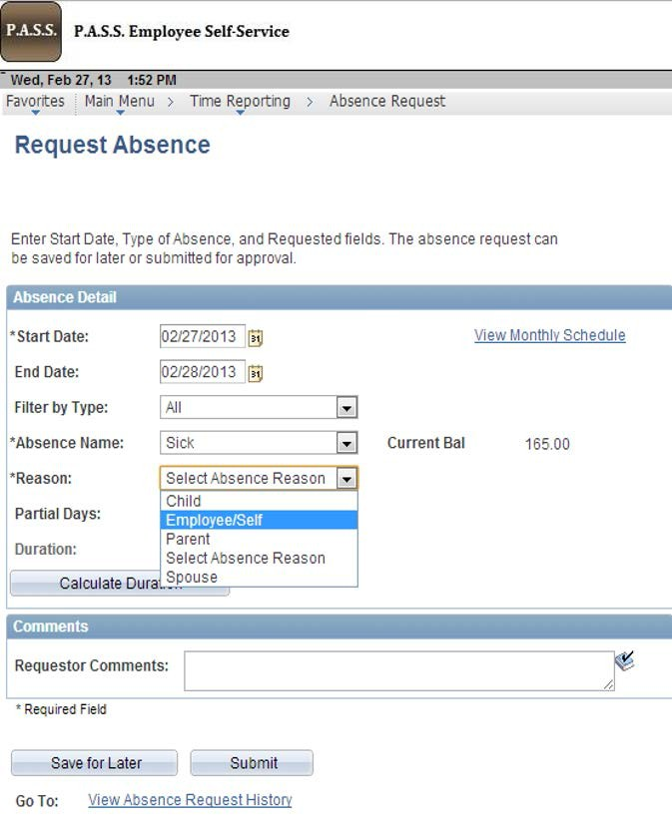
Absence Request: Reasons
Multiple absence types will require an additional reason.
As an example, for sick days, you will need to indicate if it is for you, a spouse, a child, or a parent.
If there is additional information needed, you can add it to the comments field. Certain types of leave may require additional documentation such as sick leave of 3 days or more, F M L, bereavement, leave without pay, and so forth. Please verify with your supervisor what, if any, additional documentation will be needed.
After you complete the information requested, you can save for later or submit it to the next approver.

Slide 27

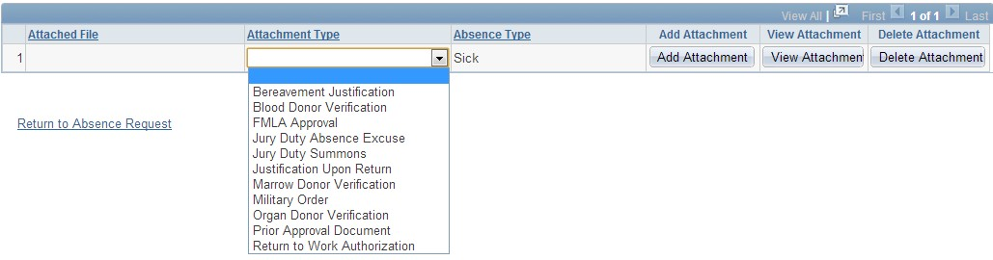
Absence Request: Attachments
Note: Please ask your supervisor to help you with attachments on an absence request. Once an absent request has been submitted you can’t go back to attach a document.

Slide 28
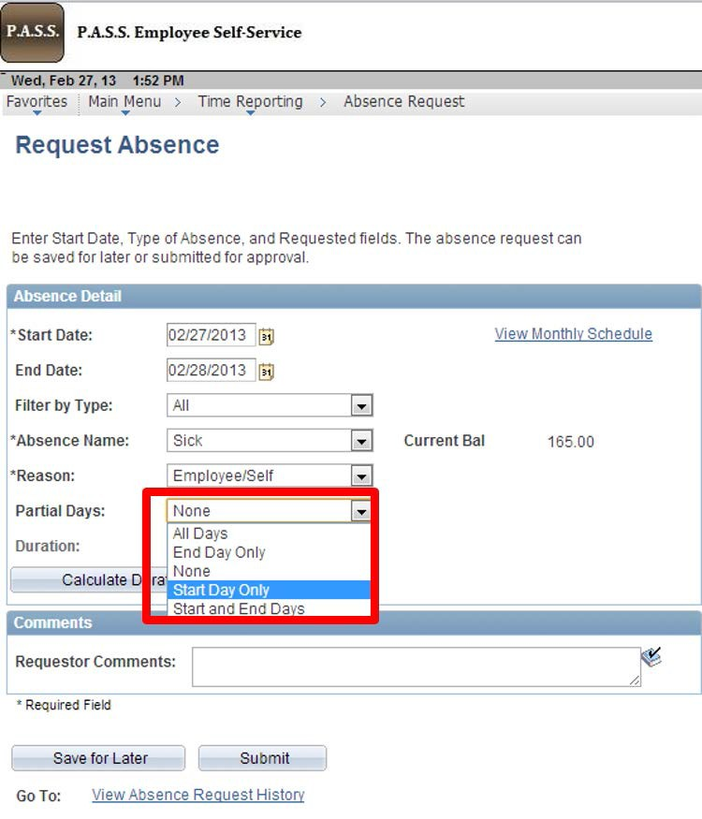
Absence Request: Partial Days
If you take partial days, select the days if it is:
The first day,
last day,
both the first and last day
if all of the days you are requesting leave are partial.

Slide 29

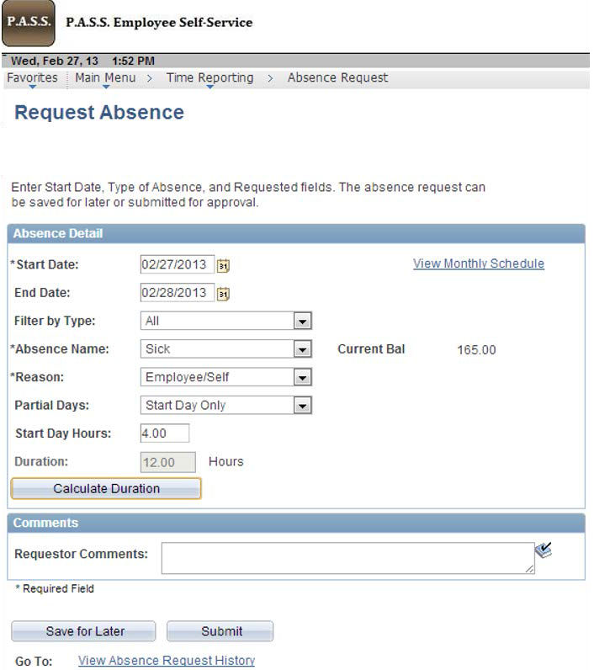
Calculation Duration for Partial Days
After you indicate that you will be taking partial days for your leave request, the field, for the hours will appear.
Enter the requested leave hours for the partial days.
When you click on calculate duration, it will calculate the hours for the partial days in the duration field.
After you complete the information requested, you can save for later or submit it to the next approver.

Slide 30
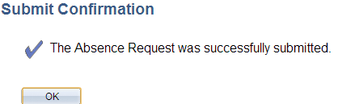
Absence Request: Partial Days
When you submit the form, you will receive a confirmation. Click "ok" to confirm the request.

Slide 31
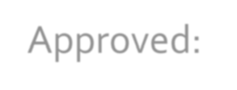




Absence Request: Status
Approved: request has been granted
Cancel: absence request was denied or pushed back to be edited or cancelled.
Deny: used when a Time Approver denies an employee’s absence request for leave.
Push Back: sent to the employee to edit, resubmit, or cancel if the request isn’t going to be modified or taken.
➢Note: If your absence request is denied, cancelled, or push backed, you need to go back and delete it.

Slide 32

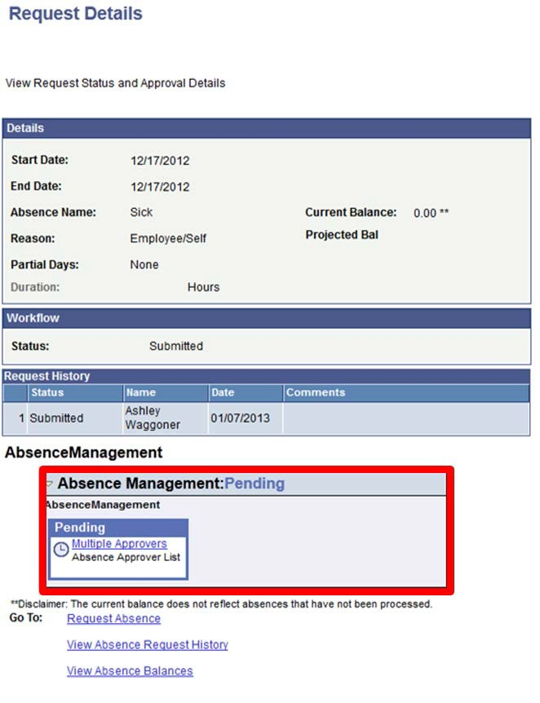
Absence Request: Details
After you click “OK,” you will be able to view the status.
Notice that the status is pending approval once you submit the request.
The request will be sent to your department approvers for authorization.

Slide 33
Time Reporting Menu: View Time

Slide 34
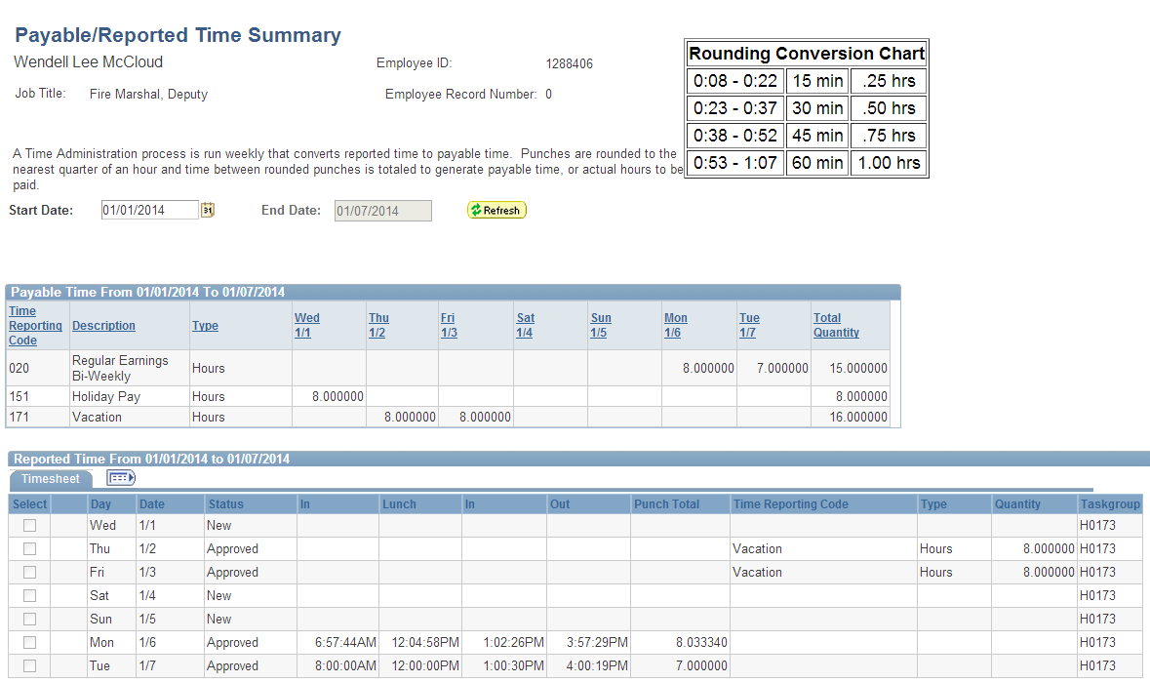

Time Reporting Menu: View Time

Slide 35
Absence Request History

Slide 36
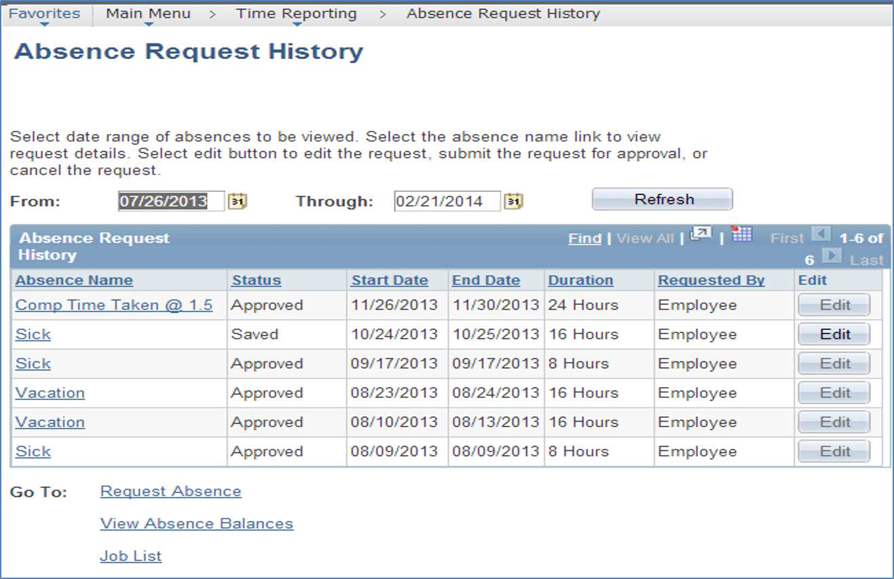
Time Reporting Menu: View Time

Slide 37




Absence Request History: Status
Saved: Not yet submitted
Submit: Once a request has been submitted, you cannot go back and attach documents.
Approved

Slide 38
Absence Balances

Slide 39
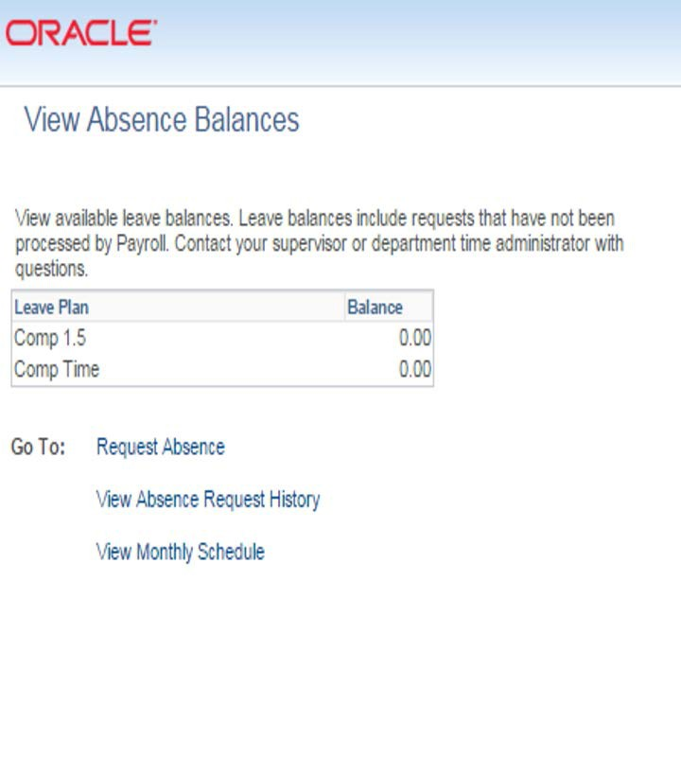
Absence Balances
Absence Balances lets you view how much sick time and vacation time you have.

Slide 40
Computer Ethics
Do not give your password to anyone. Passwords are intended to protect your computer and your files.
Please use a computer in ways that ensures consideration and respect for other people.
➢Note: Abuse of guidelines will revoke entrance into lab. Below is the link for the UH IT policies and procedures that should be followed:
➢http://www.uh.edu/infotech/policies/index.php

Slide 41

This concludes Training 102
Questions?

