Slide 1
ENROLL in the
Notes:
Hello! Thank you for joining us to learn more about enrolling in the Texa$aver 401(k) / 457 Program!
We’ll (I’ll) be available after this presentation to answer any questions you may have, and to hand out forms and fliers with additional information you can read at a later time.
The information provided today is for general education purposes.

Slide 2
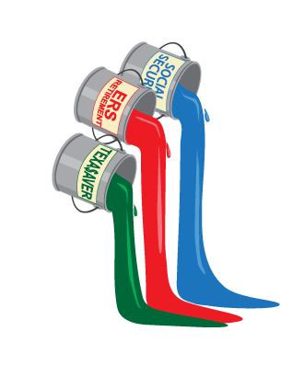
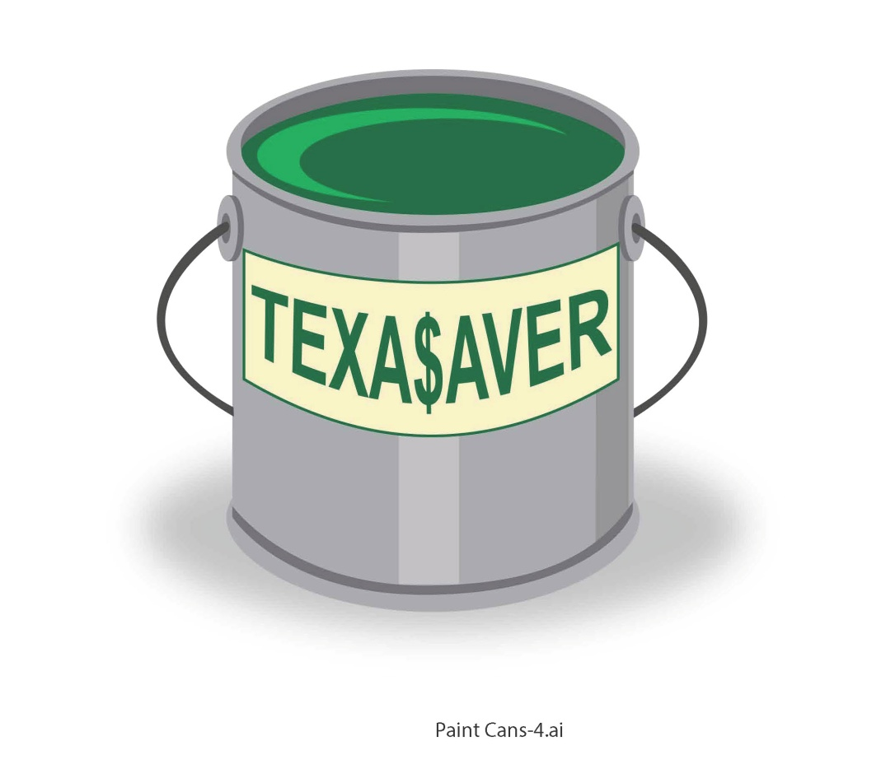
WHY ENROLL IN 457 TEXA$AVER?
Notes:
The Texa$aver program is a valuable benefit available to you as an employee of the State of Texas. You’re already contributing to your ERS Retirement, but did you know that may only replace about 50% of your salary when you retire? Social Security will help supplement that amount, but even Social Security with your ERS Retirement probably won’t add up to your monthly income while you’re working.
The good news is you don’t have to rely on just those two benefits. By contributing to the Texa$aver program, you can fill in that gap and be more prepared to meet your retirement goals.
Think of these three benefits as cans of paint. Using just one retirement benefit would be like trying to paint your retirement picture using just one color – it wouldn’t be nearly as appealing as a picture with many different colors. Just about any color you can imagine can be created using some combination of red, blue and green. When you combine ERS, Social Security and the Texa$aver program, you can create a retirement as colorful as your dreams. And with all of the tools and resources available to you as a Texa$aver participant, it’s easier than you might think.

Slide 3
WHAT IS THE TEXA$AVER PROGRAM?
401(k): All State Employees
457: All State and Higher Education Employees
Notes:
The Texa$aver program is a voluntary retirement program offered by the State of Texas with several options so you can mix just the right plan for your retirement picture.
The Texa$aver program is made up of two plan types: a 401(k) plan which is available to all state employees, and a 457 plan which is available to all state employees and all higher education employees. For a detailed comparison of the two plan types, see me after this presentation or go to www.texasaver.com.
If you’re eligible for both, you don’t have to choose – you can contribute to both! State agency employees hired in 2008 or later are automatically enrolled in the 401(k) plan at 1%. If you were automatically enrolled but had opted out of the plan, you can start making contributions by calling (800) 634-5091 or going to www.texasaver.com.

Slide 4
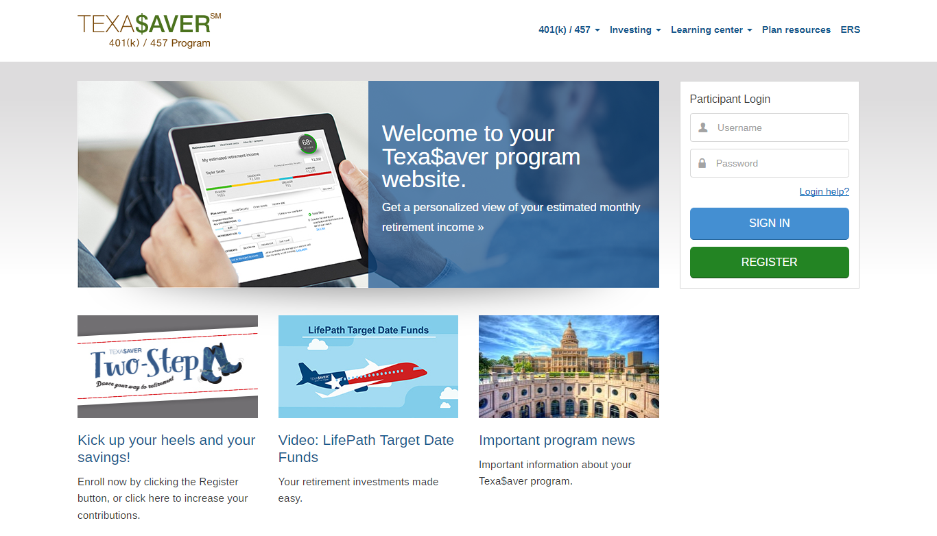
WHAT IS THE TEXA$AVER PROGRAM?
$20 or 1% per pay period
Account Balance | Monthly Fee*
$1,000.00 or less | $0.60
Between $1,000.01 and $16,000.00 | $2.05
Between $16,000.01 and $32,000.00 | $3.08
Between $32,000.01 and $48,000.00 | $4.19
Between $48,000.01 and $64,000.00 | $5.58
$64,000.01 or more | $6.99
*Per participant, per account
For new accounts, a one-time fee waiver period will be applied for the first six months. At the end of the new account waiver period, participants will pay the monthly fees based on their account balance, as outlined above.
Notes:
You can get started in the Texa$aver program with a minimum of $20 or 1% of your salary per pay period, whichever you prefer. Maximum contribution limits are set by the IRS, and if you’re over 50 or are within three years of retirement, you may be able to take advantage of catch-up contributions which are higher than the normal limits. For information on limit and catch-up contributions go to the www.texasaver.com homepage and click on the Important Program News tile.
There is a fee to participate in the Texa$aver program, as shown in this chart. The fees are competitive with, and oftentimes lower than, other plans this size. Participating in the Texa$aver program gives you access to tools and benefits you can’t find elsewhere, as well as competitive pricing for fund expenses.

Slide 5
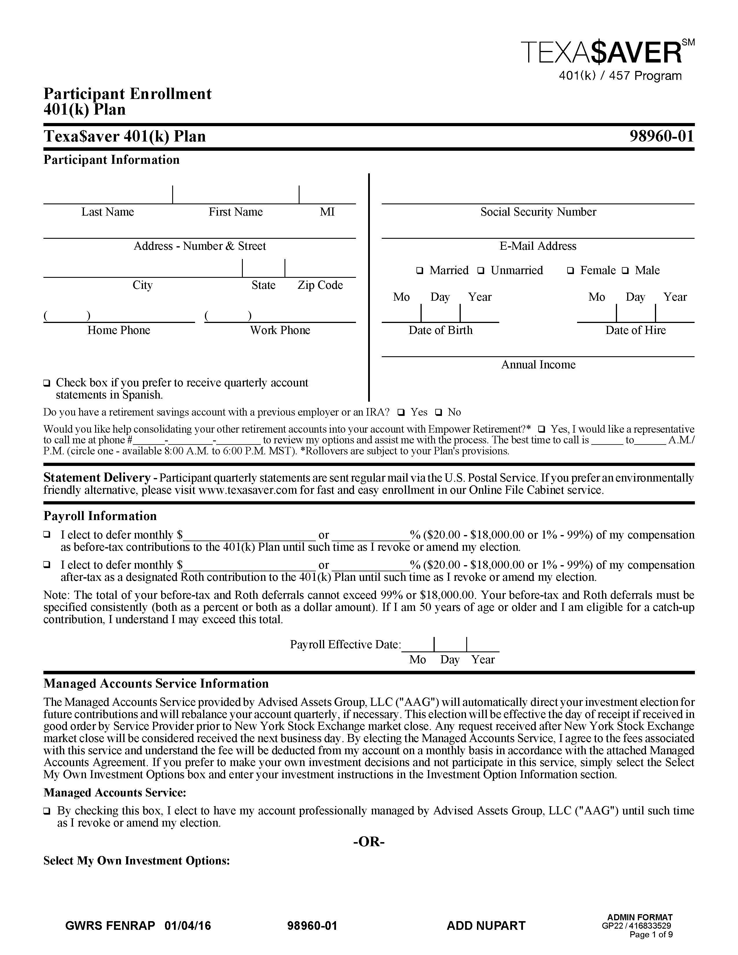
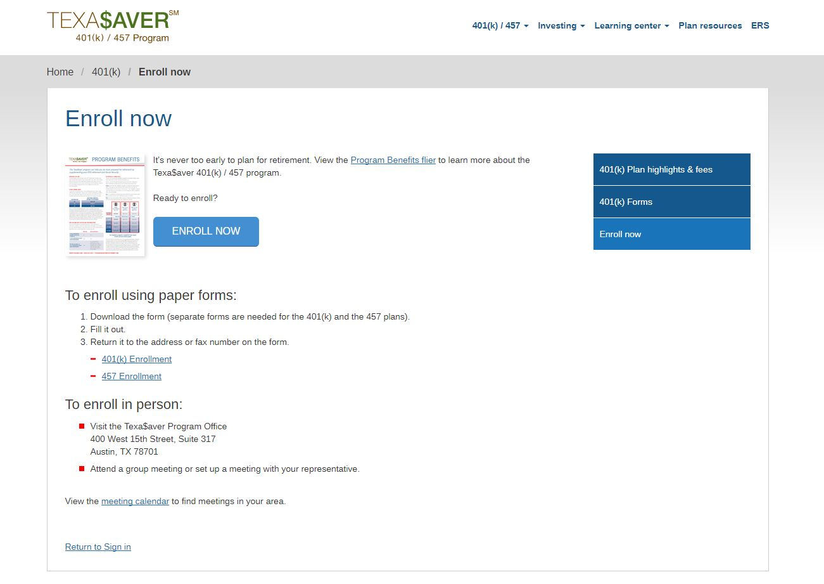
HOW DO I ENROLL?
457 Enrollment Form
Select a beneficiary
Enroll online!
www.texasaver.com
Or call
John McCabe
(832) 799-9677
Notes:
Enrolling in the Texa$aver program is simple! You can either fill out a paper form and return it by mail or fax or to me, or you can enroll online at www.texasaver.com.
You’ll also need to select which fund or funds you want to invest in from the options available in the Texa$aver program. We’ll go through your investment options in more detail in a moment.
Another important step is designating a beneficiary. You have probably already done this for your ERS retirement benefit, but you’ll need to make sure you have a beneficiary on file for the Texa$aver program also. You can do this with a beneficiary designation form. Ask me after this presentation if you have questions about this step.

Slide 6
WHAT ARE MY INVESTMENT OPTIONS?
Please consider the investment objectives, risks, fees and expenses carefully before investing. For this and other important information, you may obtain mutual fund prospectuses for registered investment options and/or disclosure documents from www.texasaver.com or by requesting one from your Texa$aver representative. For prospectuses related to investments in your self-directed brokerage (SDB) account, contact your SDB provider. Read them carefully before investing.
www.texasaver.com

Slide 7
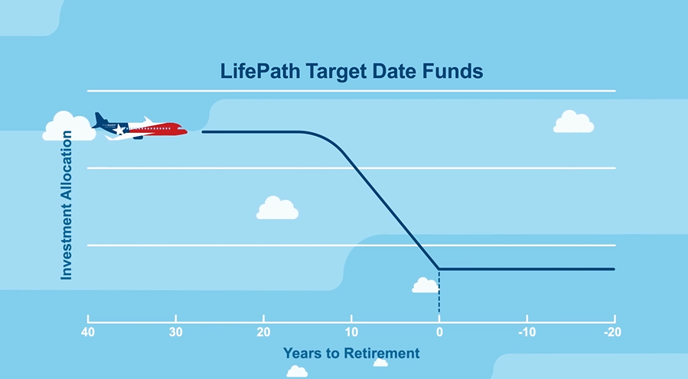
WHAT ARE MY INVESTMENT OPTIONS?
TARGET DATE FUNDS
If you were born: | And plan to retire at age 65, consider:
12/31/1957 or earlier | BlackRock LifePath® Index Retirement Fund F
1/1/1958 – 12/31/1962 | BlackRock LifePath® Index 2025 Fund F
1/1/1963 – 12/31/1967 | BlackRock LifePath® Index 2030 Fund F
1/1/1968 – 12/31/1972 | BlackRock LifePath® Index 2035 Fund F
1/1/1973 – 12/31/1977 | BlackRock LifePath® Index 2040 Fund F
1/1/1978 – 12/31/1982 | BlackRock LifePath® Index 2045 Fund F
1/1/1983 – 12/31/1987 | BlackRock LifePath® Index 2050 Fund F
1/1/1988 – 12/31/1992 | BlackRock LifePath® Index 2055 Fund F
After 1993 | BlackRock LifePath® Index 2060 Fund F
www.texasaver.com
The chart shown is a guide based on the overall design of the funds and is not intended to be investment advice.
The date in the name of the target date fund is the assumed date of retirement. The asset allocation becomes more conservative as the fund nears the target retirement date; however, the principal value of the fund is never guaranteed.
Notes:
Whatever your level of interest and comfort investing may be, we’ve got options for you.
For those of you who lack the time, interest, confidence or investment knowledge to choose your own fund lineup, or just want a no-hassle solution, the Texa$aver program offers target date funds. Target date funds are designed to have a more aggressive fund mix at first, and then automatically adjust to a more conservative mix as you get closer to retirement. The date in a target date fund’s name is the approximate date when investors are expected to start withdrawing their money (generally assumed to be at age 65). The principal value of the fund(s) is not guaranteed at any time, including at the time of the target date and/or withdrawal.
To find your target date fund, start with the year you were born, and use this chart find the fund closest to the year you expect to retire (let’s assume it’s the year you’ll turn 65).

Slide 8
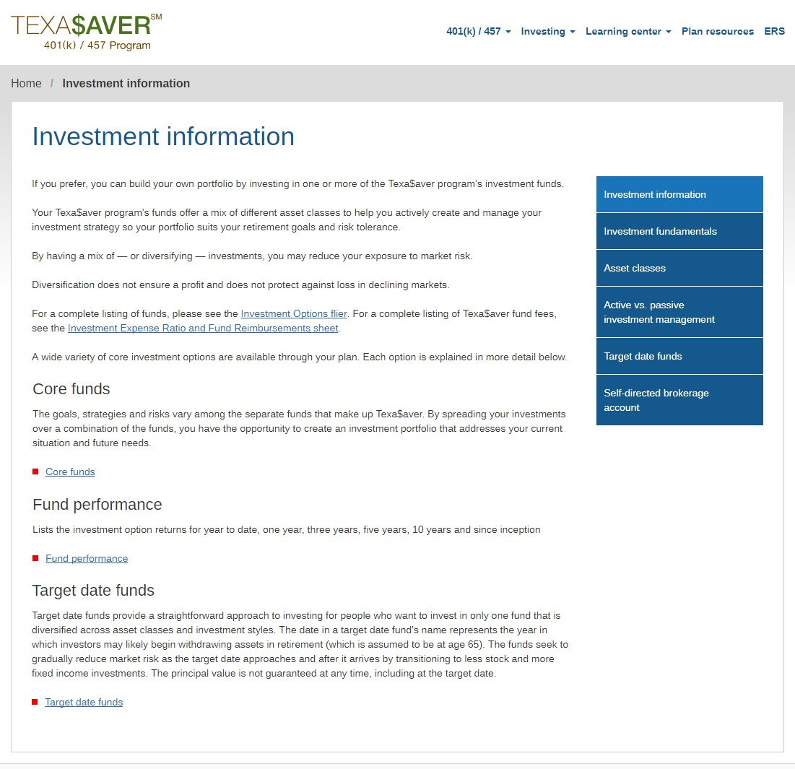
WHAT ARE MY INVESTMENT OPTIONS?
CORE FUNDS
www.texasaver.com
Notes:
If you’d prefer to pick your own investment mix, the Texa$aver program offers a lineup of core funds ranging from conservative to aggressive. You can find information about each of these options on the website. If you decide to mix your own portfolio, keep in mind that target date funds are not meant to be mixed with other funds in your portfolio – they are designed to be a stand-alone option. Mixing them with other funds changes the designed asset allocation, and could make your portfolio more conservative or more aggressive than you’d intended.

Slide 9
WHAT ARE MY INVESTMENT OPTIONS?
SELF-DIRECTED BROKERAGE ACCOUNT
www.texasaver.com
Intended for knowledgeable investors only
Notes:
If you are a knowledgeable investor and want even more freedom to mix your own investment portfolio, the Texa$aver program offers a self-directed brokerage account (SDBA) through Charles Schwab. The SDBA gives you access to a wide range of stocks, corporate bonds and mutual funds not available in the core lineup.

Slide 10
CAN I GET HELP WITH MY INVESTMENTS?
TEXA$AVER ADVISOR SERVICE Provided by Advised Assets Group, LLC (AAG), a registered investment adviser
Online Advice (No additional cost to you) | Managed Account Service (Fee based on a percentage of your account balance)
Self-service Fund-specific recommendations Personal asset allocation information Savings strategy Available online | Full service Fund-specific selection and management Personal retirement planning Savings strategy Available online or by phone Access to investment adviser representatives Will monitor and manage your account for you
Managed Account Fee
There is no guarantee provided by any party that participation in any of the advisory services will result in a profit.
Per Account, Monthly | Annual Fee
0.0292% | 0.35%
Example Account Balance | Monthly Fee Charged
$10,000 | $2.92
$20,000 | $5.84
$50,000 | $14.60
Online Advice and the Managed Account service are part of the Texa$aver Advisor Service suite of services offered by Advised Assets Group, LLC, a registered investment adviser.
Notes:
Looking for more help with your investments? Look at the Texa$aver Advisor Service, provided by Advised Assets Group, LLC, a registered investment adviser.
There are several levels of help available with Texa$aver Advisor Service: Online Advice and the Managed Account service. Online Advice is available at no additional cost to you as a participant. You are still responsible for making your own investment decisions based on the recommendations you receive. With the Managed Account service, AAG looks at the financial information in your personal account and provides you with a savings and allocation strategy as well as portfolio monitoring and rebalancing. Investment adviser representatives can help you review this strategy annually, or as needed when you request it; for example, when your financial situation changes. There is a fee to use the Managed Account service, as shown in the chart. The fee is based on a percentage of your Managed Account balance, and the fee is waived for the first 90 days you are enrolled in the Managed Account service as a complimentary trial period.
To get more information about Texa$aver Advisor Service, go to www.texasaver.com, email texasaver@empower-retirement.com or call (800) 634-5091 and ask to speak to an investment adviser representative.
There is no guarantee provided by any party that participation in any of the advisory services will result in a profit.

Slide 11
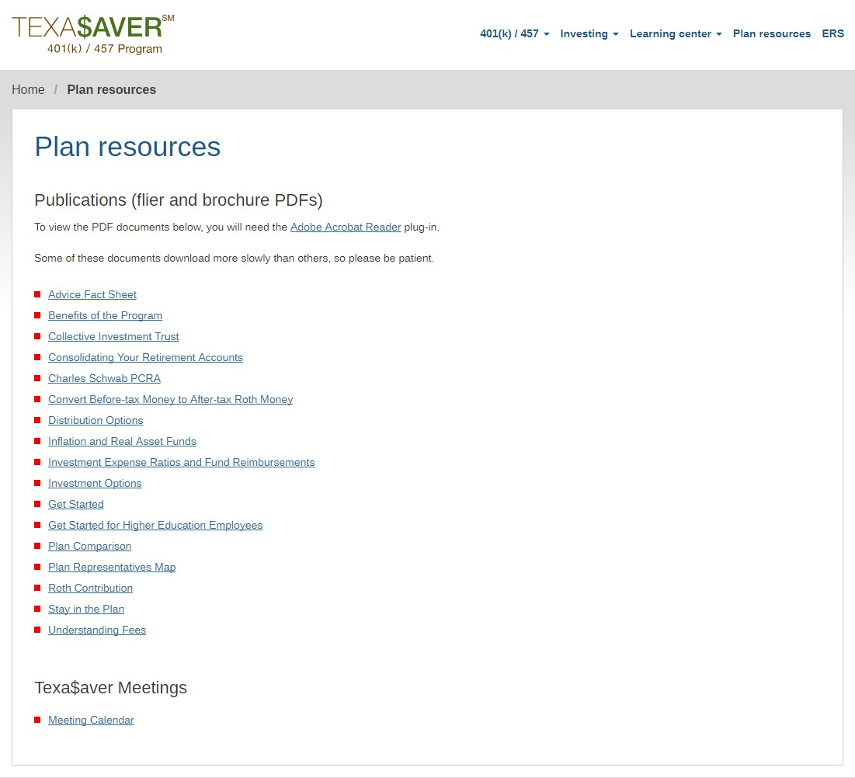
WHERE CAN I LEARN MORE?
www.texasaver.com
Notes:
Do you like to research things online before making decisions? We do too. There are lots of ways to research Texa$aver by visiting www.texasaver.com.

Slide 12
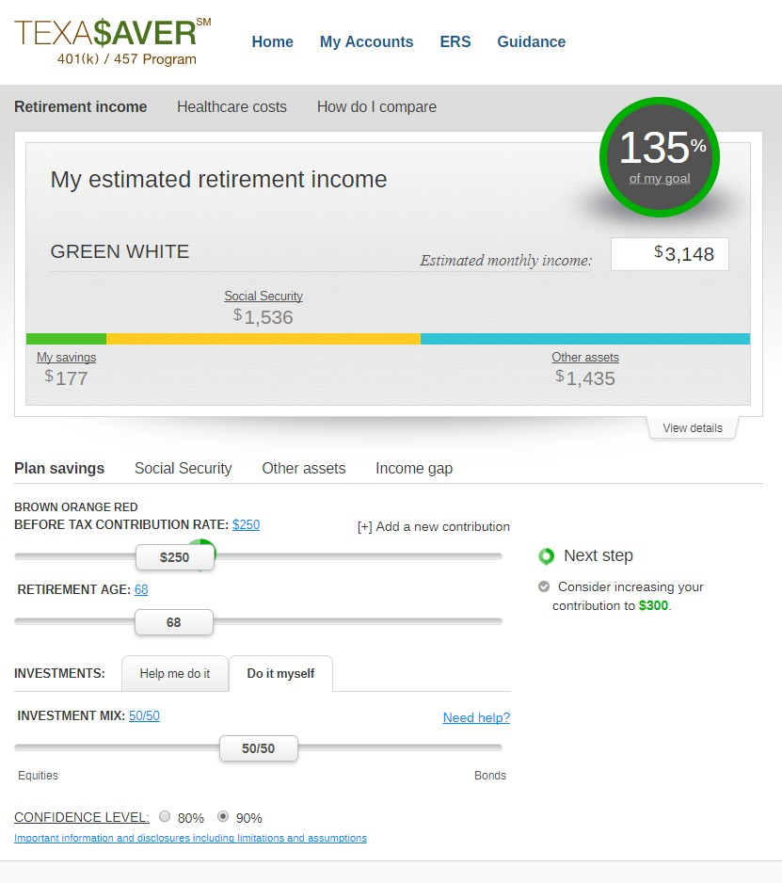
IMPORTANT: The projections, or other information generated on the website by the investment analysis tool regarding the likelihood of various investment outcomes, are hypothetical in nature. They do not reflect actual investment results and are not guarantees of future results. The results may vary with each use and over time. Healthcare costs and projections, if applicable, are provided by HealthView Services. Healthview Services is not affiliated with GWFS Equities, Inc. Empower Retirement does not provide healthcare advice. A top peer is defined as an individual who is at the 90th percentile of the selected age band, salary range and gender.
WHERE CAN I LEARN MORE?
www.texasaver.com
FOR ILLUSTRATIVE PURPOSES ONLY
IMPORTANT: The projections, or other information generated on the website by the investment analysis tool regarding the likelihood of various investment outcomes, are hypothetical in nature. They do not reflect actual investment results and are not guarantees of future results. The results may vary with each use and over time. A top peer is defined as an individual who is at the 90th percentile of the selected age band, salary range and gender.
Notes:
Once you enroll and log in to your account, you’ll get access to a powerful tool. This tool shows you how close you are to your retirement goals, and lets you adjust different variables like annual income and retirement age. You can see at a glance if there’s a gap between what your retirement income might be and what you’d like it to be. If there is, you can see ways to bridge that gap.

Slide 13
WHO CAN I TALK TO IF I HAVE QUESTIONS?
John McCabe -457 Retirement Counselor
(832) 799-9677
www.texasaver.com
For appointments -Go to website-click on link
Look for John McCabe
Notes:
With Texa$aver, you always have someone to talk to when you have questions. We’ve got local representatives called Education Counselors who can meet with you for group presentations or one-on-one meetings.
You also get 24/7 access to the website and voice response phone line, and national customer service representatives are available to help you Monday through Friday, 7 a.m. to 9 p.m. CT and Saturday, 8 a.m. to 4:30 p.m. CT by calling (800) 634-5091.

Slide 14
THANK YOU!
Enroll online:
www.texasaver.com
Securities offered by the Texa$averSM Program through GWFS Equities, Inc., Member FINRA/SIPC. GWFS is an affiliate of Empower Retirement, LLC; Great-West Funds, Inc.; and registered investment adviser Advised Assets Group, LLC. This material is for informational purposes only and is not intended to provide investment, legal or tax recommendations or advice. Investing involves risk, including possible loss of principal.
Securities available through Schwab Personal Choice Retirement Account® (PCRA) are offered through Charles Schwab & Co., Inc. (Member SIPC), a registered broker-dealer. Additional information can be obtained by calling 888-393-7272. Charles Schwab & Co., Inc. and GWFS Equities, Inc. are separate and unaffiliated. RO1169311-0420
Notes:
Thank you for taking the time today to learn about the Texa$aver 401(k) / 457 Program. We hope you’ll decide to paint a brighter retirement future for yourself today by enrolling – give us a call or send us an email anytime with questions.

