Slide 1
The Master of Science degree in Family and Consumer Sciences (FCS)
emphasis in
Hotel, Restaurant and Tourism Management

Slide 2
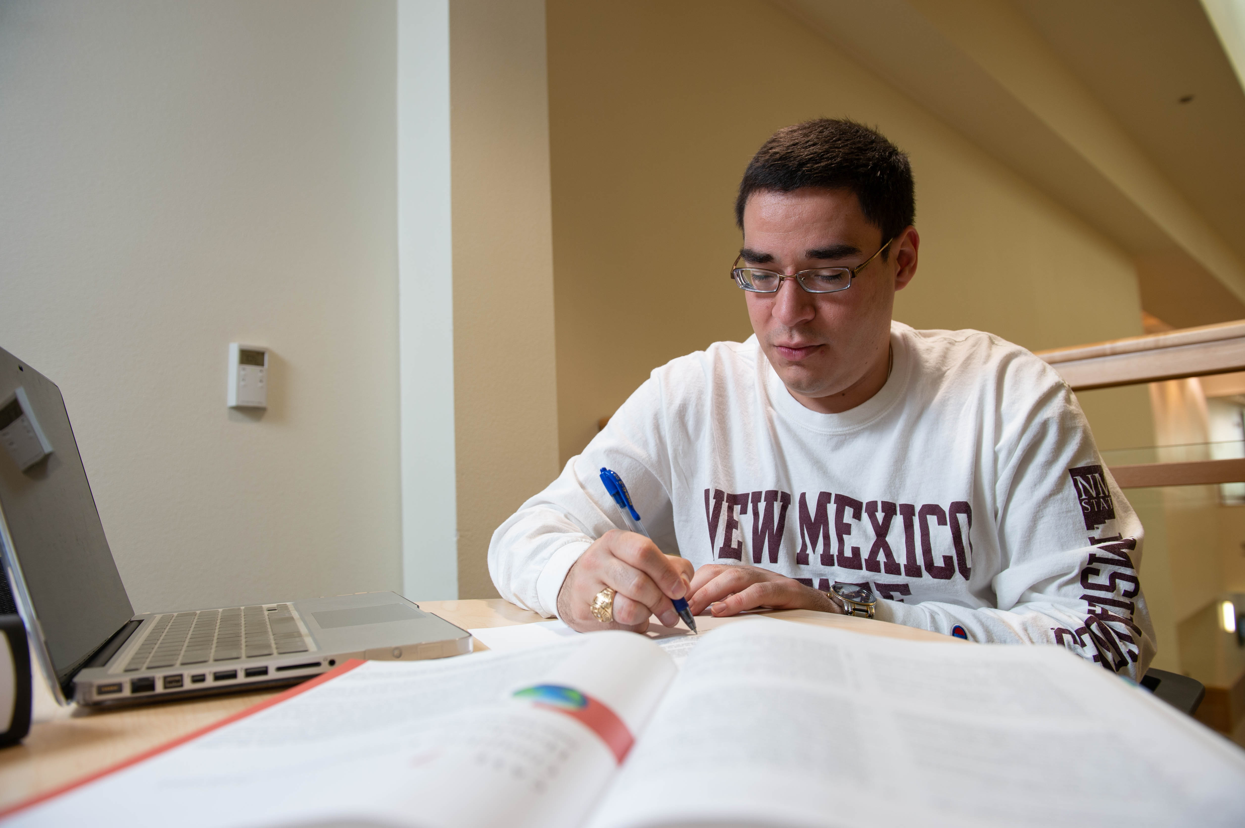
A program with the flexibility to meet the demands of your busy schedule!
You can complete the program on campus, completely online through NMSU-Online, or a combination.
Add a minor from options in a variety of supporting fields that fit your career interests.
Perfect for hospitality educators who may desire to take specialization courses in online teaching or educational technology.

Slide 3
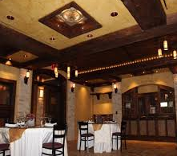
Take classes that apply to your chosen area of specialization
Choose from a variety of areas of interest such as:
Foodservice Management
Hotel Operations
Destination Management
Revenue Management
Sales and Marketing
Hospitality or Culinary Education
Beverage Management
Tourism
Resort Management
Hospitality Information Systems
Human Resources Management/Training
Bobby Lee Lawrence Academy of Wine

Slide 4
Thesis vs Non-Thesis Plan Requirements
Thesis Plan
Minimum of 30 credits (including 4-6 credits of thesis).
Oral exam on completion of the above requirements.
Non-Thesis Plan
Minimum of 32 credits of course work
Oral AND written examination upon completion of the above requirements.
Required for both plans
Half of the credits must be from above the 500 level.
Half of the credits must come from the School of Hotel, Restaurant & Tourism Management.
3 credits of statistics and 3 credits of research methodology at the graduate level.

Slide 5
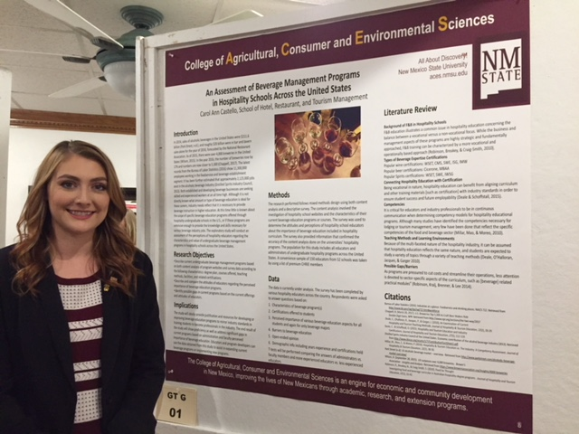
Recommended Core HRTM Courses
HRTM 501: The Hospitality Industry and Sustainable Competitive Strategy
HRTM 502: Advanced Hospitality Services Management
HRTM 503: Hospitality Organizational Leadership and Human Resources
HRTM 504: Marketing Strategy for Global Hospitality
HRTM 506: Contemporary Global Issues in Hospitality
HRTM 515: Applied Management Project
HRTM 598: Special Research Program

Slide 6
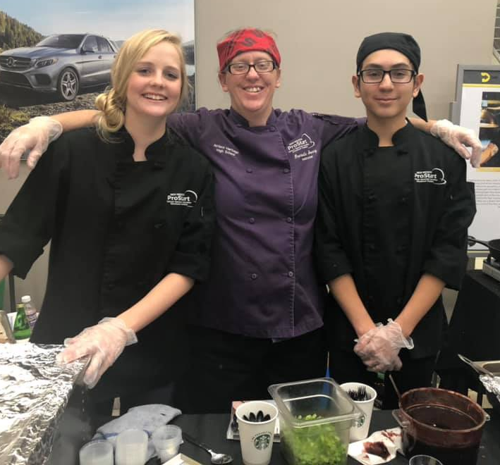
Graduate Level HRTM Courses
HRTM 510: Hospitality Cost Control
HRTM 512: Beverage Management
HRTM 516: HRTM Purchasing, Selection and Procurement
HRTM 530: Facilities Management
HRTM 531: Hotel Operations II
HRTM 532: Hotel Revenue and Sales Management
HRTM 535: Resort Management
HRTM 536: Sustainability in the Hospitality Industry
HRTM 543: Meetings, Conventions and Special Events
HRTM 550: The World of Hospitality Higher Education

Slide 7
Examples of using your credits taken in other departments
AXED – Agricultural and Extension Education
AXED 515 - Youth Program Development and Management
AXED 525 - Graduate Teaching Methods
AXED 530 - Teaching Adults in Non-formal Settings
AXED 545 - Developing Excellent Programs in Career and Technical Education
Business College
College of Education
Online Teaching
Educational Technology
Other graduate level courses – develop a degree plan with your advisor.

Slide 8
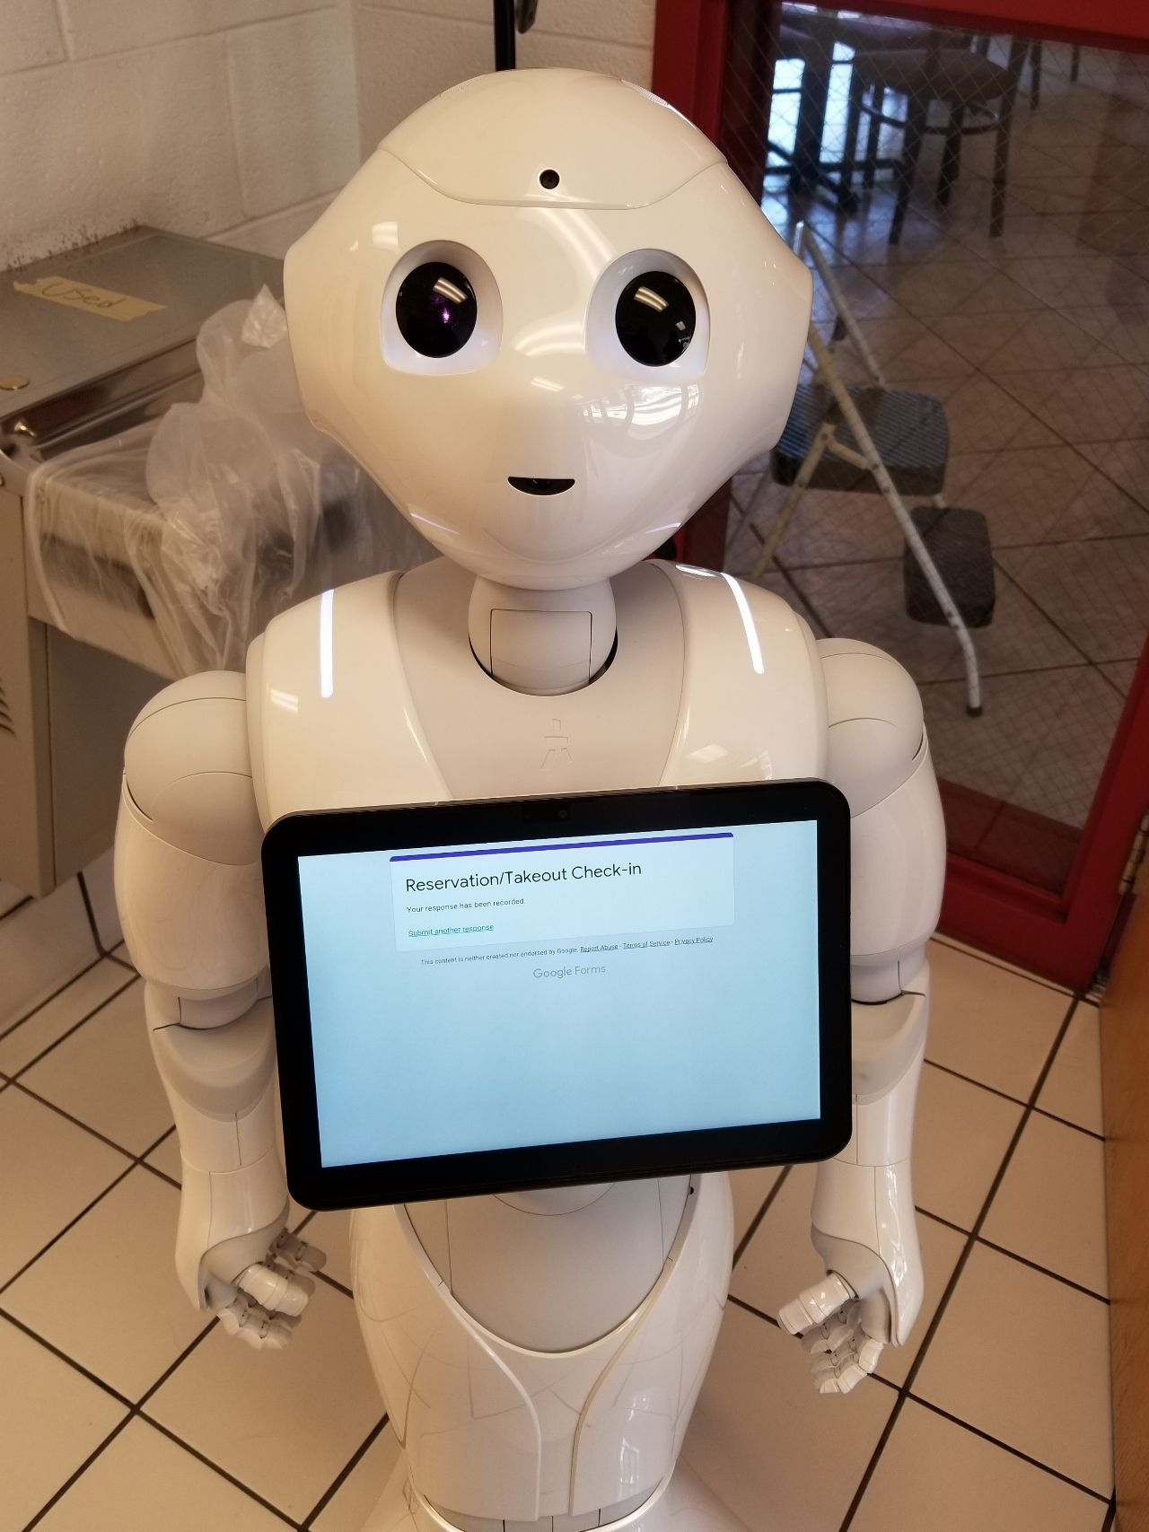
Faculty Areas of Research
Gastronomic Festivals (Food & Wine Festivals)
Hospitality Technology
Management Strategies in Hospitality
Sustainability in the Hospitality Industry
Economic Impact of Hospitality & Tourism
Beverage Management
Hospitality Education

Slide 9
Partnership with Courtyard by Marriott at NMSU

Slide 10
Application Process
Admissions criteria includes
Admission to the New Mexico State University Graduate School
Official Undergraduate Transcripts (must include GPA & number of credit hours)
One-page letter of interest
Resume
Three letters of reference
Graduate Record Examination (GRE) or Graduate Management Admission Test (GMAT)

Slide 11
Application Deadlines
Summer Sessions I & II, and Fall Semester: March 1, 2020
Summer Session II and Fall Semester: June 1, 2020
Spring Semester: November 1, 2020

Slide 12
Contact Us!
For any questions or more information: Dr. Jean Hertzman
Director; School of Hotel, Restaurant & Tourism Management
Phone: 575-646-4786
E-mail: jhertzma@nmsu.edu
Dr. Betsy Stringam
Professor; School of Hotel, Restaurant & Tourism Management
Phone: 575-646-7424
E-mail: betsys@nmsu.edu

