Slide 1
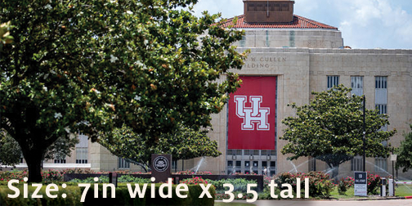
NEW COURSE FOR SPRING 2020
PLACE TITLE OF COURSE HERE
COURSE DESCRIPTION
INSTRUCTOR
Jane Doe, Professor
Department of History
This space holds 630 characters (with spacing)
CONTACT
abcdefg@uh.edu
713-743-1234
Agnes Arnold Hall
CLASS SCHEDULE
Mondays, 5:30-8:30 p.m.
AAH 210
COURSE NUMBERS
Doctoral Students: HS 8000
Section 12345
Master’s Students: HS 1234
Section 54321

