Slide 1
American Government 101
A Simple Introduction to the American Experiment
Brandon Rottinghaus
Department of Political Science
University of Houston

Slide 2
The Roots of Revolution
“No taxation without representation”
Quartering of troops
Kingly power was extensive and far-reaching
Centralized government
Lack of political equality and individual freedom

Slide 3
The Value of Experience
No Taxation w/o Representation
Quartering of troops
Kingly “power”
Centralized government
Lack of political equality and individual freedom
Taxation begins in HOR, elected
Amendment III
Minimized by
presidential “power”
Federalism
Bill of Rights and
electoral system provides
for both

Slide 4
Undemocratic “Sins” in the Constitution
Slavery, 3/5 apportionment rule (changed)
No direct election of Senators (changed)
Suffrage for women (changed)
Electoral College
Disproportionate representation in Senate by small states

Slide 5
Governing Principles of the Constitution
Republicanism
Checks and Balances
Federalism
Separation of Powers

Slide 6
A Republic, Not a Democracy
Political representation is “mediated” rather than direct
Why? The Framers did not trust the people to form good judgments about politics and issues
They also feared “mob mentality” of the members of the public

Slide 7
Federalism
Power “sharing” between federal and state governments (called “dual federalism”)
Federal supposed to stay out of states’ way but federal rules are paramount in most areas
Post-New Deal emerges “cooperative federalism”
Post-Nixon (and continuing) emerges “decentralization” or devolution
Debates about funding for border enforcement, Medicare reimbursement, national lands, right to bear arms

Slide 8
Separation of Powers
Three separate and distinct branches of government
Different methods of selecting top personnel, so each branch is responsible to a different constituency
Produces a “mixed regime” in which each department has particular expertise
In actuality is “shared” powers not “separated” powers, diminishing chance that power will be misused

Slide 9
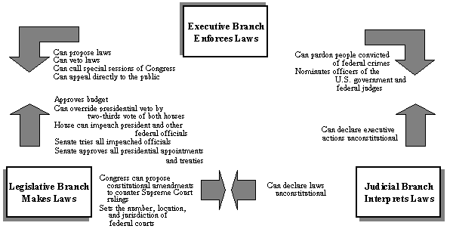
Checks and Balances (or “If men were angels, no government would be necessary” Federalist 51)

Slide 10
Executive

Slide 11
The Powers of the President
Powers of the President
Constitutional or Statutory Link
Inherent powers (“take care clause”)
Delegated powers
“Power to persuade” (what Teddy Roosevelt called the “bully pulpit”)
Chief legislator
World leader (diplomat in chief)
Military leader
Party leader
Administrative head of the nation
Trade policy, federal lands
Agenda setting, public persuasion
Veto legislation, convene congress
Ceremonial head of the nation
Commander-in-Chief (esp. post 1947)
*

Slide 12
Legislative

Slide 13
“Enumerated Powers”
Article I: Sections 1-10
Declare war
Raise an army and navy
Borrow and coin money
Regulate interstate commerce
Create and change federal courts
Establish immigration laws

Slide 14
“Implied Powers”
“Necessary and proper” clause grants these (also called the “elastic clause”)
Article I, Section 8, #18, “To make laws which shall be necessary and proper for carrying into execution the foregoing powers….”
Interpreted to provide Congress with a vast reservoir of powers unwritten in the Constitution
Powers not “boundless” but certainly greater than the Framers envisioned
Sanctioned by McCulloch v. Maryland (case of the National Bank)

Slide 15
Two Branches
House of Representatives
Senate
Up for election every two years
90+% incumbency rate
Revenue bills originate here
Impeachment
Decentralized: many committees and subcommittees
The Rules Committee: the most important Committee in Congress
The Speaker of the House runs the show: directs flow of legislation and controls Rules Committee
Elected every six years
1/3 Elected every 2 years
60% incumbency rate
Try impeachments
Approve major presidential appointments, treaties
“Unanimous Consent”
Run by Senate Majority Leader, who’s powers are more persuasive than structural

Slide 16
Judiciary

Slide 17
The Creation of the Judiciary “The Least Dangerous Branch”
Only mention in Constitution is “one supreme court”
Deferred to Congress
Judiciary Acts of 1789 (established three Circuit Courts and thirteen District Courts)
Few early cases (did not rule on a single case for three years)
But, the power of the court was established in Marbury v Madison which created judicial review.

Slide 18
Do Courts Make Policy?
Maybe. Sometimes.
Yes
Laws are vague
Get to interpret facts (“is this police interrogation or police inquiry?”)
Get to determine Constitutional rights
No
Precedents
Congress or President can choose any issue on which to focus
Can force the hands of legislators and the president
But, the Court lacks “influence over the sword or purse” (Federalist #78)

