Slide 1
Student Centers Lunch and Learn: Recycling 101 September 12, 2017

Slide 2
Learning Outcomes
What is Recyclable
Where to Recycle
Helpful Resources
E-Waste
Water Conservation
Energy Conservation

Slide 3
What Do We Recycle?

Slide 4
Where to Recycle
Indoor:
Blue Bins
Outdoor: Big Belly

Slide 5
UH Single Stream Accepts Plastics #1-5 and 7 (Styrofoam and other #6 plastics are not accepted)

Slide 6
Helpful Resources
G2 Revolution - www.g2rev.com/
K Cup Recycling
TEJAS or Brawner Paper Co.
100% Post-Consumer Paper
Printer Ink Recycling
Green Certified Products
Housekeeping Services
Ensure Green Cleaning Products

Slide 7
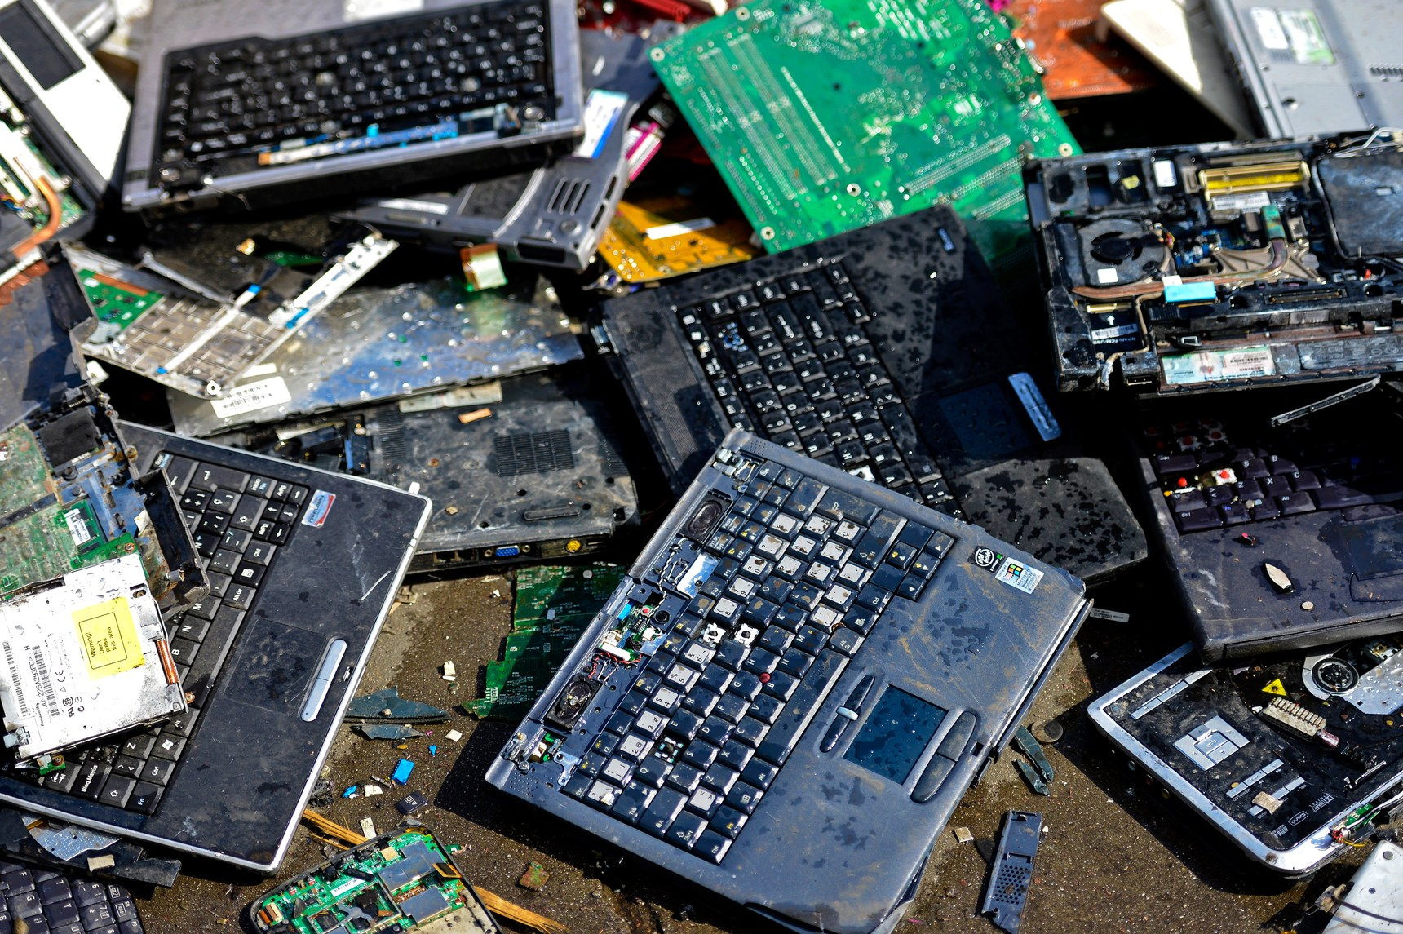
e-waste is a growing problem…
Cell phones
Life span is about 1.5 years now
130 million are retired a year
Over 500 million are stockpiled
Computers
20 million retired a year
240 million already stockpiled
Estimated that for every new cell phone or computer one becomes obsolete

Slide 8
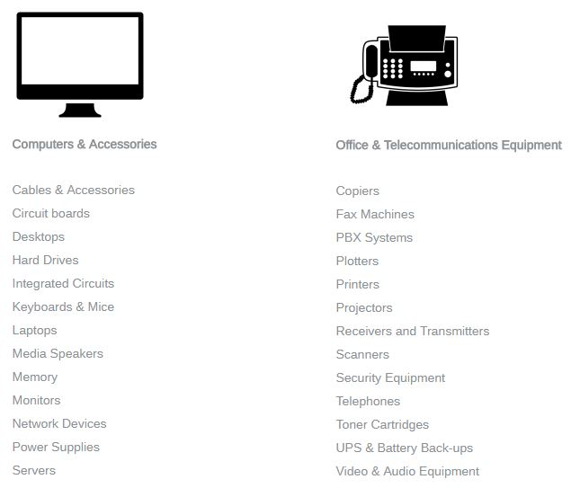
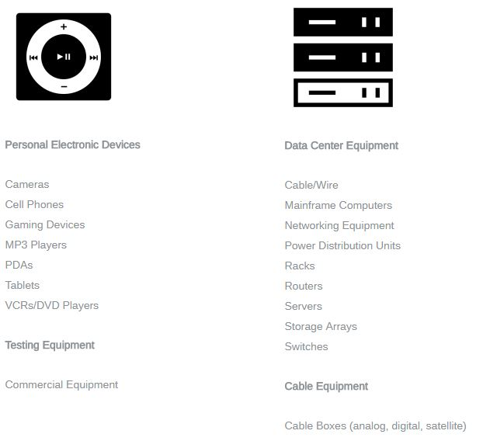
Notes:
Usually in Feb

Slide 10
Water Usage Per Year
That’s over 316 BILLION gallons!

Slide 11
5 Easy Water Saving Tips
Wash laundry & dishes with full loads
Always turn off running water
Take shorter showers
Eliminate any and all leaks
Reduce the flow of toilets & showerheads
Notes:
There are 5 easy ways you can start conserving water today.
We all need to take responsibility for saving water whether or not there is a drought.
Remember, every drop counts.
Additional Tips:
As you are warming the shower water, put a bucket in to collect the clean water. This water can be used for several things in your home, such as watering plants, mopping the floor and a variety of household chores.
Plan ahead when cooking and thaw out food in the refrigerator to prevent running under water to thaw.
You should also reduce the flow of water from your showerhead. The average showerhead uses 2.5 gallons of water a minute. A low-flow showerhead can easily reduce the flow to 1.5 gallons per minute.
If you don’t know how much water your shower uses, you can measure the flow rate per minute with a bucket. You could hold the bucket under the showerhead for one minute, but it is easier to check the flow for 30 seconds and multiply by two to get the per minute flow.

Slide 12
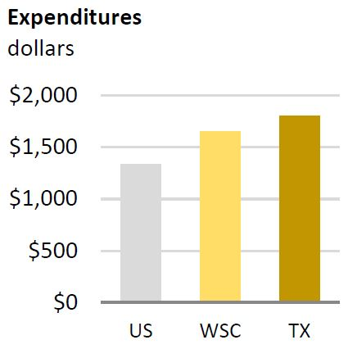
Texas Facts
Average electricity consumption per Texas home is 26% higher than the national average.
The average annual electricity cost per Texas household is $1,801, among the highest in the nation.
US Energy Information Administration’s 2009 Residential Energy Consumption Survey www.eia.gov/consumption/residential/

Slide 13
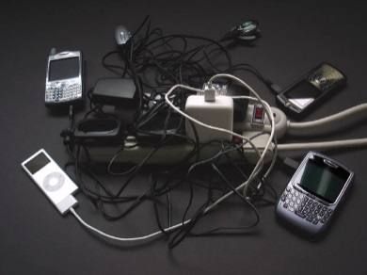
Electronics and Lights
Chargers still draw energy when plugged in
Open the blinds or drapes
Use dimmers
Remember to turn off lights or use automatic controllers
TVs and Computers
Standby mode uses up to 10% electricity
Consider power strips with On/Off switch

Slide 14
THANKS!! QUESTIONS??

