Slide 1
Lync Audio/Video/Online Meeting Conferencing
Planning For Meeting Rooms
Technology Services & Support

Slide 2
Why Lync Is The Conference Room Solution for UH?
Audio Visual A/V Equipment is the same as on your desk, classroom, conference rooms and across various platforms, Microsoft, Skype, Google, Polycom, etc.
Lync provides A/V Conferencing functionality
Web Conference (slide sharing, application sharing, whiteboard, etc.)
On-Premises Audio Conferencing
Higher Resolutions for Video Content – VGA, RTV, H.263, HD and Panorama
Various Lync Clients provide several avenues of conferencing capabilities
Group IM
Scalability – 250 users per conference/meeting or larger
Federation with external Lync users
More to Come in Lync 2013 server and client

Slide 3
What is the Lync Conference Room Solution for UH?
The core pieces of equipment needed to make any conference room a Lync meeting room are:
TV/Projector
USB Web camera
Audio & Microphone
PC w/ Wireless Keyboard and Mouse
Network Connection
UIT recommends 3 standard Lync Conference room solutions:
Design #1 is for large conference rooms between 10 to 20 seats
Design #2 is for small to mid size conference rooms less than 10 seats
Design #3 is a mobile conference room solution
Can I customize or pick and choose the type of equipment in the room?
Yes, we strongly recommend Lync Optimized/Approved devices.

Slide 4
Lync Conference Room Solutions
 | Design # 1 | Design # 2 | Design # 3
TV/Projector | HD Projector $2,000 | 65” LED Display $1,200 | 55” LED Display $800
USB Web Camera | VDO360 USB $1,500 | Logitech B910HD $150 | Logitech C930e $150
Audio & Microphone | Vaddio Easy USB Mixer & Mics $2,000 | Polycom CX3000 $700 | Plantronics Calisto P620-M $150
Computer w/Wireless Keyboard & Mouse | Dell OptiPlex Small Form Factor $1,000 | Dell OptiPlex Small Form Factor $1,000 | Surface Pro Tablet $1,000
Network Connection | Wired $250 | Wired $250 | Wired/Wireless
Fixed or Mobile | Cabinet $400 | Cabinet $400 | Mobile $400
Other Accessories | Mounts, cables, etc. $500 | Mounts, cables, etc. $400 | Mounts, cables, etc. $500
BYOD | Yes | No | Yes
Total Est. Cost | $7,650.00 | $4,100.00 | $3,000.00

Slide 5
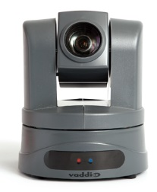
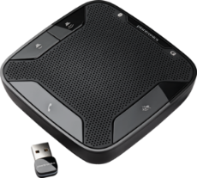
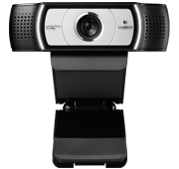
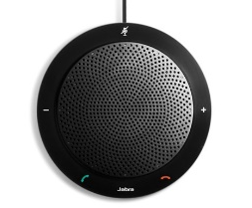
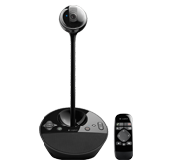
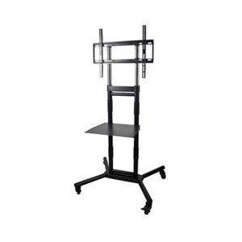
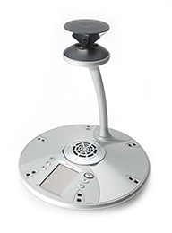
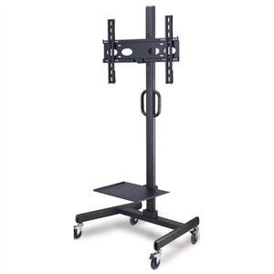
Other Enhancement Options
Vaddio Easy USB Camera
High Definition USB 2.0 Pan/Tilt/Zoom Camera. $3,000
Plantronics Calisto P620-M
Wireless speakerphone, Bi-directional microphones activate in the direction of speaker’s voice 360 degrees. $150
Logitech USB Webcam C930e
1080p HD Webcam support H.264 with scalable video coding and UVC 1.5 encoding. $130
Jabra SPEAK 410 MS
USB corded with built-in, omni-directional microphone and a powerful speaker that enable 360-degree coverage of up to 1 meter. $100
Logitech BCC950 Conference Cam
Combines HD 1080p 30fps video with high-quality full-duplex speakerphone clarity for business-grade video conferencing. $250
60" Rolling TV Cart
Color: Black
Height Adjustable:1200-1800mm
Materials: Steel
Maximum Weight Capacity: 132 lbs. (60 kg)
Television Size Supported: (most) 32" to 60“. $300
Polycom CX5000 HD
720p HD active-speaker video, 360-degree panoramic view of the conference room. $4,000
32" - 52" Adjustable TV Cart
Easily adjust screen position - up, down, tilt, rotate between portrait and landscape orientation.
Ergonomic solution with easy installation features
Maximum Weight Capacity: 110 lbs. (50 kg)
Television Size Supported: (most) 32" to 52“. $350
More Lync Optimized Accessories: http://technet.microsoft.com/en-us/lync/gg278164.aspx

