Slide 1


Slide 2
2019 Annual Meeting
EDGE: The “Eye in the Woods”
Image-based Human Detection and
Recognition System
Ioannis A. Kakadiaris
University of Houston
Other personnel: Ha Le, Charles Livermore, Lei Shi,
Christos Smailis, Yuhang Wu, Xiang Xu (Ph.D. Candidates);
Ioannis Konstantinidis (Staff)

Slide 3
Presentation Goals
Knowledgeable
Excited

Slide 4
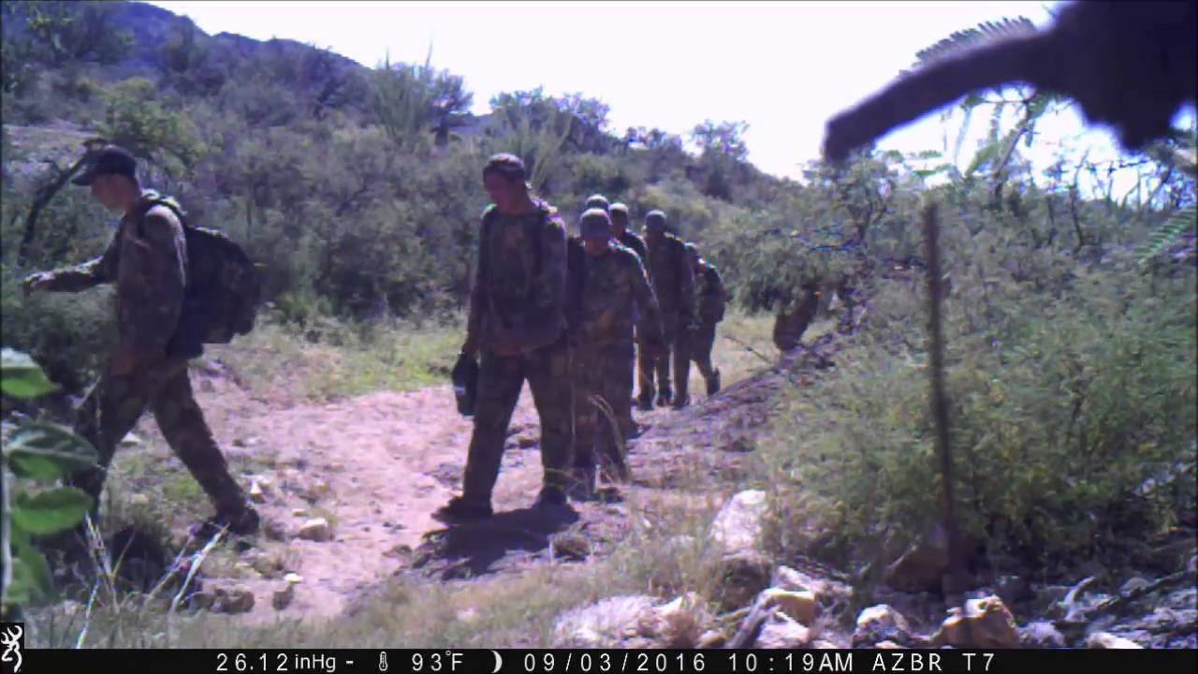
Project Overview: Knowledge Gap
Identify border crossers (if there is available information) to enable dispatchers to alert agents in the field
https://www.youtube.com/watch?v=BWJbazGLhH4

Slide 5
Project Overview
End-users of this research
Enforcement Systems Division: Dispatchers
DHS strategy officials: Analysts
Main outcomes and benefits end-user desires
Pain Points
  Limited matching success matching images where a person’s face is partially visible due to pose or illumination
  Lack of filtering of images where movement occurs but there is no human present
Gain Desired
  A method that will accurately identify individuals in real-time to enable the dispatchers to alert agents in the field

Slide 6
Project Overview: Goal
Design, develop, and evaluate a system to automatically detect and match human subjects from
trail camera images.

Slide 7
Project Overview: Objectives (2018- 2019)
Design and develop algorithms for matching images in the visible domain
Acquire, curate and annotate images by trail cameras (VIS and NIR) in non-urban environments
Deploy a private cloud-based software system for software evaluation

Slide 8
Project Overview: Objectives (2019- 2020)
Evaluate FR matching on the acquired data
Design, develop, and evaluate algorithms to match images in the NIR domain
Design, develop, and evaluate algorithms to classify and tag the acquired images (VIS and NIR) by:
      human presence or no human presence, and
      if human presence is detected, classify whether or not the image is usable for face recognition;
Design, develop, and evaluate algorithms to extract (for each image tagged to have human presence) the following information:
      direction of movement of the individual or group, and
      carry-weapon / carry-load / no-carry;

Slide 9
Objective 1: Matching Facial Images
Face Detection
Illumination Enhancement
Occlusion-Aware Matching
Compact Pose-Robust Template Generation

Slide 10
Objective 1.1: Face Detection - LR
Two-stage Detectors
        Increased network complexity difficulty of network convergence due to the multiscale training
One-stage Detectors
        Sub-optimal feature selection for the detection task due to
          noise introduced by choosing simple combinations of different levels of features
          Use of pre-trained model based on only classification task only instead of the classification and regression tasks needed
        Introduction of gridding due to Dilated Convolutions
        Low computational efficiency because of computationally heavy modules for fusing different levels of features

Slide 11
Objective 1.1: Face Detection - LR
Two-stage Detectors
        Increased network complexity difficulty of network convergence due to the multiscale training
One-stage Detectors
        Sub-optimal feature selection for the detection task due to
          noise introduced by choosing simple combinations of different levels of features
          Use of pre-trained model based on only classification task only instead of the classification and regression tasks needed
        Introduction of gridding due to Dilated Convolutions
        Low computational efficiency because of computationally heavy modules for fusing different levels of features
SSFD+

Slide 12
Objective 1.1: Face Detection - LR
Two-stage Detectors
        Increased network complexity difficulty of network convergence due to the multiscale training
One-stage Detectors
        Sub-optimal feature selection for the detection task due to
          noise introduced by choosing simple combinations of different levels of features
          Use of pre-trained model based on only classification task only instead of the classification and regression tasks needed
        Introduction of gridding due to Dilated Convolutions
        Low computational efficiency because of computationally heavy modules for fusing different levels of features
SANet

Slide 13
Objective 1.1: Face Detection - LR
Two-stage Detectors
        Increased network complexity difficulty of network convergence due to the multiscale training
One-stage Detectors
        Sub-optimal feature selection for the detection task due to
          noise introduced by choosing simple combinations of different levels of features
          Use of pre-trained model based on only classification task only instead of the classification and regression tasks needed
        Introduction of gridding due to Dilated Convolutions
        Low computational efficiency because of computationally heavy modules for fusing different levels of features
SEFD

Slide 14
Milestones: SSFD+
Contributions
        A comparative study is conducted to investigate which layer contributes more to detecting multi-scale faces
        A simple network structure is designed and implemented to improve the performance of detecting multi-scale faces by incorporating additional contextual information
      Advantages
        SSFD+ employs a single-scale input image and a single-scale feature map to detect multi-scale faces and achieves comparabile results on the WIDER Face validation, testing, FDDB, Pascal Faces and AFW datasets, which demonstrates the robustness and effectivenss of SSFD+ on detecting multi-scale faces.

Slide 15
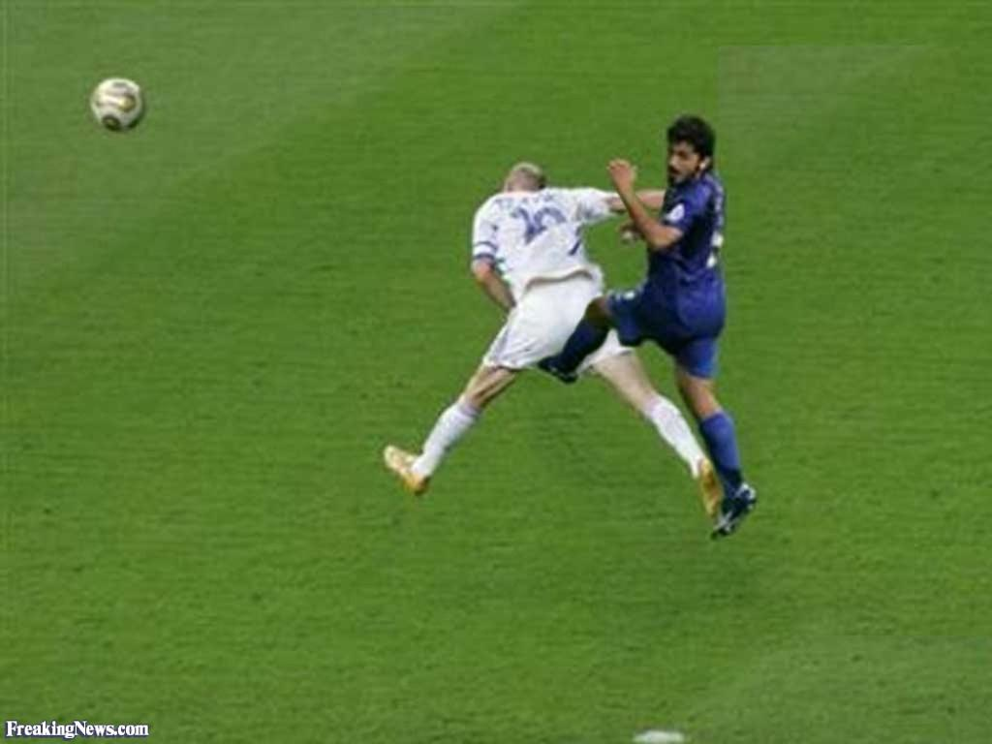
SSFD+: A Robust Two-Stage Face Detector
The first stage
CAM
s:1
s:2
s:4
s:8
s:8
s:4
Conv1
Conv2
Conv3
Conv4
Conv5
The second stage
fc6
fc7
L^{C}
Concatenation
TransConv
DilaConv(r=2)
DilaConv(r=3)
15
L^{R}
ROIPooling

Slide 16
Face Detection: SANet
Contributions
        The Attention-guided Feature Fusion Module (AFFM) integrates high-level and low-level semantic features
        EThe Smoothed Context Enhancement Module (SCEM) is designed to avoid the artifacts and increase the power of feature representation through re-learning the relationship among completely separable sets of units produced by Dilated convolution
      Advantages
        SANet produces state-of-the-art results on the UFDD dataset and achieves promising results on the WIDER Face validation and testing datasets, which demonstrates the robustness and effectiveness of SANet on detecting multi-scale faces, especially small faces.

Slide 17
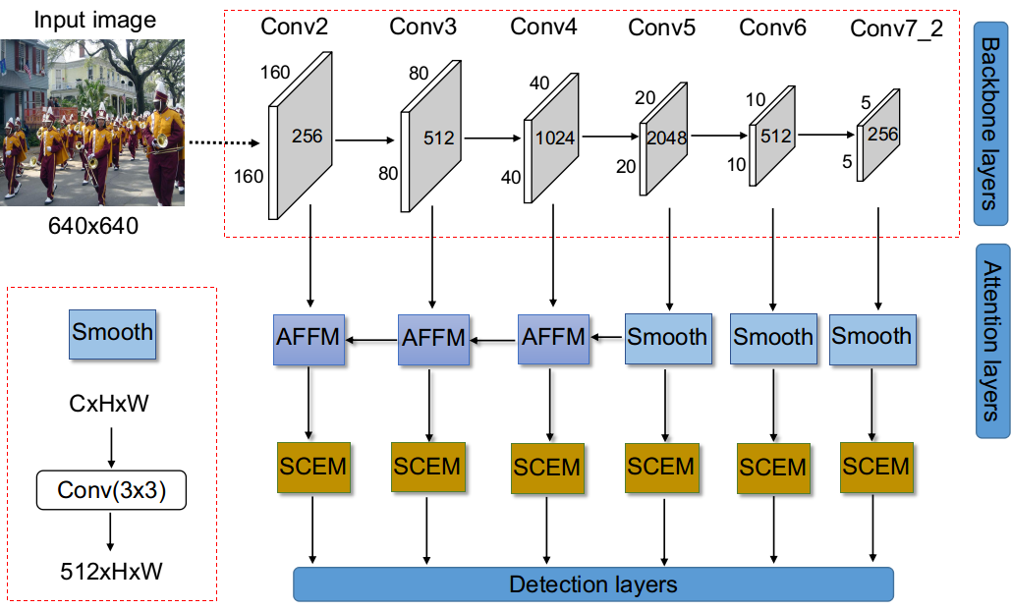
SANet: Smoothed Attention Network for
Single Stage Face Detector

Slide 18
Face Detection: SEFD
Contributions
        The Feature Aggregation Module (FAM) is designed to aggregate high-level and low-level semantic features and incoporate contextual features
        The Aggregation loss is introduced to increase the power of learning discriminative features of the backbone network
        Performed omprehensive studies on aggregation loss to investigate the influence of classification and regression tasks on improving the power of learning discrininative features of the backbone network
        Advantages
        SEFD is state-of-the-art on UFDD dataset, and achieves comparable performace on the WIDER Face validation, testing datasets on detecting multi-scale faces.

Slide 19
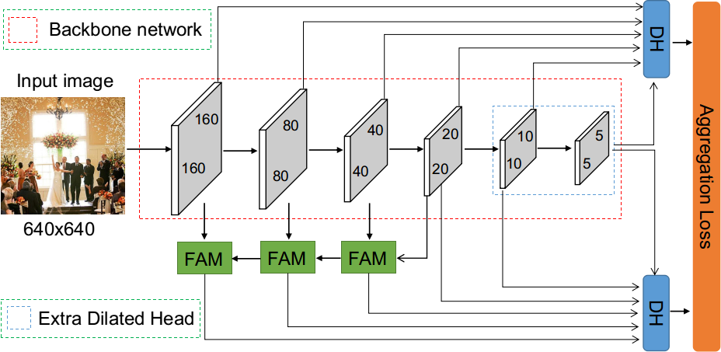
SEFD: A Simple and Effective
Single Stage Face Detector

Slide 20
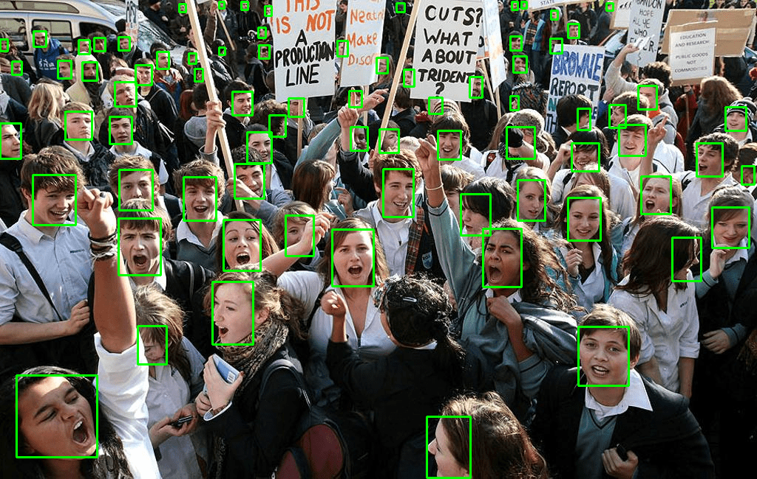
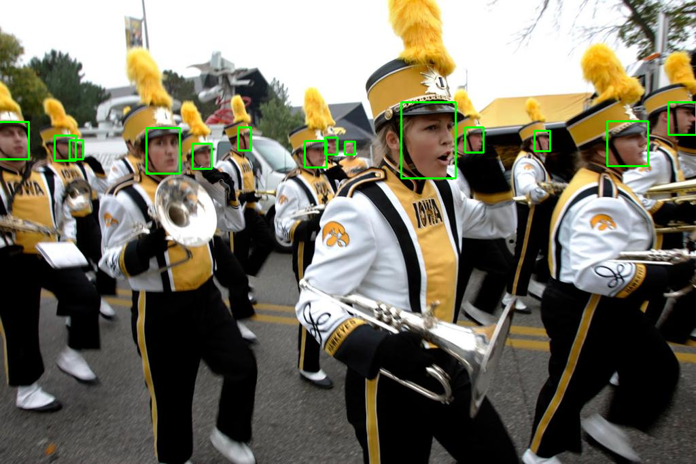
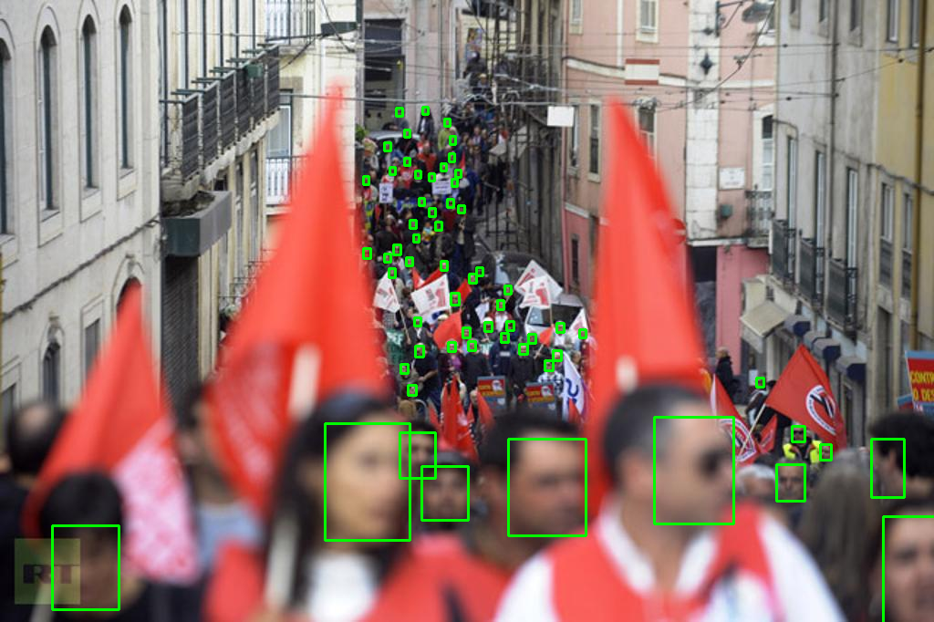
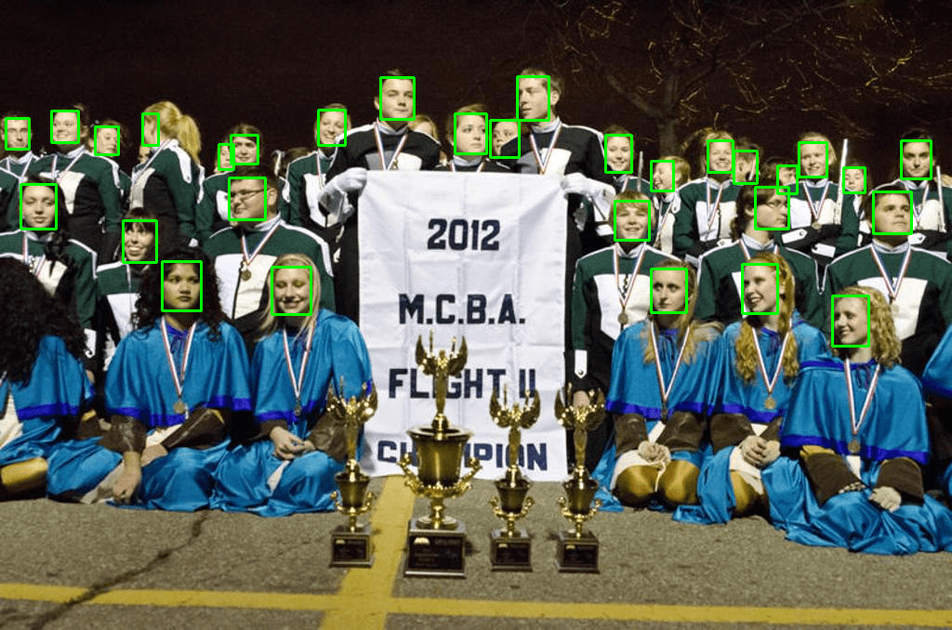
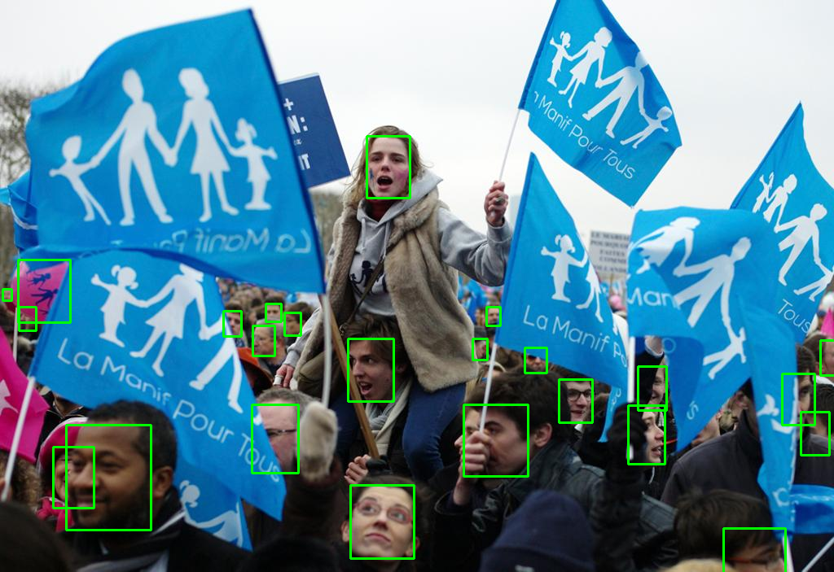
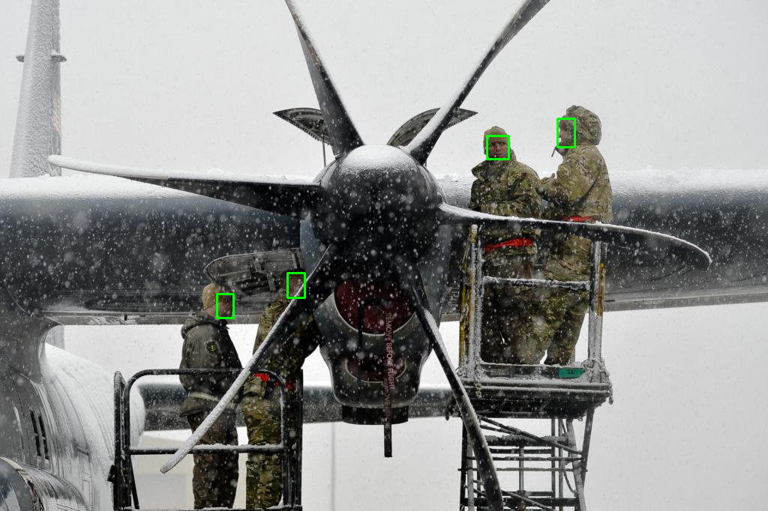
Face Detection: Quantitative Results
SSFD+
SANet
SEFD

Slide 21
Objective 1.2: Illumination Enhancement
SeLENet: Low light face enhancement for extreme dark face images
FRADA: Illumination-invariant template learning
FRnR: Improves FRADA to be faster and more accurate

Slide 22
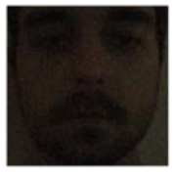
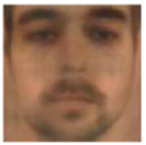
SeLENet: Low Light Illumination Enhancement
Face images acquired in poor lighting conditions suffer reduced recognition performance
Illumination
Enhancement
CNN
Low light face
Enhanced face
FR Network
Face Template

Slide 23
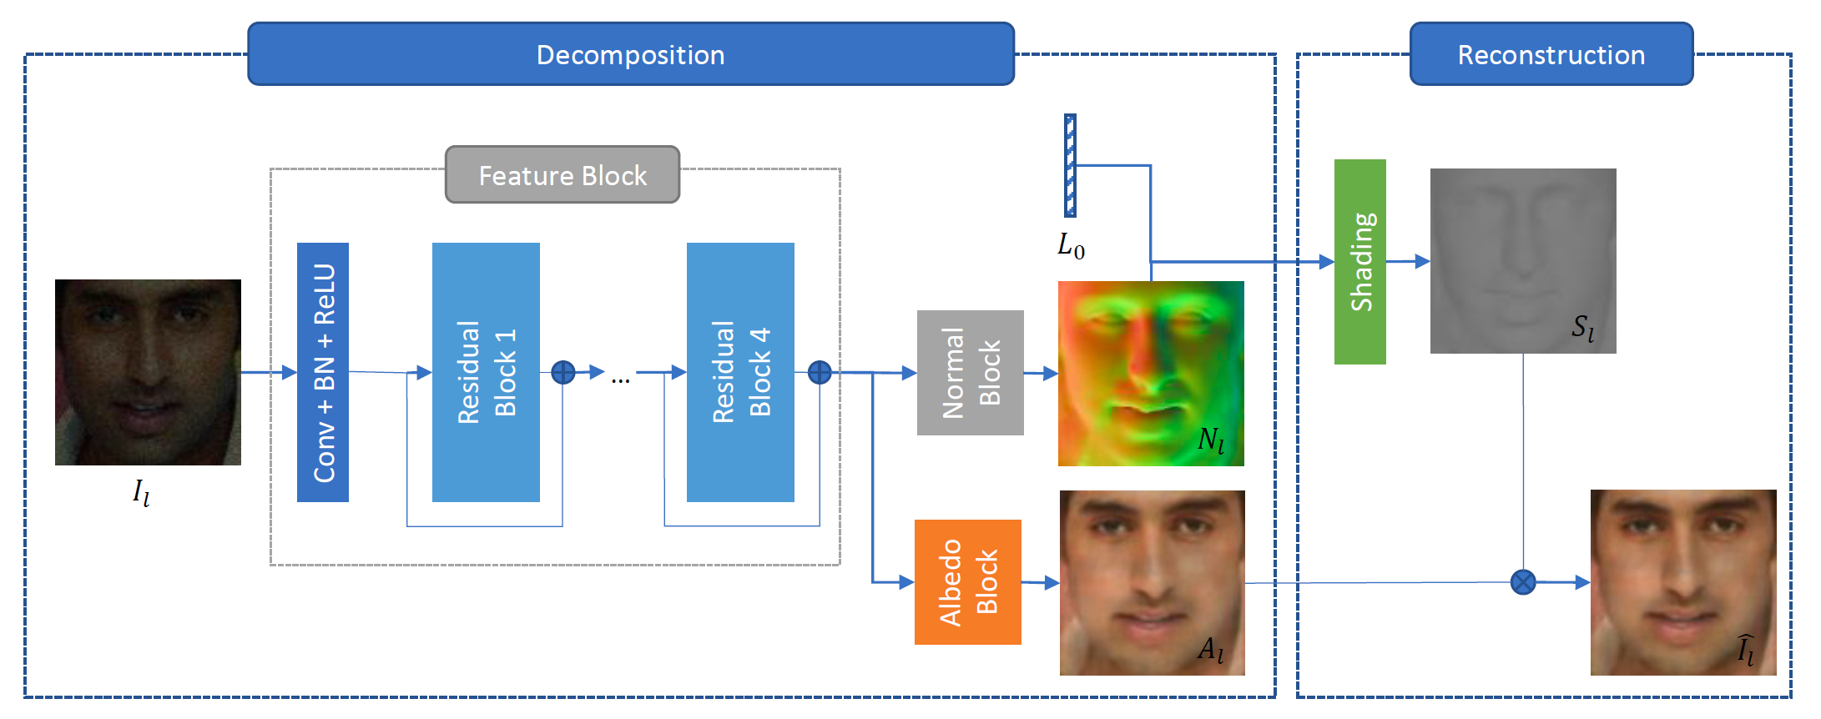
SeLENet: Architecture

Slide 24
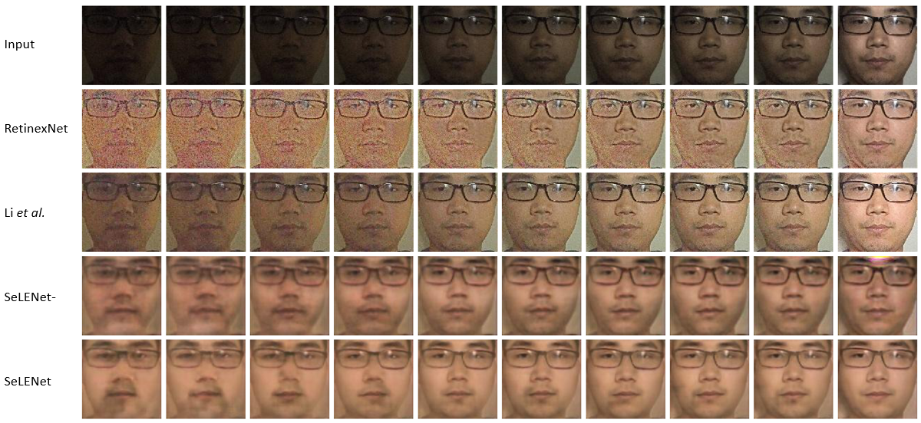
SeLENet: Results

Slide 25
SeLENet: Performance Metrics
Method | CFP-FF
 | Orig. | 01 | 02 | 03 | 04 | 05 | 06 | 07 | 08 | 09 | 10
N/A | 99.43 | 96.14 | 98.00 | 98.46 | 98.66 | 98.94 | 98.96 | 99.03 | 99.10 | 99.17 | 99.34
RetinexNet | 98.94 | 86.37 | 89.86 | 91.24 | 91.47 | 91.27 | 92.13 | 93.16 | 95.43 | 96.44 | 98.07
Li’s | 99.00 | 95.60 | 97.69 | 98.16 | 98.34 | 98.30 | 98.43 | 98.53 | 98.60 | 98.46 | 98.81
SeLENet- | 97.21 | 96.09 | 96.74 | 96.94 | 97.24 | 97.39 | 97.57 | 97.66 | 97.50 | 97.61 | 97.6
SeLENet | 99.47 | 99.17 | 99.49 | 99.47 | 99.57 | 99.56 | 99.63 | 99.59 | 99.60 | 99.64 | 99.61

Slide 26
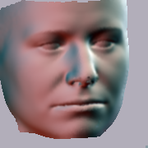
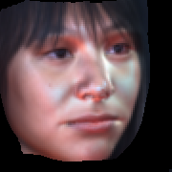
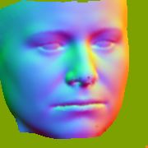

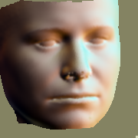
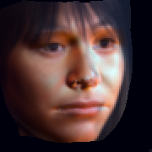
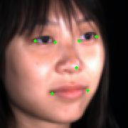
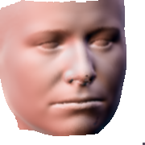
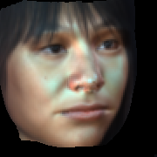
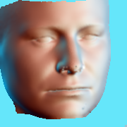
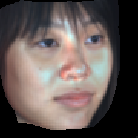
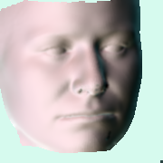
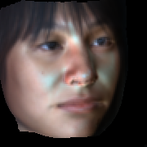
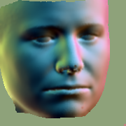
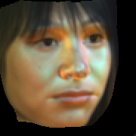



FRADA
Face Relighting
3D Reconstruction
New Shadings
Relit Images
Normal
Mask
E2FAR
3DMM Coefficients
$$αs$$
$$αe$$
Illumination Estimation
SH Lighting
DLRN
$$L$$
Shading
Albedo

Slide 27
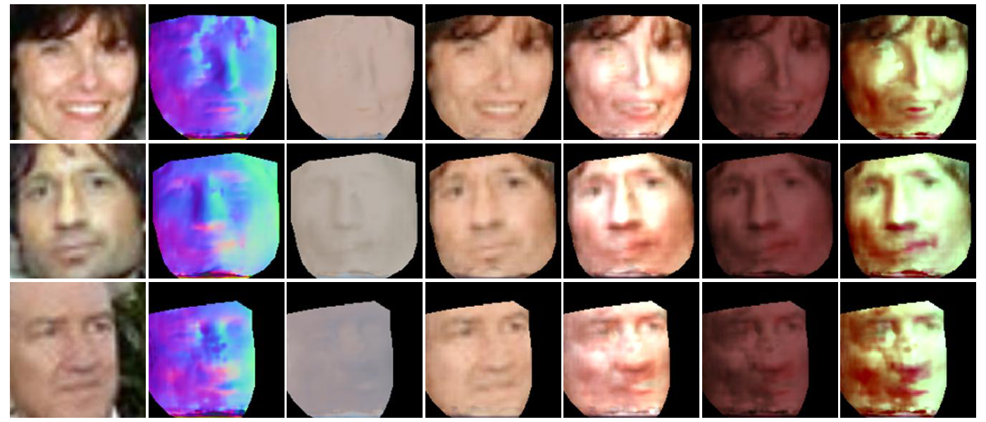
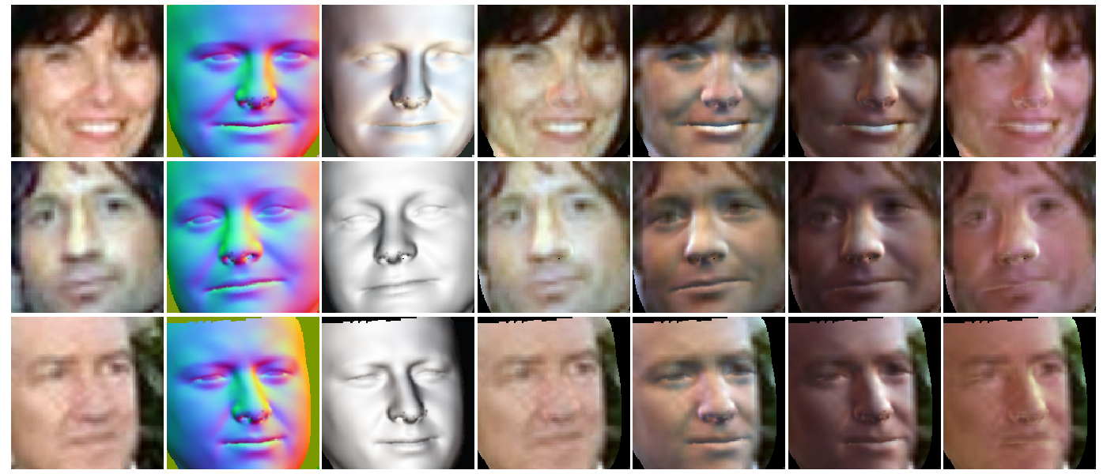
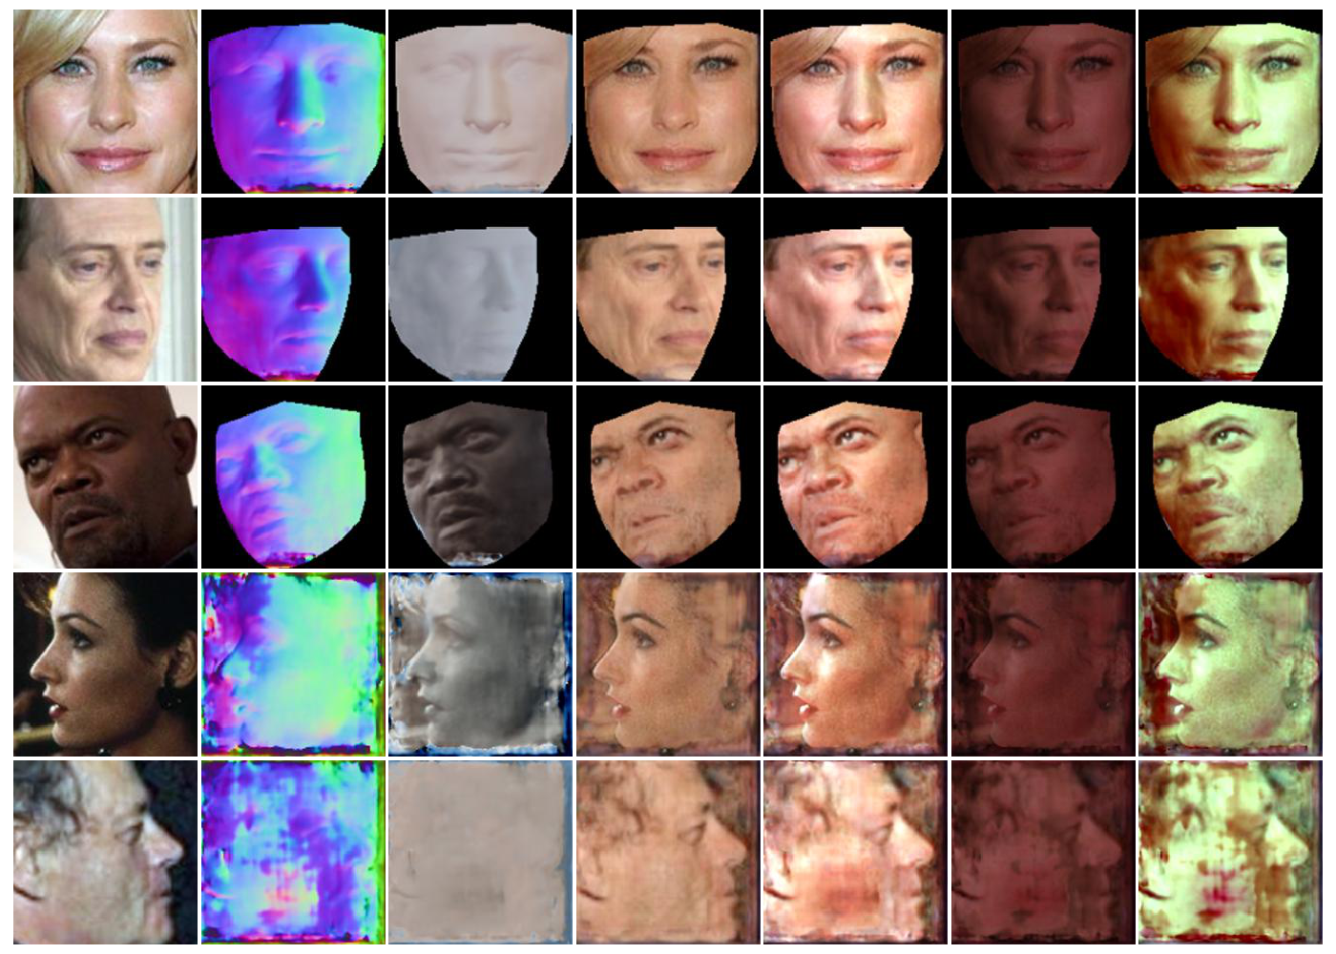
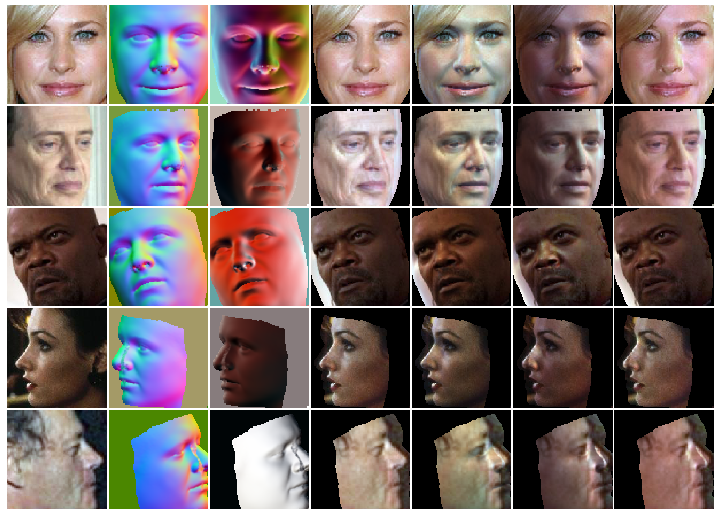
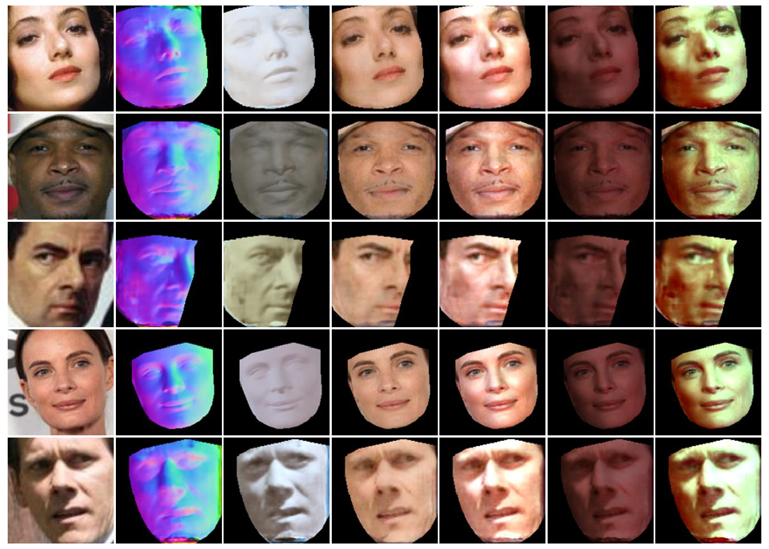
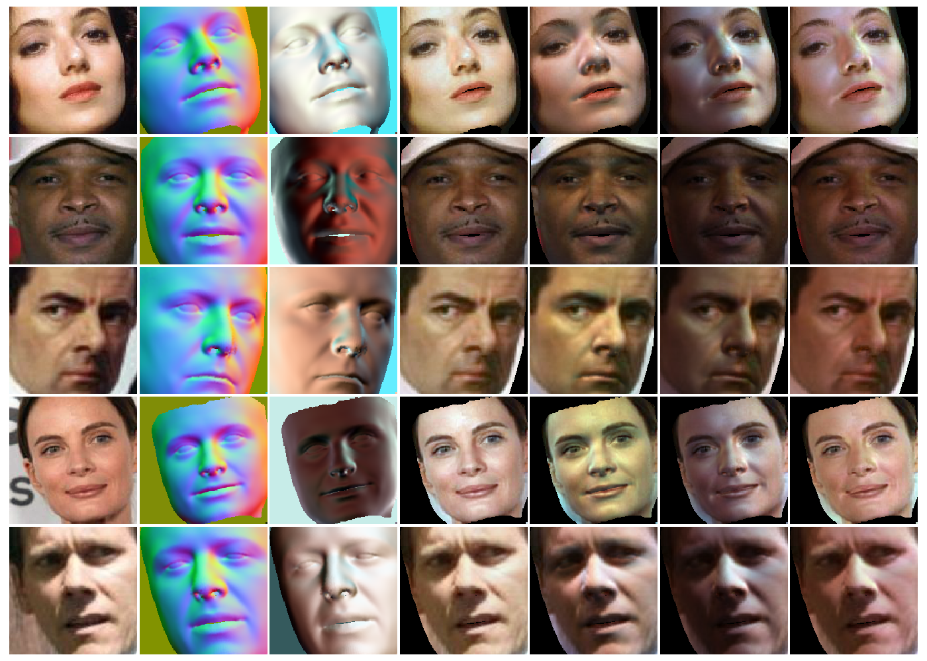
FRADA: Qualitative Results
Input
SfSNet
FRADA

Slide 28
FRADA: Quantitative Results
Method | UHDB31.R0128 |  |  |  | UHDB31.R0256
 | I01 | I03 | I05 | Mean | I01 | I03 | I05 | Mean
SLR50I-NA | 80.39 | 90.53 | 81.28 | 84.07 | 81.63 | 90.84 | 83.16 | 85.21
SLR50I-CA | 83.01 | 88.45 | 81.88 | 84.45 | 83.92 | 90.06 | 83.95 | 85.98
SLR50I-SfSNet-RL | 76.59 | 81.33 | 75.81 | 77.91 | 80.12 | 85.56 | 80.51 | 82.06
SLR50I-FRADA-UL | 78.26 | 84.16 | 76.51 | 79.64 | 80.61 | 88.21 | 81.22 | 83.35
SLR50I-FRADA-RL | 85.27 | 90.10 | 84.92 | 86.76 | 88.59 | 91.98 | 86.16 | 88.91
FRADA reduces the gap in rank-1 identification rate between I01, I05, and I03 from approximately 10% to 5%.

Slide 29
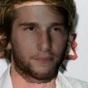
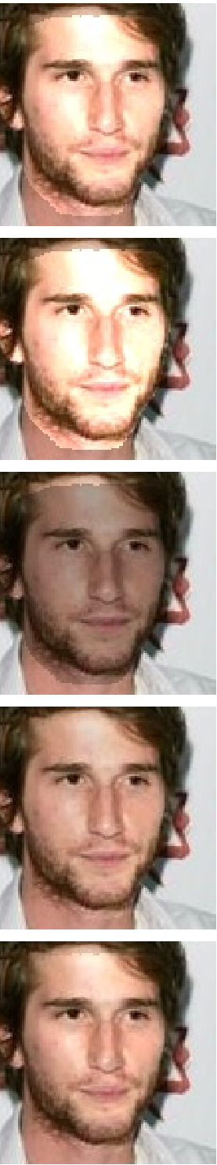
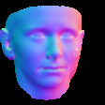

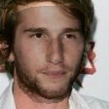
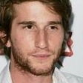
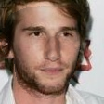
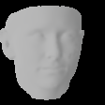
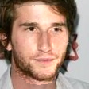
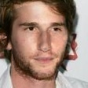
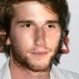

FRnR
Face Relighting
Relit Images
Normal
Mask
3DMM Reconstruction
FRnR
Coefficients
$$αs$$
$$αe$$
$$L$$
Shading
Albedo

Slide 30
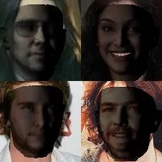
FRnR: Relighting Results

Slide 31
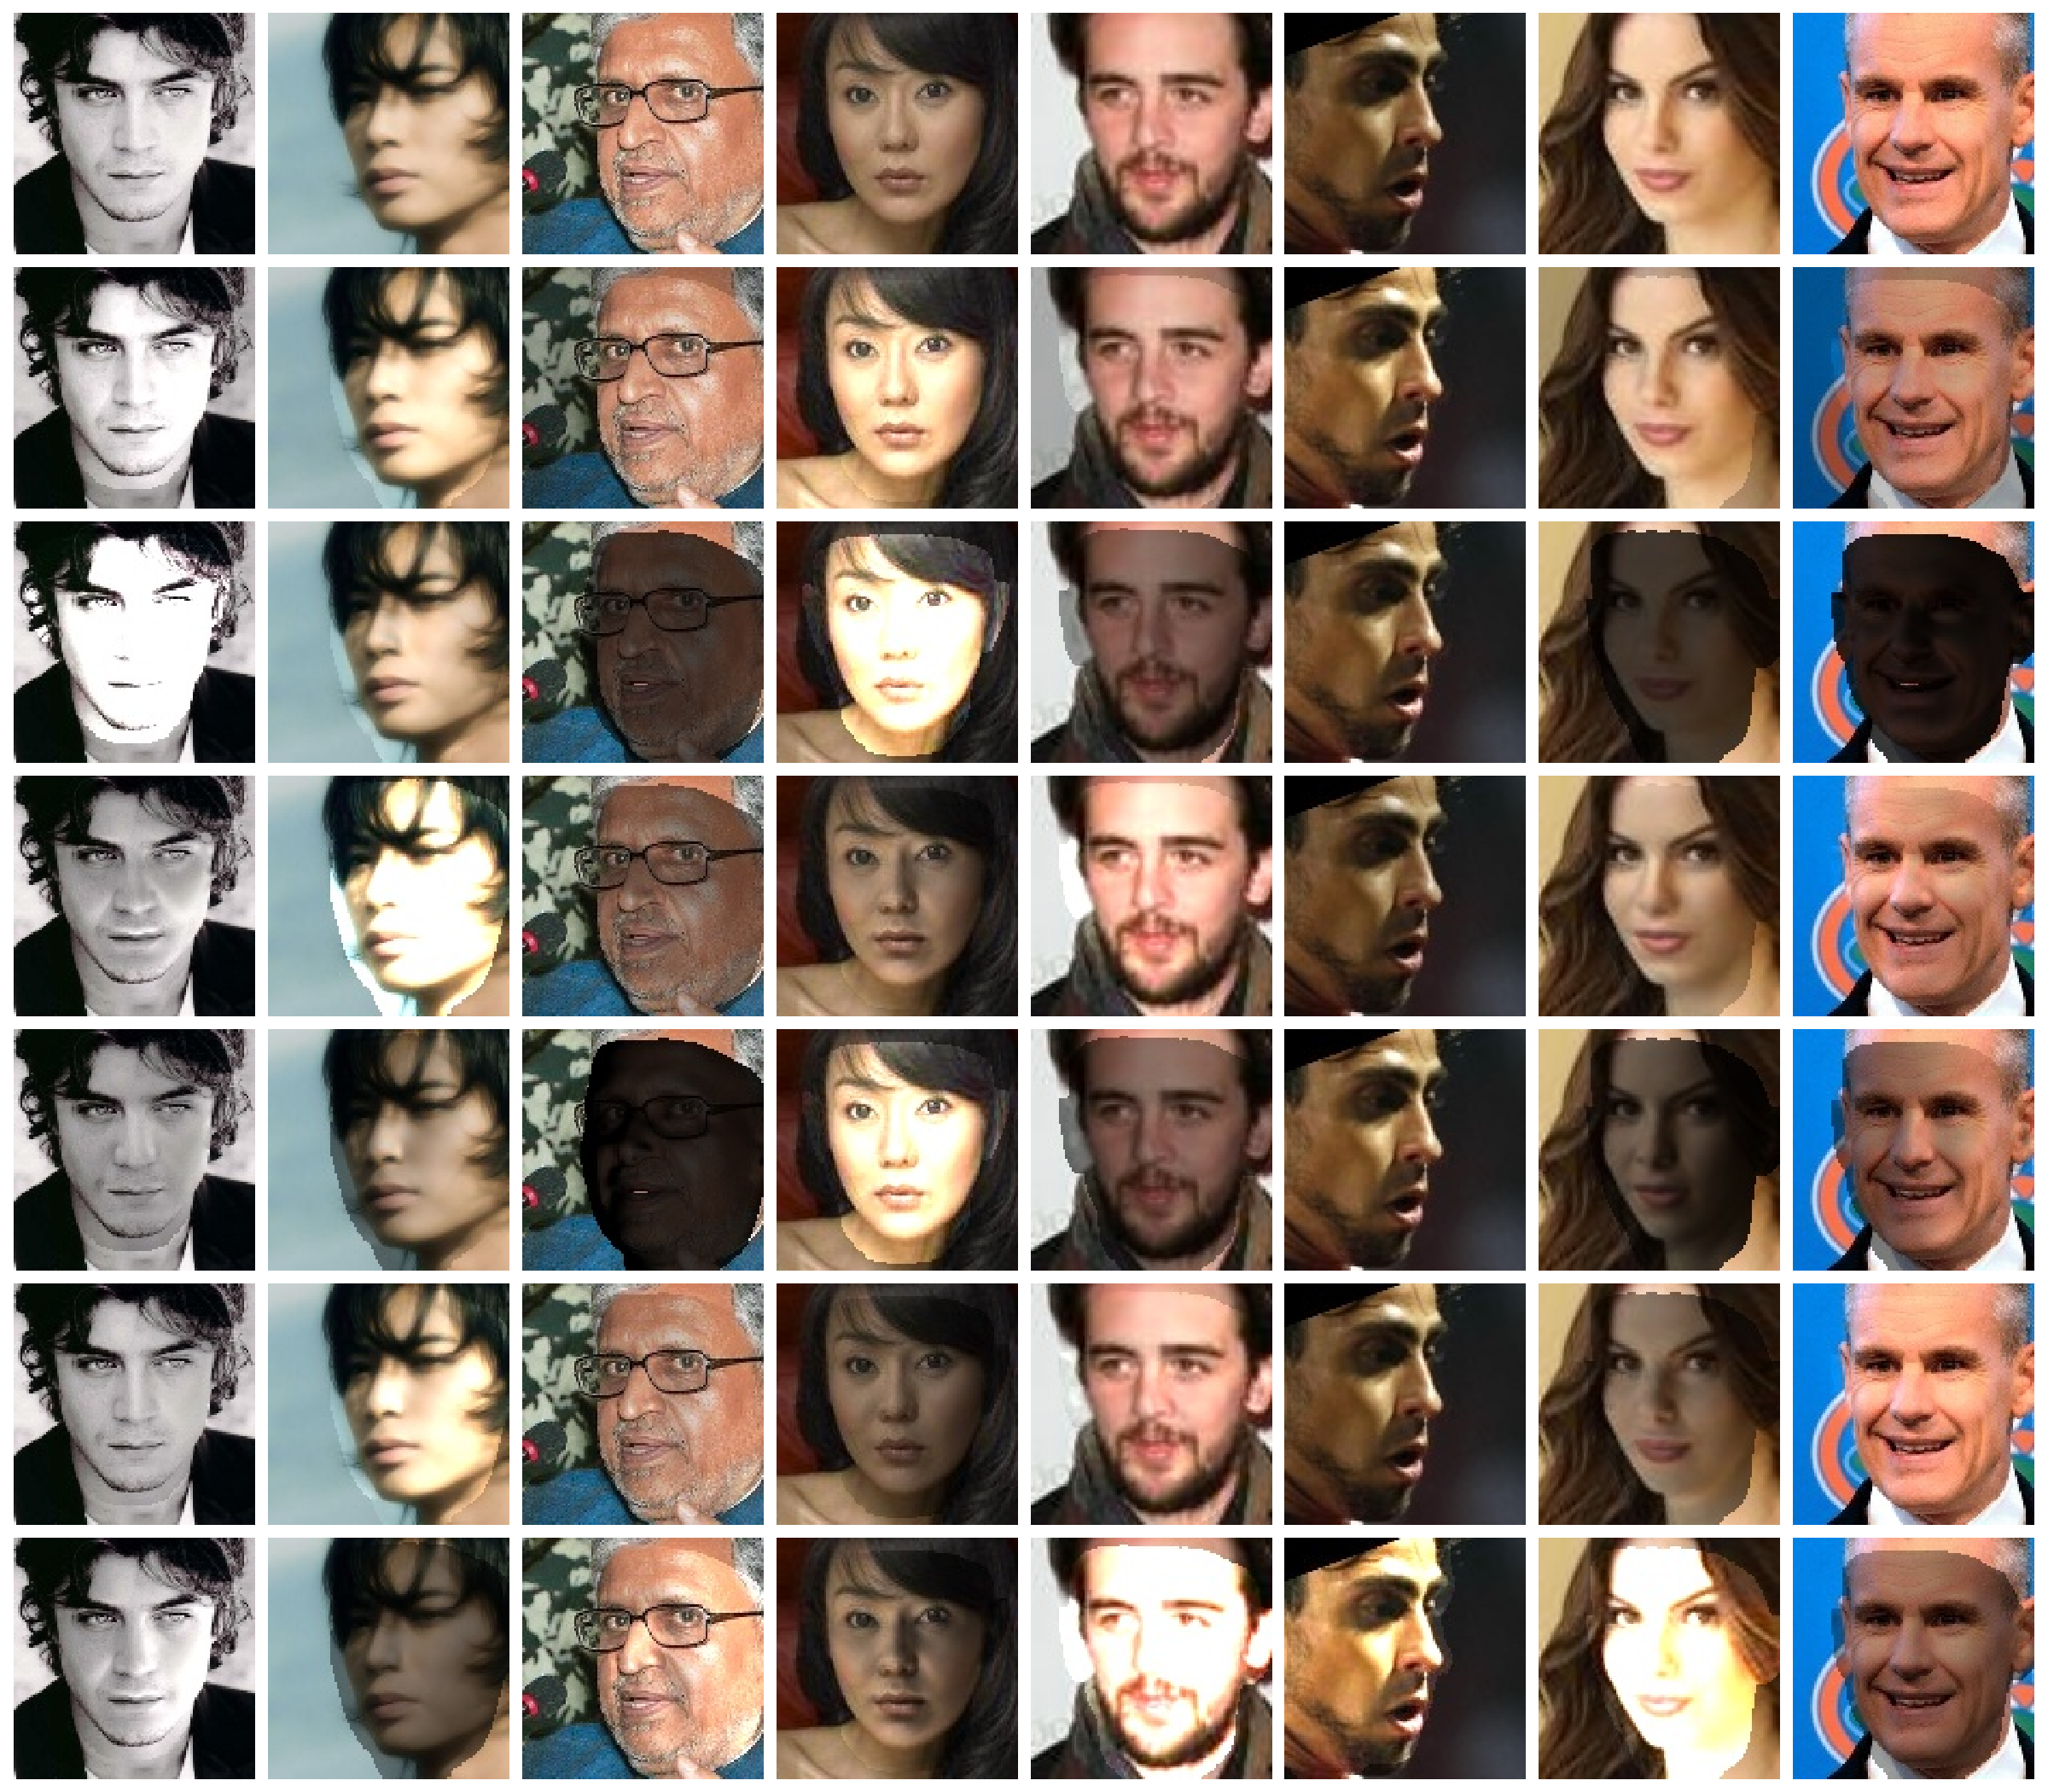
FRnR: Relighting Results (2)

Slide 32
FRnR: Quantitative Results
Method | UHDB31.R0128 |  |  |  | UHDB31.R0256
 | I01 | I03 | I05 | Mean | I01 | I03 | I05 | Mean
ArcFace | 87.60 | 90.32 | 87.51 | 88.48 | 88.38 | 90.64 | 88.46 | 89.16
ArcFace-CA | 87.81 | 90.96 | 88.14 | 88.97 | 88.10 | 91.91 | 88.74 | 89.58
ArcFace-FRADA | 89.09 | 92.55 | 88.07 | 89.90 | 90.61 | 92.04 | 89.37 | 90.67
ArcFace-FRnR | 89.17 | 92.04 | 89.54 | 90.25 | 90.47 | 92.23 | 91.17 | 91.29
FRnR improved ArcFace in all set of illuminations.

Slide 33
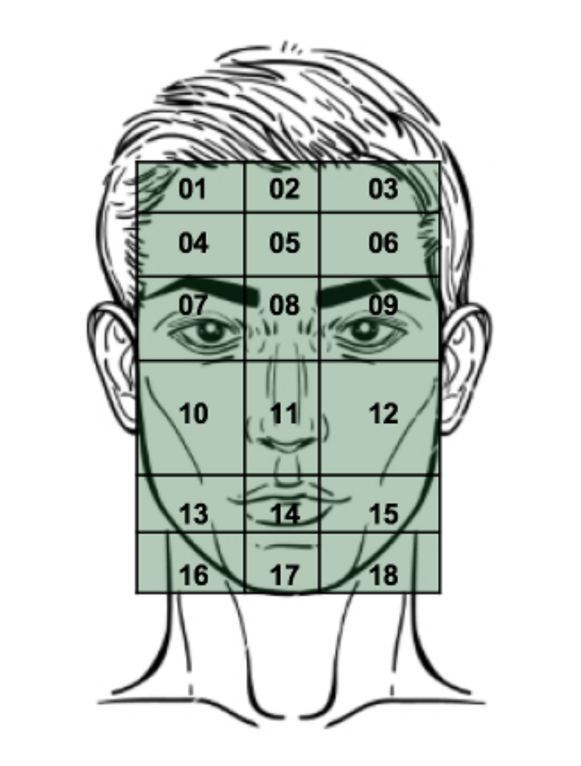


Objective 1.3: Occlusion-Aware Matching
Bangs, Hat
Eyeglasses
Sideburns
Mustache
The attributes can be ranked according to the rank-1 identification rate degradation as follows: Eyeglasses (18%) > Wearing Hat (12%) > Bangs (7%) > Sideburns (3%) > Mustache (2%).
Challenges
  Identity information degradation
  Occlusion imbalance

Slide 34
OREO: Overview
Input Images
Proposed Template Generator
Proposed Loss Functions

Slide 35
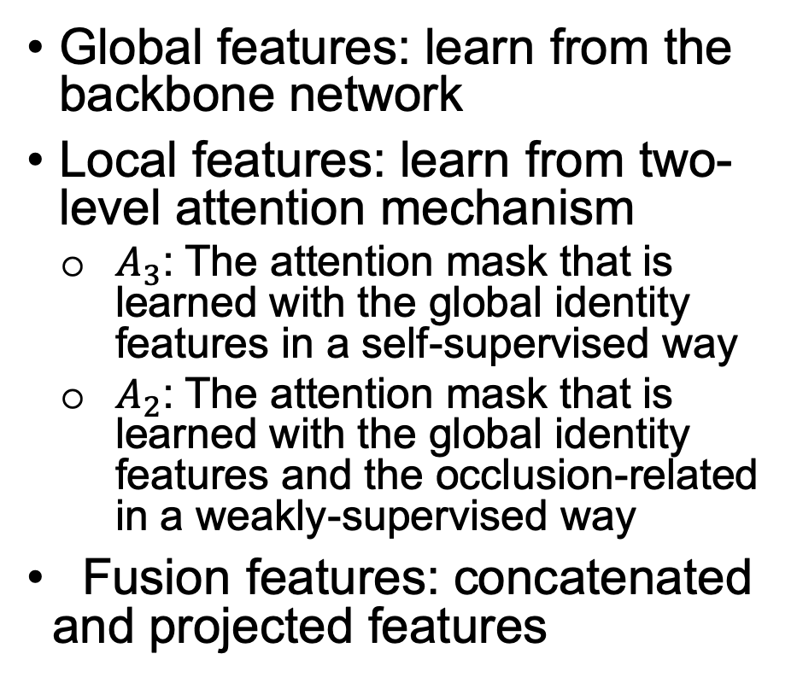
OREO: Template Generator
Global features: learn from the backbone network
Local features: learn from two-level attention mechanism
  $A_{3}$: The attention mask that is learned with the global identity features in a self-supervised way
  $A_{2}$: The attention mask that is learned with the global identity features and the occlusion-related in a weakly-supervised way
Fusion features: concatenated and projected features

Slide 36
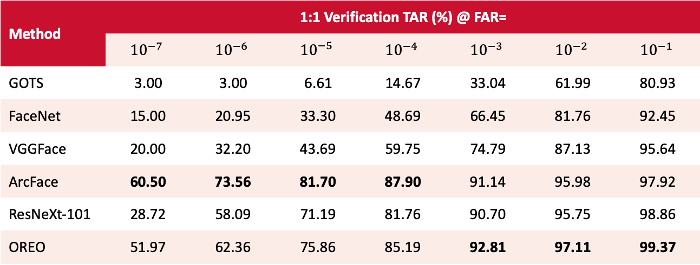
Objective 1.3: Performance metrics
Method | 1:1 Verification TAR (%) @ FAR=
 | $${10}^{−7}$$ | $${10}^{−6}$$ | $${10}^{−5}$$ | $${10}^{−4}$$ | $${10}^{−3}$$ | $${10}^{−2}$$ | $${10}^{−1}$$
GOTS | 3.00 | 3.00 | 6.61 | 14.67 | 33.04 | 61.99 | 80.93
FaceNet | 15.00 | 20.95 | 33.30 | 48.69 | 66.45 | 81.76 | 92.45
VGGFace | 20.00 | 32.20 | 43.69 | 59.75 | 74.79 | 87.13 | 95.64
ArcFace | 60.50 | 73.56 | 81.70 | 87.90 | 91.14 | 95.98 | 97.92
ResNeXt-101 | 28.72 | 58.09 | 71.19 | 81.76 | 90.70 | 95.75 | 98.86
OREO | 51.97 | 62.36 | 75.86 | 85.19 | 92.81 | 97.11 | 99.37
Comparison of the face verification and identification performance of different methods on the IJB-C dataset using 1: 1 verification protocol

Slide 37
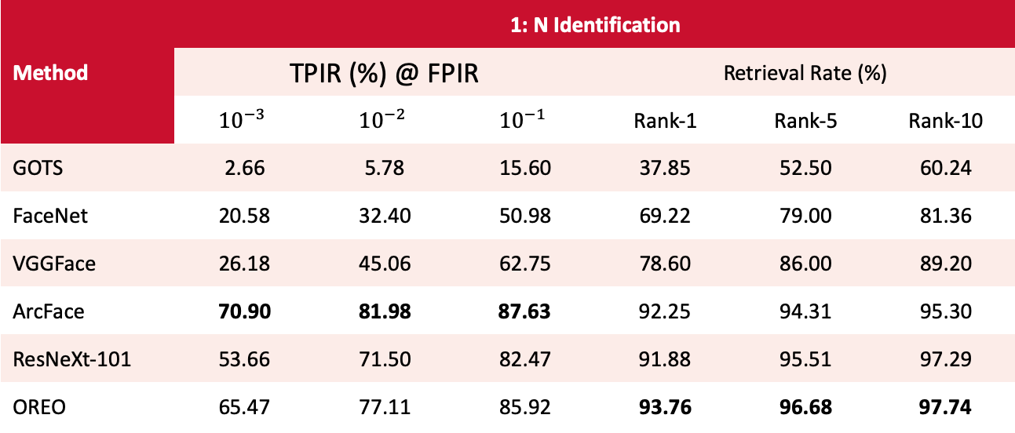
Objective 1.3: Performance metrics
Method | 1: N Identification
 | TPIR (%) @ FPIR |  |  | Retrieval Rate (%)
 | $${10}^{−3}$$ | $${10}^{−2}$$ | $${10}^{−1}$$ | Rank-1 | Rank-5 | Rank-10
GOTS | 2.66 | 5.78 | 15.60 | 37.85 | 52.50 | 60.24
FaceNet | 20.58 | 32.40 | 50.98 | 69.22 | 79.00 | 81.36
VGGFace | 26.18 | 45.06 | 62.75 | 78.60 | 86.00 | 89.20
ArcFace | 70.90 | 81.98 | 87.63 | 92.25 | 94.31 | 95.30
ResNeXt-101 | 53.66 | 71.50 | 82.47 | 91.88 | 95.51 | 97.29
OREO | 65.47 | 77.11 | 85.92 | 93.76 | 96.68 | 97.74
Comparison of the face verification and identification performance of different methods on the IJB-C dataset using 1: 1 identification protocol

Slide 38
Objective 1.3: Contributions
An attention module is introduced that disentangles the features into global and local parts, resulting in more discriminative representations
An occlusion-balanced sampling strategy along with a new loss function are proposed to alleviate the large class imbalance that is prevalent due to non-occluded images

Slide 39
Objective 1.3: Advantages
A systematic analysis of the impact of attributes to the face recognition performance
An occlusion-aware feature generator is introduced which results in facial embeddings that are robust to occlusions originating from visual attributes.

Slide 40

Objective 1. 4: Performance vs template size on UHDB31
DPRFS [2]
OGCTL [1]
FaceNet [3]
VGG [4]
COTS
References
[1] Y. Wu, I.A. Kakadiaris, “Occlusion-guided compact template learning for ensemble deep network- based pose invariant face recognition,” In Proc. IAPR international conference on biometrics, Crete, Greece, June 4-7, pp. 1-8, 2019.
[2] X, Xiang, H. A. Le, P. Dou, Y. Wu, and I. A. Kakadiaris. "Evaluation of a 3D-aided pose invariant 2D face recognition system." In Proc. IEEE International Joint Conference on Biometrics, Denver, Colorado pp. 446-455. 2017.
[3] S. Florian, D. Kalenichenko, and J. Philbin. "Facenet: A unified embedding for face recognition and clustering." In Proc. IEEE conference on computer vision and pattern recognition, pp. 815-823, Boston, MA, June 7-12, 2015.
[4] O. M. Parkhi, A. Vedaldi, and A. Zisserman. Deep face recognition. In Proc. British Machine Vision Conference, pp. 1–12, Swansea, UK, September 7-10 2015

Slide 41
Objective 1.4: Compact Pose-Robust Template Generation
Accomplishments
    A complete pipeline for extract pose-robust facial template (4096D) from VIS image
    A module to extract more compact facial template (128D) from the existing template (4096D)
    Faces under visible light condition can be described with a 4096D or 128D facial template

Slide 42





DPRFS: Deep Pose Robust Feature Signature
Divide
UR2D
pipeline
Frontalized facial
texture
Facial Patches
Image
Divide
Occlusion map
Occlusion Patches

Slide 43
OGCTL: Occlusion-guided Compact Template Learning
DPRFS
Face representations
(1024D)
OGCTL
Step 1
Step 2
Compact Template
(128D)
Occlusion estimation
Occlusion masks

Slide 44
Objective 1.4: Performance Metrics
  Face verification performance on IARPA Janus IJB-C database
TAR (True Accept Rate %) against the FAR (False positive rate %)
 | Tem. Size | FAR=10⁻⁵ | FAR=10⁻⁴ | FAR=10⁻³ | FAR=10⁻² | FAR=10⁻¹
COTS-1 | - | 0.090 | 0.160 | 0.320 | 0.620 | 0.800
FaceNet [1] | 0.5KB | 0.330 | 0.490 | 0.660 | 0.820 | 0.920
VGG-CNN [2] | 16KB | 0.430 | 0.600 | 0.750 | 0.860 | 0.950
DPRFS [3] | 16KB | 0.310 | 0.461 | 0.638 | 0.807 | 0.939
OGCTL | 0.5KB | 0.608 | 0.737 | 0.839 | 0.918 | 0.975
  Face matching speed
      Without compact template learning (DPRFS): 15K faces per second
      With compact template learning (OGCTL): 1M faces per second
[1] F. Schroff, D. Kalenichenko, and J. Philbin. FaceNet: A unified embedding for face recognition and clustering. Proc. Computer
Vision and Pattern Recognition, pages 815-823, June 2015.
[2] O. M. Parkhi, A. Vedaldi, and A. Zisserman. Deep face recognition. In Proc. British Machine Vision Conference, pages 1-12, Swansea, UK, September 7-10 2015.
[3] X. Xu, H. Le, P. Dou, Y. Wu, and I. A. Kakadiaris. Evaluation of 3D-aided pose invariant 2D face recognition system. In Proc. International Joint Conference on Biometrics, pages 446-455, Denver, Colorado, October 2017.
44

Slide 45
Objective 1: Performance Metrics
2018 – 2019
  within schedule
  within budget
2019 – 2020
  Rank-1 > COTS Rank-1

Slide 46
Objective 2: Data Acquisition & Curation
Data Acquisition
Annotation Tool
Curation & Inter-observer Agreement

Slide 47


Objective 2.1: Data Acquisition
Day time at Lynn Eusan Park
Night time at Lynn Eusan Park

Slide 48
Objective 2.1: Data Acquisition (2)
Number of subjects
Number of images
Hardware
  Four trail cameras
  Four light meters
Day Session | Night Session
197 | 67
Type | Cam 1 | Cam 2 | Cam 3 | Cam 4
Day - VIS | 685 | 620 | 719 | 673
Night - NIR | 187 | 181 | 218 | 229

Slide 49




Objective 2.1: VIS Images
Camera 1
Camera 2
Camera 3
Camera 4

Slide 50




Objective 2.1: NIR Images
Camera 1
Camera 2
Camera 3
Camera 4

Slide 51
Objective 2.2: Data Annotation Tool
  Designed, developed, and evaluated a GUI to perform annotation of VIS and NIR images
  Cloud based deployment (AWS EC2)
  Multiple user accounts, image and annotations upload, management of user gallery
  Manual annotation of human, object and facial bounding boxes as well as pose and facial landmarks
  Integration of automated person detection and pose estimation results to speed up the annotation process (AlphaPose Algorithm)
  Action & Attribute Labels (Default: Carrying Tube, Carrying Backpack, Wearing Hat, Wearing Woolen Cap )
  Customizable Class Labels and Pose Key point formats

Slide 52

Objective 2.2: Data Annotation Tool

Slide 53
Objective 2.3: Inter-observer Agreement
Two Human Annotators refined the Person & Face Detection as well as Pose and Facial Key-point Proposals or provided annotations when the tool failed.
 | InstaANT | Annotator 1 | Annotator 2
AlphaPose | - | 0.99 | 0.99
Annotator 1 | 0.99 | - | 0.99
Annotator 2 | 0.99 | 0.99 | -
 | InstaANT | Annotator 1 | Annotator 2
AlphaPose | - | 0.99 | 0.99
Annotator 1 | 0.99 | - | 0.99
Annotator 2 | 0.99 | 0.99 | -
Table 1: Pearson’s Correlation Coefficient for mean Bounding Box Area between Alpha Pose and two Human Annotators
Table 2: Pearson’s Correlation Coefficient for mean Keypoint Euclidian distance from the origin of the Person’s BBox, between Alpha Pose and two Human Annotators

Slide 54
Objective 2: Performance Metric
Achieve >70% inter-annotator agreement for image annotation

Slide 55
Objective 2: Deliverables
  Current status
    Image Annotation Tool delivered within budget and within schedule
    Curated data on schedule and within budget to be delivered by June 30, 2019
  Possible problems
    N/A

Slide 56
Objective 3: Cloud Infrastructure
Setup & Deployment
Training

Slide 57
Objective 3: Setup & Deployment
  Jupyter notebooks for demo
        AWS Rekognition demo with S3
        2 EDGE Pipeline notebooks
  EDGE facial recognition code for Jupyter notebooks also deployed on EC2 instance for direct inspection and experimentation.

Slide 58
Objective 3: Training
  Created AWS demo account and authentication tokens for access to EC2 instance and programmatic access to AWS resources
  Provided access tokens to specified individuals
  Demo access included:
    Investigation of cloud resources
    Use of early EDGE pipeline code
    Access to AWS Rekognition
Notes:
Jeffrey Chudik
Steven Vlcan

Slide 59

Objective 3: Deliverables – FR Code
  Interactive exploration
  Demonstration video
  Report

Slide 60

Objective 3: Deliverables – Annotation Tool
  Interactive exploration
  Demonstration video
  Report

Slide 61
Objective 3: Deliverables
  Current status
    Private cloud infrastructure delivered within budget and within schedule
    Data and Annotation tool to be delivered by 6/30
  Possible problems
    N/A

Slide 62
Publications
C. Smailis, Ha Le, I.A. Kakadiaris, “InstANT: Image ANnotation Tool and a database for VIS-NIR Face and Carrying Action Recognition,” in Proc. International Joint Conference on Biometrics, Houston, USA, September 27-30, 2020. (In Preparation)
Y. Wu, I.A. Kakadiaris, “Occlusion-guided compact template learning for ensemble deep network- based pose invariant face recognition,” In Proc. IAPR international conference on biometrics, Crete, Greece, pp. 1-8, June 4-7, 2019.
Y. Wu, I.A. Kakadiaris. " Three-Dimensional Face Alignment Using A Convolutional Point-Set Representation”, IEEE Transactions on Biometrics, Behavior, and Identity Science, 2019. (Under Review)
H. Le and I. A. Kakadiaris. Illumination-invariant Face Recognition with Deep Relit Face Images. In Proc. Winter Conference on Applications of Computer Vision, Waikoloa Village, Hawaii, Jan. 2019.
X. Xu, H. Le, and I. A. Kakadiaris. On the Importance of Feature Aggregation for Face Reconstruction. In Proc. Winter Conference on Applications of Computer Vision, Waikoloa Village, Hawaii, Jan. 2019.

Slide 63
Publications (2)
X. Xu, N. Sarafianos, and I. A. Kakadiaris. On Improving the Generalization of Face Recognition in the Presence of Occlusions, In Proc. IEEE International Conference on Computer Vision, Seoul, Korea, Oct. 27 - Nov. 2, 2019 (Under Review).
X. Xu and I.A. Kakadiaris. Open Source Face Recognition Performance Evaluation Package, In Proc. International Conference on Image Processing, Taipei, Taiwan, Sept. 22-25, 2019
L. Shi, X. Xu, and I. A. Kakadiaris, Smoothed Attention Network for Single Stage Face Detector, In Proc. International Conference on Biometrics, Crete, Greece, Jun. 4-7, 2019.
L. Shi, X. Xu, and I. A. Kakadiaris, A Simple and Effective Single Stage Face Detector, In Proc. International Conference on Biometrics, Crete, Greece, Jun. 4-7, 2019.
X. Xu, H. Le, and I. A. Kakadiaris. On the Importance of Feature Aggregation for Face Reconstruction, In Proc. Winter Conference on Applications of Computer Vision, Waikoloa Village, Hawaii, Jan. 7 - 11, 2019.

Slide 64
Publications (3)
H. Le and I. A. Kakadiaris. Improved face reconstruction and relighting for illumination-invariant face recognition. IEEE Transaction on Biometrics, Behavior, and Identity Science (In preparation).
H. Le and I. A. Kakadiaris. Semi-supervised low light face enhancement for mobile face unlock. In Proc. International Conference On Biometrics, Crete, Greece, Jun. 2019.
L. Shi, X. Xu, and I. A. Kakadiaris, SSFD: A Face Detector using a Single-scale Feature Map, In Proc. The IEEE International Conference on Biometrics: Theory, Applications, and Systems, Los Angeles, CA, Oct. 22-25, 2018.
L. Shi, X. Xu and I. A. Kakadiaris. “SSFD+: A Two-Stage Robust Face Detector.” IEEE Transactions on Biometrics, Behavior, and Identity Science. (In Press)

Slide 65
Project Overview: Objectives (2018- 2019)
Design and develop algorithms for matching images in the visible domain
Acquire, curate and annotate images by trail cameras (VIS and NIR) in non-urban environments
Deploy a private cloud-based software system for software evaluation

Slide 66
Additional Opportunities
  CBP Data Breach
    Develop tools to help investigators locate dark web marketplaces
  Face Recognition
    for minors
    for vehicle biometric exit
    predict face using image of hands and speech
  Video analytics
    for drone footage
  Artificial intelligence
    predicting adverse events
    using Immigration data

Slide 67
Questions and Answers

