Slide 1
Nicholas A. Randol, MHA Graduate Student randol@student.uiwtx.edu The U.S. Department of Homeland Security Minority Serving Institutions (MSI) Summer Research Teams (SRT) Program DHS Center of Excellence (COE) Border, Trade & Immigration (BTI) Institute Research Mentors Dr. Luis R. TORRES Dr. Maura PEREIRA DE LEON Dr. Nürşen Albayrak ZANCA (PI) zanca@uiwtx.edu
THE GLOBAL TERRORISM INDEX: Methodology & Meaning

Slide 2
○ We are grateful to the U.S. Department of Homeland Security (DHS) Minority Serving Institution (MSI) Summer Research Team (SRT) Program for allowing us to be a part of SRT 2019 at DHS COE BTI Institute  Special THANKS are due to BTI Team ⬇A more detailed Acknowledgements in the Final Report  Our SRT experience at the BTI Institute was a great chance for learning and professional development  We are grateful for the uninterrupted 10 weeks intense research time  University of Houston MD Anderson Library - Access to a large volume of literature in Terrorism Research & Office Space
ACKNOWLEDGEMENTS

Slide 3
○ DHS’s mission states ‘protecting the American people from terrorist threats is the reason DHS was created, and remains our highest priority.’  As such, any formal knowledge related to terrorism is of interest to the DHS.
RELEVANCE TO THE MISSION OF DHS

Slide 4
#1: The proper definition of terrorism. #2: The proper measurement of terrorism. #3: Availability of data and data quality. #4: How to distinguish domestic & international terrorism? #5: How should the domestic terrorism be defined & measured?
There are five major issues in studying terrorism:

Slide 5
○ The first objective is to investigate the methodology and the meaning of the Global Terrorism Index (GTI).  The second objective is to investigate the past and present trends in the GTI score for the United States.  The third objective is to investigate the economic cost of terrorism to the U.S. economy.  And, finally, since the national level GTI score does not allow for making local decisions about domestic threats, we propose to investigate an alternative index called ‘Regional Terrorism Index’ for the metropolitan areas.
DESCRIPTION OF THE RESEARCH PROJECT The objective of this research project are four-fold:

Slide 6
QUESTION #1: How to DEFINE TERRORISM?  There is no universally accepted definition.  Each Federal Agency have their own perspective. QUESTION #2: How to MEASURE Terrorism?  WHICH proxy variables to be included? ⬇ The GTI ‘determinants’ (4 variables)  WHAT methodology to be employed? ⬇ Weighted INDEX  Impact of TIME LAG ⬇ 5-year-average
TERRORISM: Definition & Measurement

Slide 7
#1: Total number of terrorist incidents in a given year #2: Total number of fatalities caused by terrorism in a given year #3: Total number of injuries caused by terrorism in a given year #4: The approximate level of total property damage from terrorist incidents in a given year
The GTI is a weighted index based on relative impact of four variables:

Slide 8
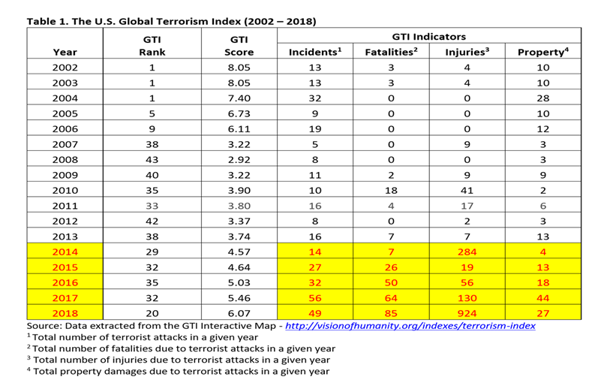

Slide 9
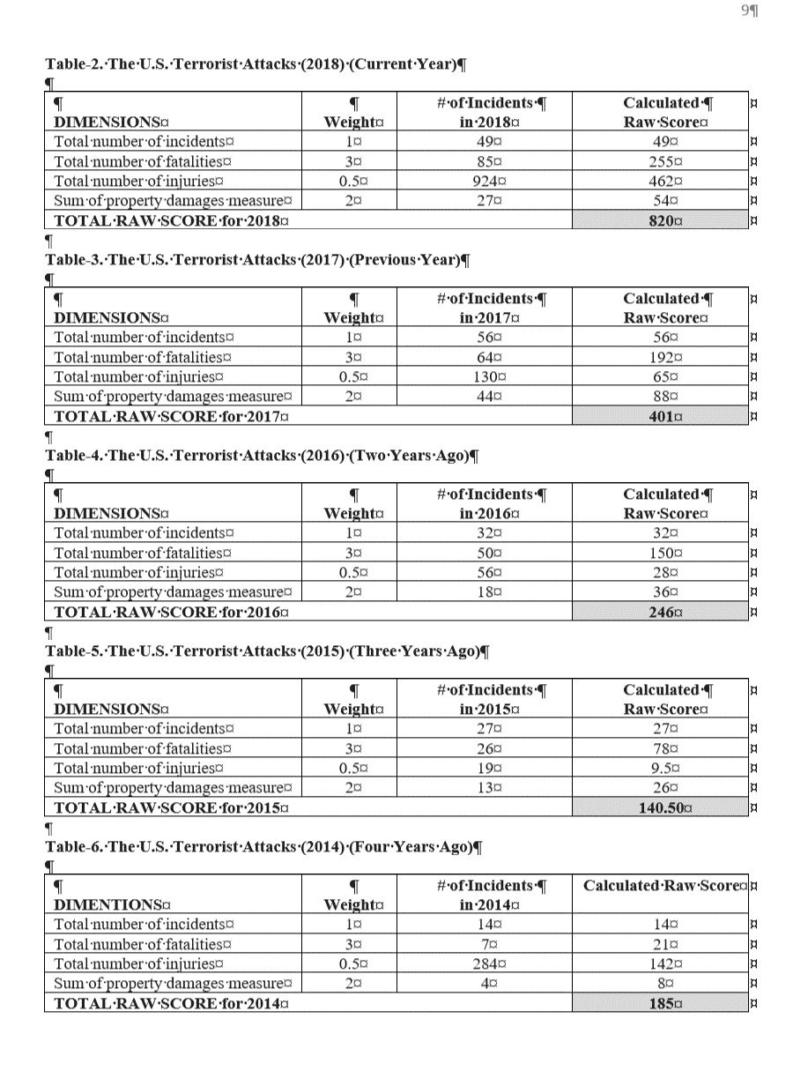
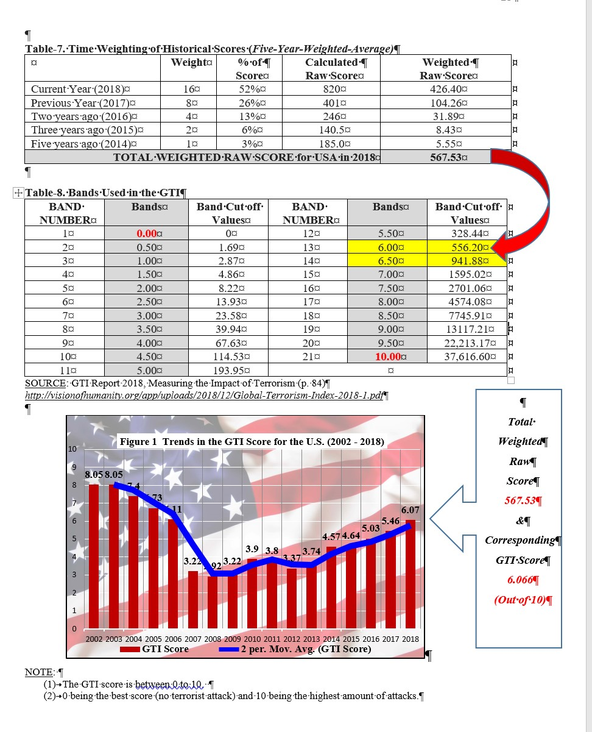

Slide 11
○ Figure 1 demonstrates the historical trends in the GTI score for the U.S. between 2002 to 2018.  The trend line (2013 to 2018) indicate a sharp rise, 3.74 to 6.07, in the GTI score which is an indication of a rise in terrorist activity.  Our conclusions are in agreement with Stewart (2015) who states that “domestic terrorism is a persistent threat and is currently at the peak of cycle in the U.S.”  “Despite the intense and decade long focus on international threat, domestic terrorism is still an issue for the U.S.”  “The threat of domestic terrorism is often overlooked and underestimated. There is a need for a comprehensive assessment and evaluation for rising domestic terrorism.”
Preliminary Conclusions

Slide 12
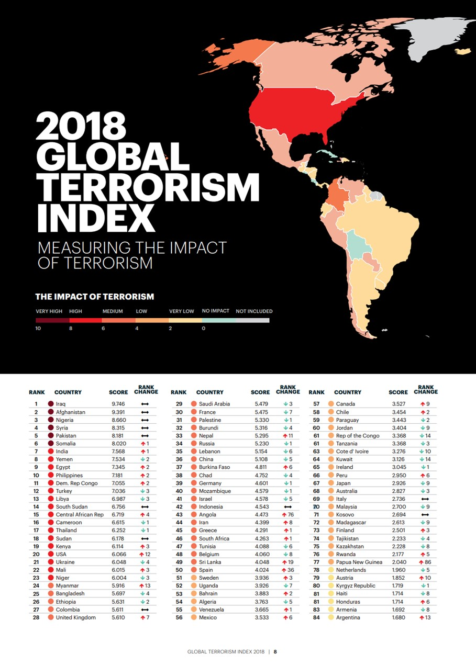
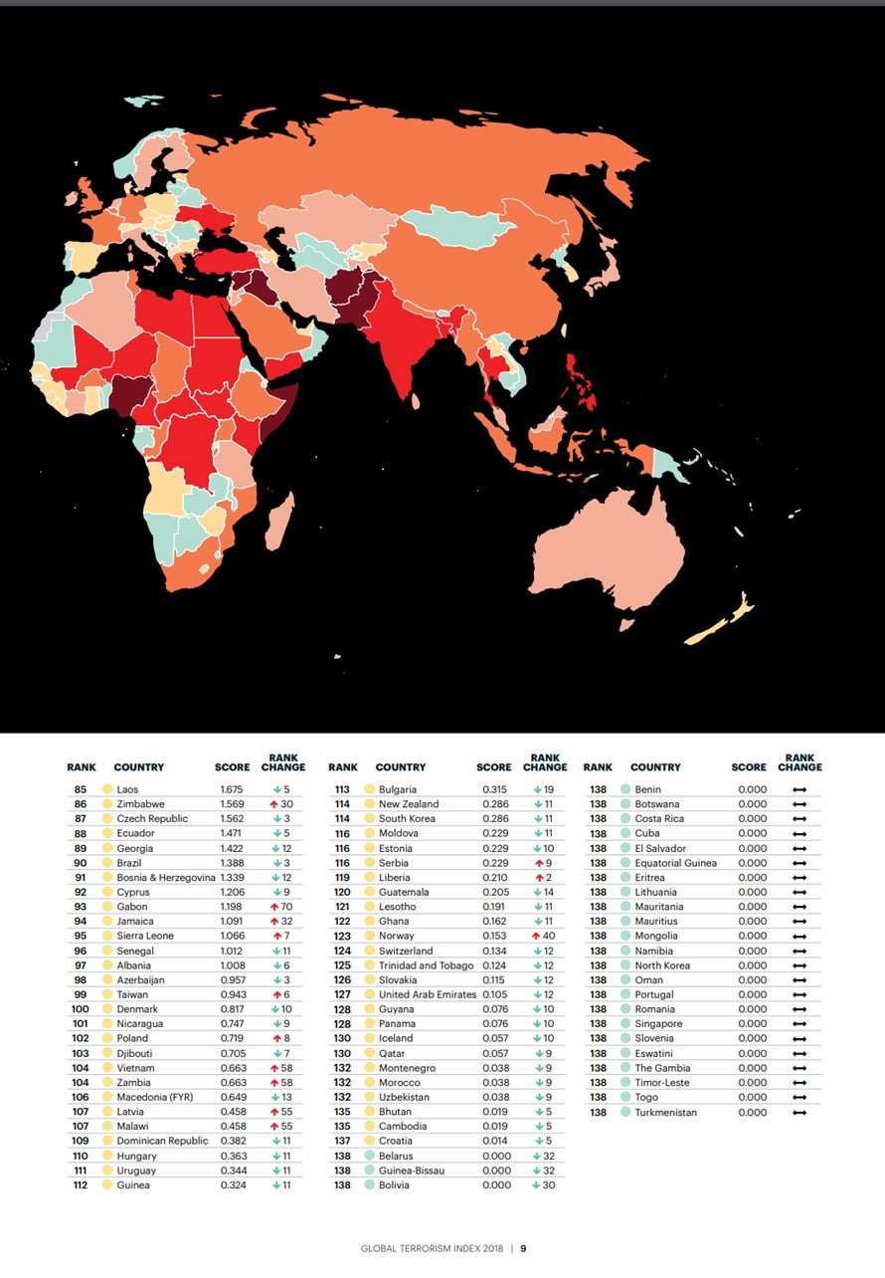
COUNTRY GTI Score
#1: Iraq 9.75
#2: Afganistan 9.39
#3: Nigeria 8.66
#4: Syria 8.32
#5: Pakistan 8.18 .
.
.
.
#20: U.S.A 6.07

Slide 13
○ I have a created a PADLET platform to share my Project with my students back on campus.  My PADLET custom URL for this project: https://padlet.com/nursenzanca/hoon7jb4ik9k  I plan to utilize the Global Terrorism Index (GTI) methodology in my ECON classes  My goal is to create awareness for both Global Terrorism Index (GTI) and Global Peace Index (GPI)
CLASSROOM INTEGATION PLAN & CONTRIBUTIONS TO MY TEACHING

Slide 14
○ The preliminary results of our Project indicates that there is a need for a more comprehensive assessment of the domestic terrorism treat.  For our future research, in order to distinguish and capture the impact of ‘domestic terrorism,’ we propose to investigate an alternative index called ‘Regional Terrorism Index’ for the metropolitan areas in the U.S.  The GTI does NOT allow for making local decisions about threats and resource allocation. A new ‘Regional Terrorism Index’ will provide critical information and decision-making tool for local, state, and federal law enforcement to assess local threats, deploy resources efficiently and keep our population safe from potential terrorism.
FUTURE RESEARCH DIRECTIONS &
FOLLOW-UP GRANT

Slide 15
QUESTIONS & COMMENTS Summer 2019 The U.S. Department of Homeland Security Minority Serving Institutions (MSI) Summer Research Team (SRT) DHS Center of Excellence Border, Trade & Immigration (BTI) Institute Nicholas A. Randol Dr. Nürşen A. ZANCA (a.k.a. NINA)

